Slide 2
Why we have failed to tackle the influx of drugs and the increasing rate of drug addiction?
National Management College
117th National Management Course
Contemporary Issue Series (CIS)
By:
Sohail Akhtar,
Secretariat Group
Sponsor DS: Ms. Sijal Tauseef
24th November, 2022

Slide 3
Sequence of Presentation
Introduction
Problem Statement
Key Questions
Scope
World Situation
Situation in Pakistan
Analysis
Conclusion
Recommendations

Slide 4
Acronyms
LSD – Lysergic Acid Diethylamide
PCP – Phenylcyclohexyl Piperidine (Angel Dust)
HIV – Human Immunodeficiency Virus
HCV – Hepatitis C Virus
TB – Tuberculosis
EU – European Union
UK – United Kingdom
WHO – World Health Organization
UNODC – United Nations Office on Drugs & Crime

Slide 5
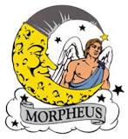
Introduction
Drug originate from Old French "drogue", deriving from "droge (vate)" from Middle Dutch meaning "dry (barrels)", referring to medicinal plants preserved as dry matter in barrels.
Drug is a chemical substance that causes a change in an organism's physiology or psychology when consumed.
Drug addiction is a chronic, often relapsing brain disease that causes compulsive drug seeking and use.
In medicine - Friedrich Serturner (1804), a German researcher separated the chemical from opium and named it “Morphium”, after the Greek god of dreams, Morpheus.

Slide 6
Why people try drugs

Slide 7
Problem Statement
The supply and use of drugs hasn’t just increased—it has created a massive illicit market that contributes to violence, amplifies conflict, and breeds corruption. Poorly designed drug policies, the criminalization of people who use drugs and harsh enforcement measures have fueled social marginalization, health crises, and mass incarceration.

Slide 8
Key Question
Why we failed to tackle the influx of drugs and increasing rate of drug addiction?
Is there any new approach to deal with it?

Slide 9
Analysis
The War on Drugs
“When the United Nations Single Convention on Narcotic Drugs came into being [60] years ago, and when President Nixon launched the U.S. government’s war on drugs [50] years ago, policymakers believed that harsh law enforcement action against those involved in drug production, distribution and use would lead to an ever-diminishing market in controlled drugs such as heroin, cocaine and cannabis, and the eventual achievement of a “drug free world”. In practice, the global scale of illegal drug markets—largely controlled by organized crime—has grown dramatically over this period”.
The War on Drugs: Global Commission on Drug Policy Report
:

Slide 10
Heroin & Opium
Afghanistan: 380 Metric tons (375+5)
Myanmar + Lao: 50 Metric tons
Balken Route: $20 billion
Northern Route: $13 billion
Notes:
At current levels, world heroin consumption (340 tons) and seizures represent an annual flow of 430-450 tons of heroin into the global heroin market. Of that total, opium from Myanmar and the Lao People's Democratic Republic yields some 50 tons, while the rest, some 380 tons of heroin and morphine, is produced exclusively from Afghan opium. While approximately 5 tons are consumed and seized in Afghanistan, the remaining bulk of 375 tons is trafficked worldwide via routes flowing into and through the countries neighbouring Afghanistan.
The Balkan and northern routes are the main heroin trafficking corridors linking Afghanistan to the huge markets of the Russian Federation and Western Europe. The Balkan route traverses the Islamic Republic of Iran (often via Pakistan), Turkey, Greece and Bulgaria across South-East Europe to the Western European market, with an annual market value of some $20 billion. The northern route runs mainly through Tajikistan and Kyrgyzstan (or Uzbekistan or Turkmenistan) to Kazakhstan and the Russian Federation. The size of that market is estimated to total $13 billion per year.

Slide 11
Cocaine
Global consumption: 470 Metric tons
Worth $88 billion
North America + European Union
= 80% of global consumption
Notes:
North America accounted for more than 40 per cent of global cocaine consumption (the total was estimated at around 470 tons), while the 27 European Union and four European Free Trade Association countries accounted for more than a quarter of total consumption. These two regions account for more than 80 per cent of the total value of the global cocaine market, which was estimated at $88 billion.
For the North American market, cocaine is typically transported from Colombia to Mexico or Central America by sea and then onwards by land to the United States and Canada. Cocaine is trafficked to Europe mostly by sea, often in container shipments. Colombia remains the main source of the cocaine found in Europe, but direct shipments from Peru and the Plurinational State of Bolivia are far more common than in the United States market.

Slide 13
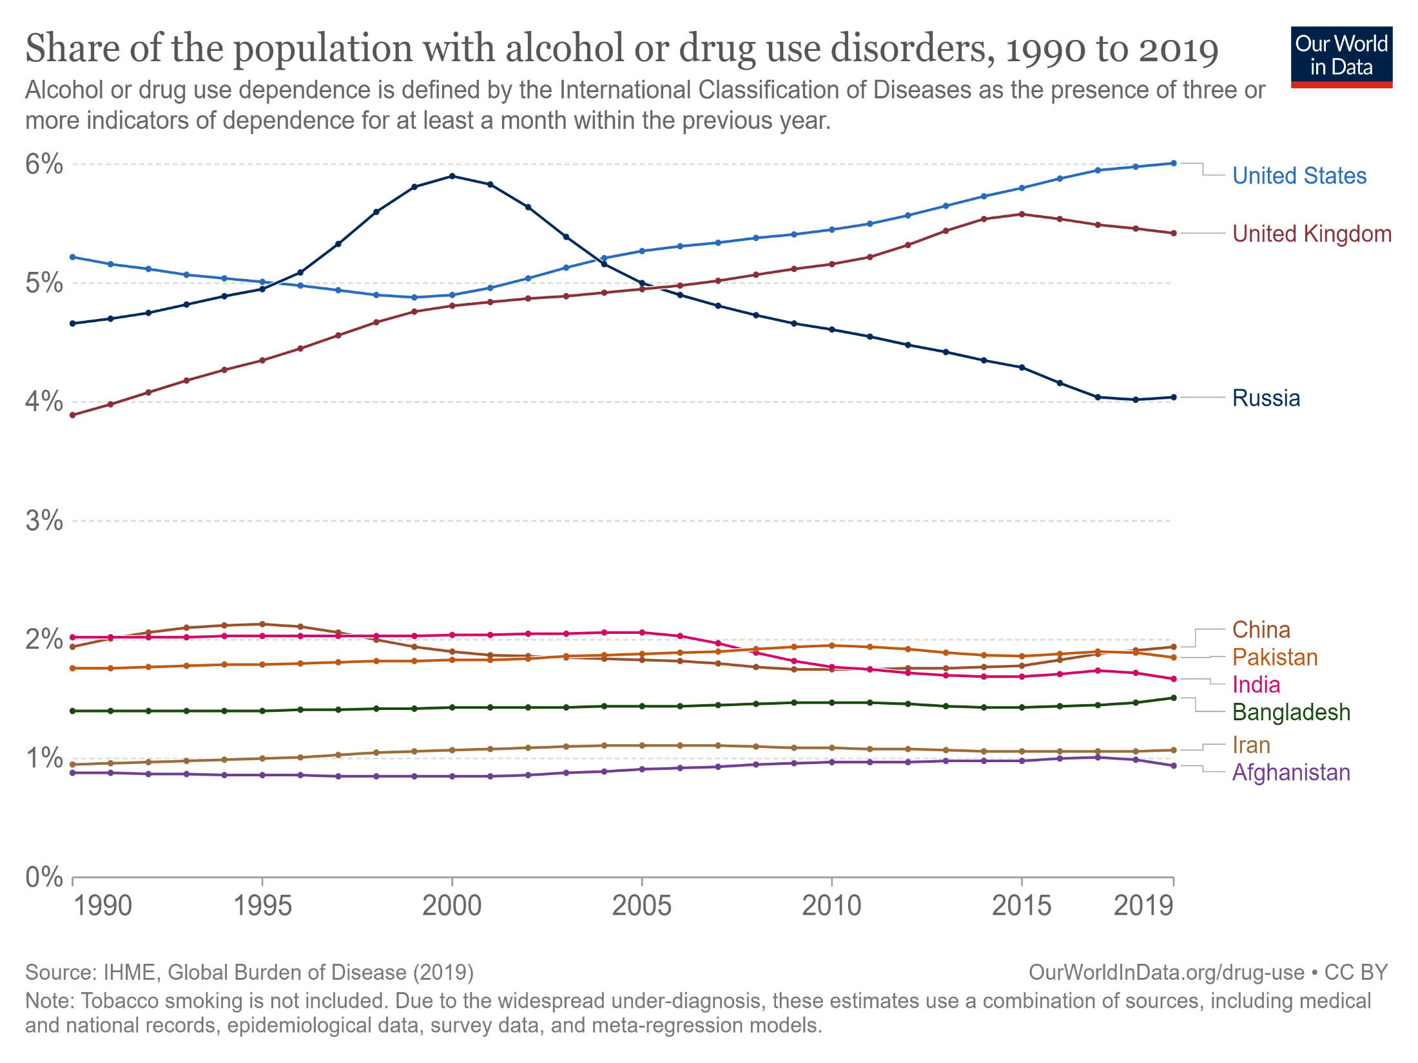
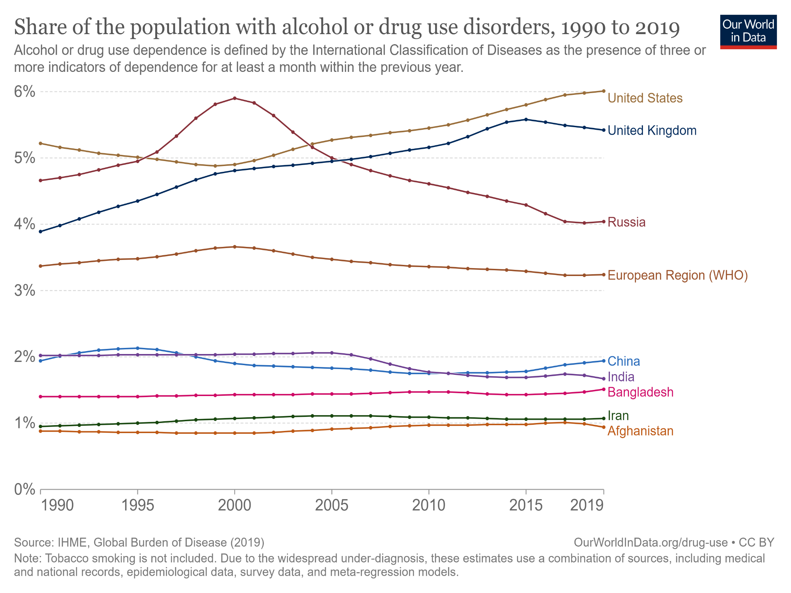
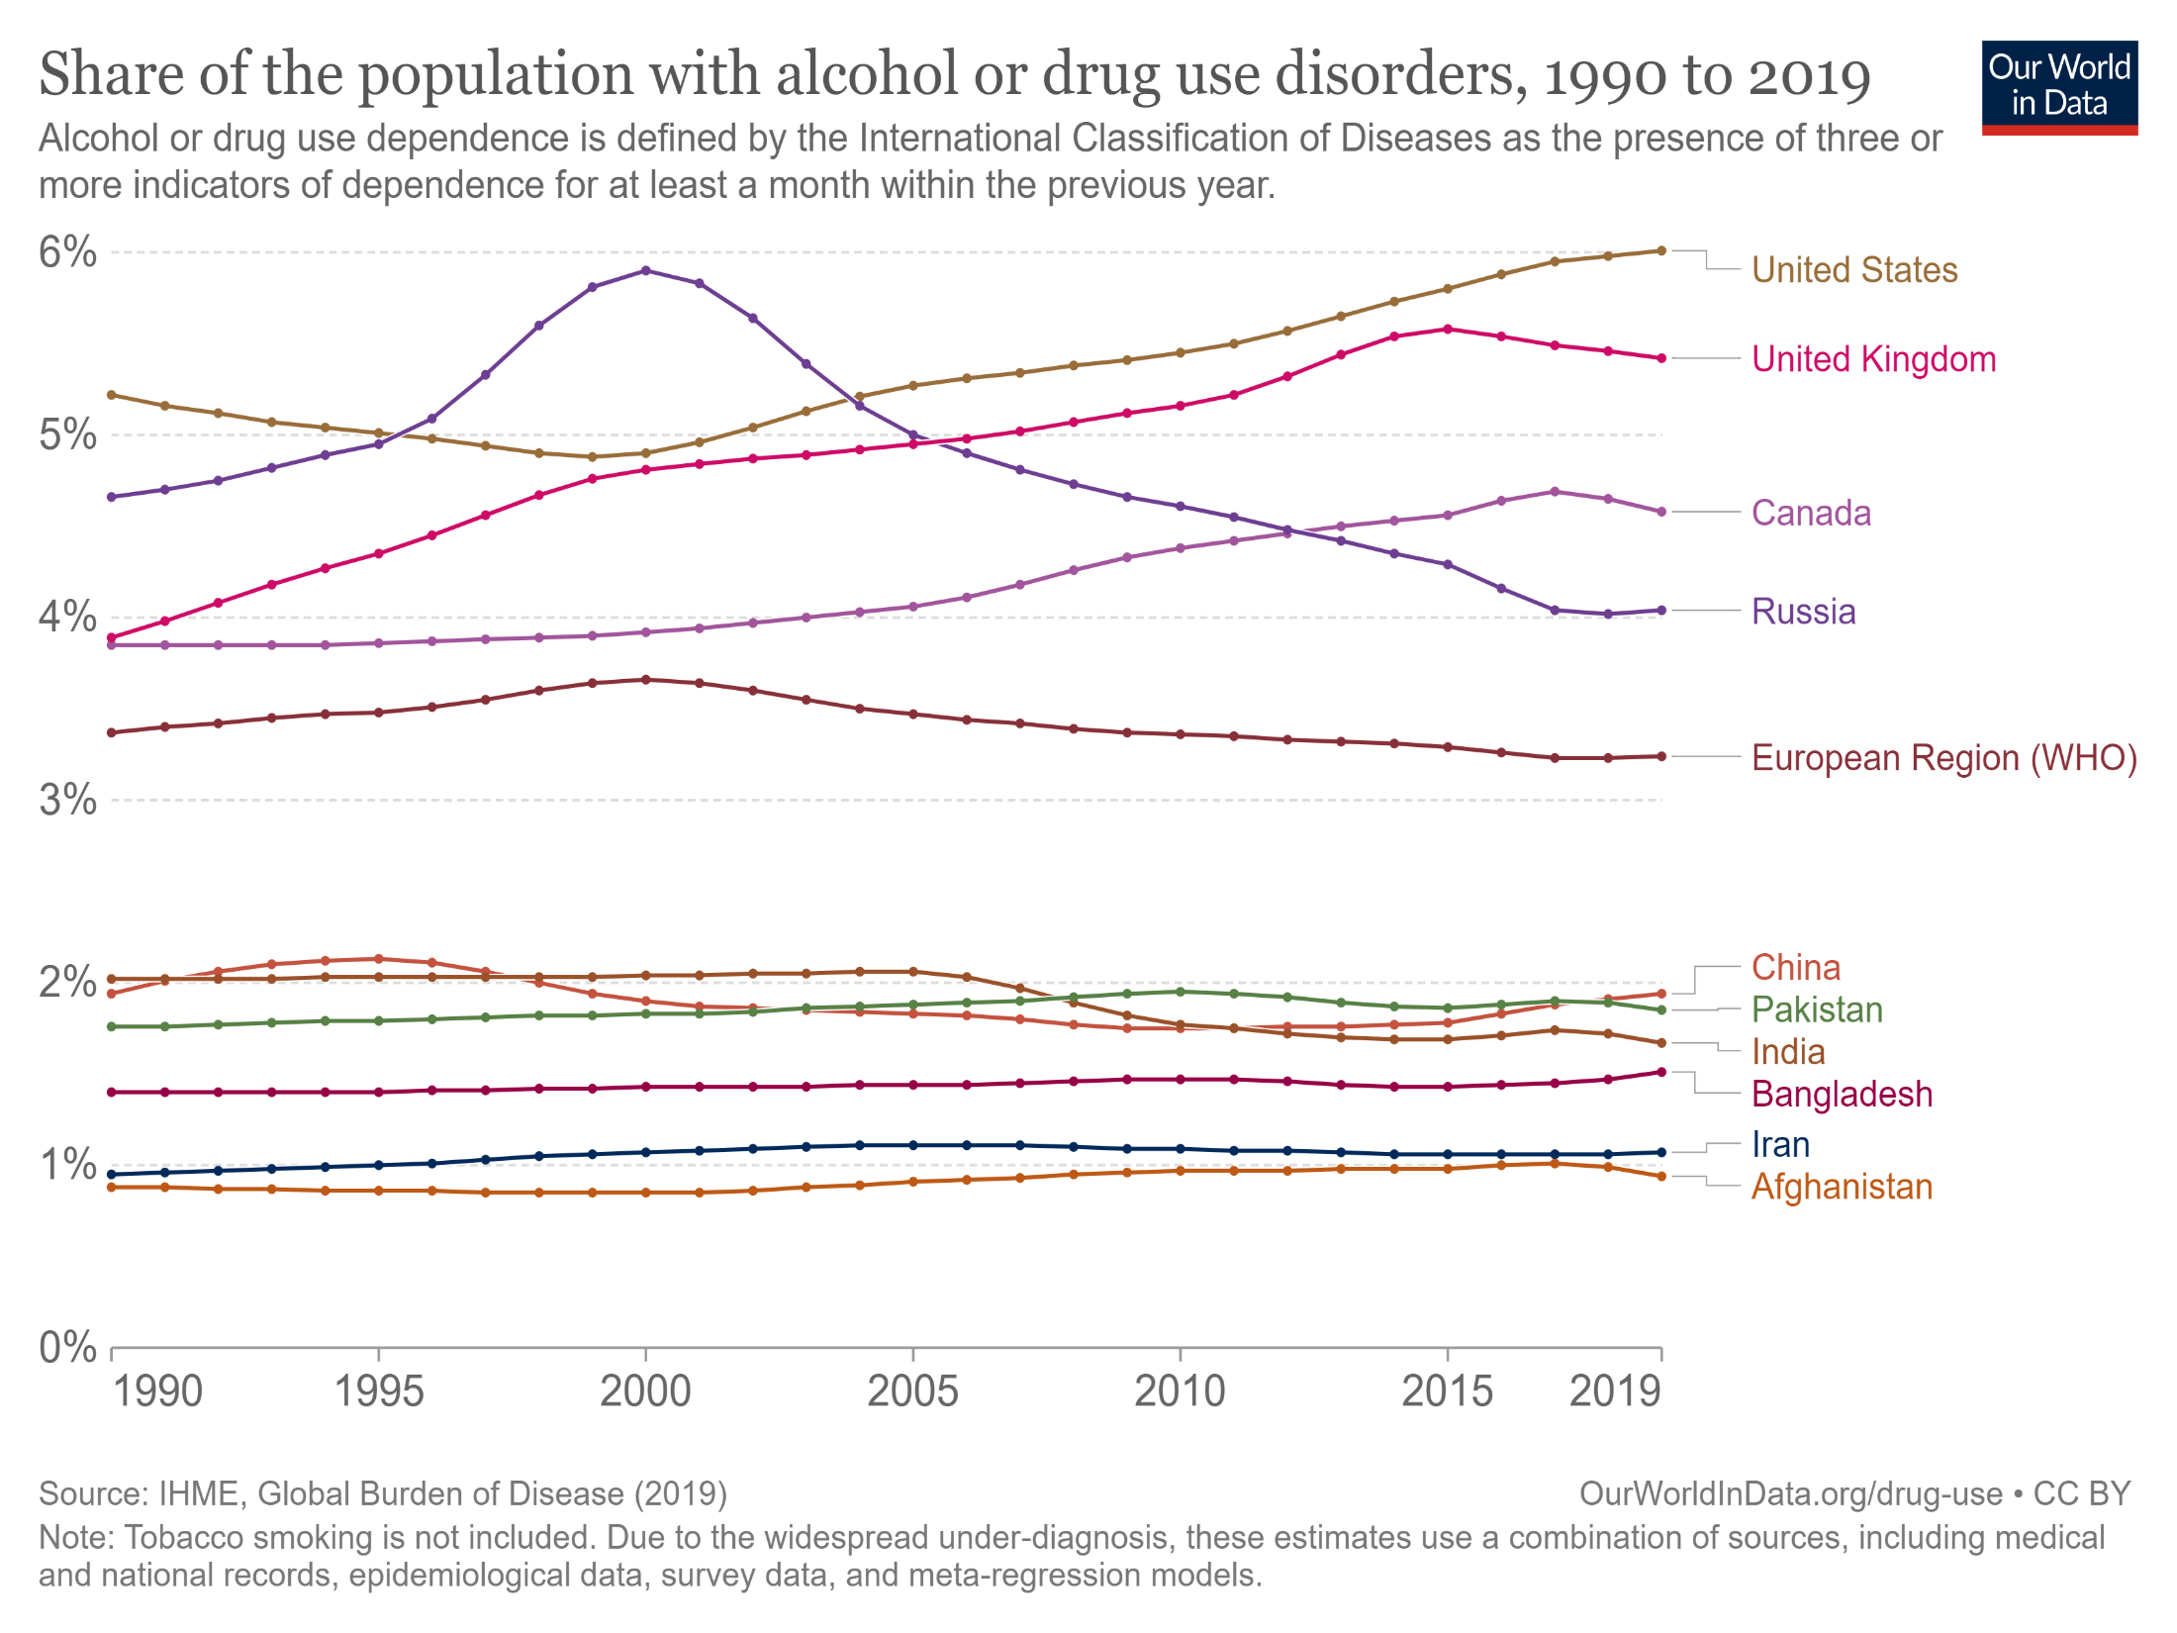

Slide 17
UNODC Drug Report 2022
Record rise in the manufacturing of cocaine and opium.
26% increase over the previous decade.
284 million people use drugs worldwide.
Gaps in the availability of drugs treatments.
Expansion - synthetic drugs to new markets (Africa & Asia)
Conflict Zones - magnets for synthetic drug production and shifting of drug trafficking routes.
Ukraine – Laboratories (manufacturing amphetamine) grew from 17 (dismantled) to 79.

Slide 18
UNODC Drug Report 2022
11% increase in Cocaine Manufacturing in one year.
7% increase in Opium production last year (mainly from Afghanistan).
117 countries reporting seizures of synthetic drug (methamphetamine) in 2016‒2020 versus 84 in 2006‒2010.
Quantity seized grew five-fold between 2010 and 2020.
11.2 million - injecting drugs worldwide.
5.5 million - hepatitis C,
1.4 million - HIV
1.2 million - with both.

Slide 19
Situation in Pakistan
Pakistan a Poppy Free State (less than 1000 hectares), but a victim of Afghan Drug Trafficking.
Afghanistan is the biggest cultivator of Poppy Opium in the world with a cultivation area of 183,000 Hectare.
40% of Afghan Drug Trafficking utilizes drug trade routes passing form Pakistan.
9 million Pakistanis involved in taking Drugs - 78% are male and 22% are female.
Addicts are increasing at the rate of 40,000 per year, making Pakistan one of the most drug-affected countries in the world.

Slide 20
Situation in Pakistan
Anti-Narcotics Force (ANF) in Pakistan is mandated to counter narcotics covering entire spectrum/all facets.
5 Regional Directorates spread along Provincial Capitals with 1 Regional Directorate solely focused on Northern Areas.
ANF burned narcotics - 137 MT worth US$ 0.825 billion in 2014, 320 MT worth US$ 2.25 billion in year 2015 and 2860 MT in 2016-17.
MATRCs: Established 3 Model Addiction Treatment & Rehabilitation Centres (MATRCs) and from 2005 till now treated 14,388 patients.
ANF convicted 604 individuals in crimes related to Drug Trafficking form year 2014 till now.

Slide 21
Situation in Pakistan
Inadequate Rehabilitation Services
KPK and Sindh: highest numbers of drug users – 11% and 6.5%, respectively. But only 2 Special Courts in Sindh with 9000 pending cases whereas KPK has no Special Court.
2018 – only 300 drug users can receive treatment at one time.
Model Addiction Treatment & Rehabilitation Centres (MATRCs) capacity is 150 drug addicts and only in 3 major cities – Islamabad, Karachi and Quetta.

Slide 22
Situation in Pakistan
Pakistan signatory to UN Conventions
Single Convention on Narcotics Drugs, 1961
Convention on Psychotropic Substances, 1971
Convention against Illicit Traffic in Narcotic Drugs & Psychotropic Substances, 1988
Law & Policy
Control of Narcotics Substances Act, 1997
Ant-Narcotics Policy 2019

Slide 23
Why we failed?
Ineffective policy method;
Lack of Crime prevention programs;
Lack of political will in the context of drug demand reduction;
Lack of financial resources;
Lack of capacity building;
Lack of involvement of civil society;
Lack of genuine and committed non-governmental organizations;
Lack of hospitals and treatment facilities.
While health issues got devolved to the provinces, narcotics control remains a federal subject.

Slide 24
Global Drug Policy Index
Highest ranking
74/100 Norway
71/100 New Zealand
70/100 Portugal
Lowest ranking
26/100 Brazil
28/100 Uganda
29/100 Indonesia

Slide 25
Parameters for Global Drug Policy Index
Absence of Extreme Responses: Death penalty, Extra-judicial killings, Militarized policing, Life sentencing and non-consensual confinement for compulsory drug treatment.
Proportionality & Criminal Justice: Human Rights violations, Equity of impact of criminal justice response (ethnic and gender), Mandatory minimum sentencing and pre-trial detention.
Harm Reduction: Supportive reference available in the policy, People with drugs included in national strategic plan for HIV, HCV and TB etc., provision of funding as per need, one person one needle, and equity in harm reduction (ethnic and gender).
Access to Medicines: Availability and access to controlled medicines for pain and sufferings, equity in distribution of medicines (ethnic and gender).

Slide 26
Recommendations
What Kind of Policies Could We Enact Instead?
Failure of War on Drugs has led to new ideas and alternative models:
Short Term:
Incremental Reforms in enforcement, public health and treatment interventions (within the existing prohibition legal framework) to improve policy outcomes.
Adequate investment in evidence-based prevention, treatment and harm reduction which should form a key pillar of drug policy under any legal framework.
Re-orientation to a health based approach: Treatment services can be scaled up and people are more inclined to seek medical support without fear of reprisal.

Slide 27
Recommendations contd…
Long Term:
Decriminalization: Possessing drugs for personal use be treated as an administrative offence, no longer punishable by imprisonment and does not result in a criminal record and associated stigma. Drugs are, however, still confiscated and possession may result in administrative penalties such as fines or community service.
Regulation of drug market: In a regulated drug market, supply and purchase of drugs is permitted and legal under specific circumstances. It offers the potential to dramatically reduce costs associated with illegal trade but requires negotiating obstacle of the inflexible UN Drug Convention.
Some models include:
Medical prescription,
Government-run monopoly on supply and access,
Non-profit user collectives, and
Government-licensed private operators.

Slide 28
Recommendations contd…
Examples of such Countries:
Norway, New Zealand, Mexico, Australia, Czech Republic, Netherland, Colombia, Argentina, Norway, Portugal etc.
Supporters of Decriminaliztion:
WHO
American Public Health Association
Human Rights Watch
International Federation of Red Cross & Red Crescent Societies
Global Commission on Drug Policy

Slide 29
Sources
Drug decriminalisation in Portugal: setting the record straight. | Transform (transformdrugs.org).
https://globaldrugpolicyindex.net/ranking.
Drug Use - by Hannah Ritchie and Max Roser (https://ourworldindata.org/drug-use).
The War on Drugs, 2011- Global Commission on Drug Policy Report
https://www.globalcommissionondrugs.org/reports/the-war-on-drugs
https://www.opensocietyfoundations.org/explainers/why-we-need-drug-policy-reform.
https://reliefweb.int/report/world/unodc-world-drug-report-2022
AWDR-exec-summary.pdf (unodc.org)
http://anf.gov.pk/qf.php
https://www.pakistantoday.com.pk/2022/10/25/menace-of-drug-addiction/
https://www.thelancet.com/journals/lancet/article/PIIS0140-6736(13)61426-9/fulltext
https://www.paradigmshift.com.pk/narcotics-in-pakistan/

Slide 30
Thank you

