Slide 2
NATIONAL MANAGEMENT COLLEGE 117th National Management Course
Contemporary Issue Series Presentation
Brain Drain – Is it a Myth or Reality?
Sajjad Taslim Azam
(IRS)
Sponsor DS: Dr. Naveed Ahmad Chaudhry
Dated: 24 November 2022

Slide 3
Acronyms
BE&OE Bureau of Emigration & Overseas Employment
FIA Federal Investigation Agency
HEC Higher Education Commission
HQ Highly Qualified
HS Highly Skilled
IT Information Technology
M/o OP & HRD Ministry of Overseas Pakistanis & Human Resource Development
NAVTEC National Vocational & Technical Training Commission
PBS Pakistan Bureau of Statistics
UK United Kingdom
USA United States of America
WW-II World War -II
NAL VOCATIONAL & TECHNICAL TRAINING COMMISSION
NATIONAL VOCATIONAL & TECHNICAL TRAINING COMMISSION
NATIONAL VOCATIONAL & TECHNICAL TRAINING COMMISSION

Slide 4
Sequence
Introduction
Scope
Statement of Problem
Key Research Questions
Analysis
Education Landscape
Push Factors
Pull Factors
Implications
Conclusion
Recommendations

Slide 5
Introduction
“Brain Drain” is an informal term
Flight of Intellectual Human Capital across borders
Refers to Highly qualified & highly skilled individuals
Denotes specialized knowledge and skill set
In any society, it is an engine of growth
Gift of Globalization especially after WW-II

Slide 6
Scope
Pakistan context
Highly qualified and highly skilled migrants
HQ – Doctors, Engineers, IT and Finance Professionals, Professors, Agriculture specialists etc
HS – Industry Managers, Nurses, Skilled Industrial workers etc.
Due to data constraints - migration through legal channels

Slide 7
Statement of Problem
Flight of Pakistan’s highly qualified and highly skilled human resource is posing a challenge for the development of the country

Slide 8
Key Research Questions
1. What are the factors leading to brain drain?
2. How can Pakistan promote “reverse brain drain” ?

Slide 9
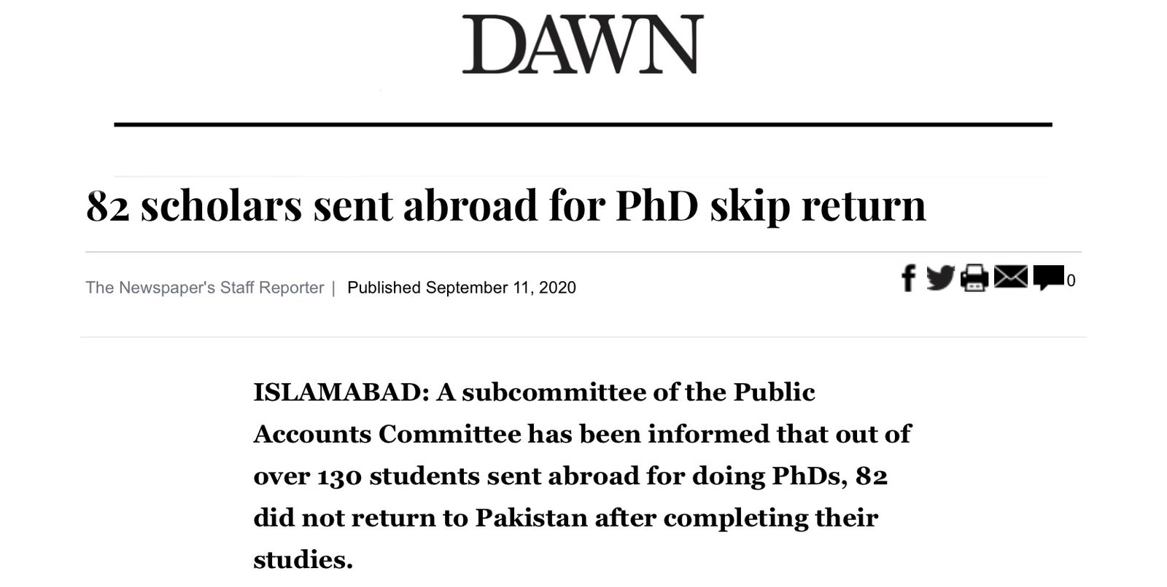
Brain Drain – Problem at Hand

Slide 10
Analysis
Educational Landscape
Burgeoning Population – est. at 224(M) in 2022*
“Youth Bulge” at 60% (15 to 30 yrs.)(6th Census Pak.)
244 Universities / 3634 Technical Institutes**
Churning out 400,000 graduates including 32,000 Doctors, 25,000 Engineers & 25,000 IT specialists.***
101,000 Technically skilled graduates from NAVTEC and Provincial technical institutes****
Source :*Economic Survey of Pakistan 2021-22 ** HEC Website – www.hec.gov.pk 2022 *** Based on estimates appearing in various newspapers. ****.https://navtec.gov.pk/ 2022

Slide 11
Analysis
…Contd.
Educational Landscape
50,000 Students studying abroad (Est.)
HEC - 445 students foreign scholarships in 2020 -21**
273 for PhDs**
Source: **HEC Yearbook 2020-2021

Slide 12
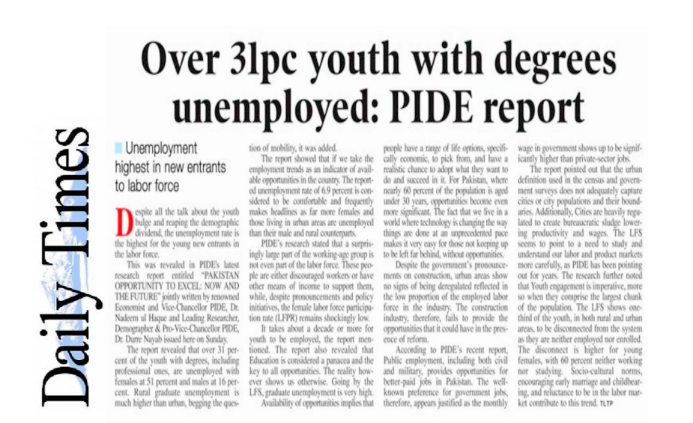
Analysis
…Contd.
Source: Daily Times 19-03-2022

Slide 13
Overseas Employment
Source: BEOE Website: www.beoe.gov.pk/reports-and-statistics

Slide 14
Overseas Employment
…Contd.
Source: BEOE Website: www.beoe.gov.pk/reports-and-statistics

Slide 15
HQ & HS
Source: BEOE Website: www.beoe.gov.pk/reports-and-statistics

Slide 16
Analysis
…Contd.
Pakistan ranked at 77/177 in Global Brain Drain Index*
Intellectual migration is usually permanent
Class Issue: Elite / Upper Middle vs Middle
Contribution to foreign remittances hence Govt. indifference
Desire for migration remains inelastic
Source: * Fund for Peace – www.fragilestatesindex.org

Slide 17
Analysis
…Contd.
Human Smuggling - (Est.) yearly 200,000 leave or attempt to leave Pakistan each year*
681,000 illegal Pakistanis deported from 2015-2021 (FIA)
No data on their qualifications
Migration through marriage
Migration through special immigration schemes by US, Canada & Europe
*Source : A Migrant’s Journey for Better Opportunities: The Case of Pakistan.
World Bank Report, 2019

Slide 18
Analysis
…Contd.
Push Factors
Limited Economy – Incapacity to absorb
Low compensation
Socio-political despondency - Nepotism / Political Instability (World Happiness Index 121/146)
Lack of recognition and respect – Wealth a virtue
Lack of an academic research base

Slide 19
Analysis
…Contd.
Pull Factors
Better quality of life
Social Safety Net – welfare and pensions
Social Mobility abroad and at home
Econo-logic – weighing of skill set and compensation
Attractive immigration schemes such as H1B & FSW
Opportunities for further specialization

Slide 20
Analysis
…Contd.
Implications
Loss of investment in the individual
Limits educational stimulation
Affects Economic growth and development
Loss of important skills and expertise
Research base remains deficient
Limits capacity for innovation - G.I.Index 87/132

Slide 21
Conclusion
Pakistan has faced a significant brain drain over a considerable period of time and the country’s socio-economic conditions are not conducive enough to attract back our intellectual talent from abroad. The Government needs to promote an environment which utilizes their potential for the uplift of the country.

Slide 22
Recommendations
Govt. must end apathy on the issue and promote schemes
Fair recruitment and respect for merit
Greater job opportunities and job security - Investment
Better economic reward system
Search for talent be institutionalized
Develop more cities apart from Provincial capitals
Follow India / China Models – actively promoted “reverse brain drain” by investing in research and technology – led to tech hubs

Slide 23
Bibliography
World Bank Open data available at: https://data.worldbank.org/
Ul Haque, Nadeem. (2005) Brain Drain or Human Capital Flight, PIDE
Pakistan Bureau of Statistics available at website : www.beoe.gov.pk/reports-and-statistics
http:/pkusembassy.gov
https://canadaimmigrants.com
HEC Yearbook 2020-2021 available at www.hec.gov.pk
A Migrant’s Journey for Better Opportunities: The Case of Pakistan. World Bank Report, 2019
Sajjad, Nadia. (2011) Causes and Solutions to Intellectual Brain Drain in Pakistan The Dialogue Vol. VI No.1
Ul-Haque, Siraj & Chandio, Javed. (May, 2013) Human Capital Flight in Pakistan: Strategies for Coping Brain Drain Situation IJEBMS Vol. 2, No.2 75-82
Economic Survey of Pakistan 2021-22
Ul-Haque & Nayab: Pakistan Opportunity to Excel; Now and The Future – Pakistan Institute of Development Economics – 2022
Ume Laila: Impact of brain drain on economic growth in Pakistan, 2018

Slide 24
Thank You
“Ask not what your country can do for you; ask what you can do for your country”
J.F.Kennedy–Former US President

