Slide 1


Slide 2

NATIONAL MANAGEMENT COLLEGE
117th National Management Course
Contemporary Issue Series Presentation
USE OF DARK WEB IN PAKISTAN’S CRIME SCENE: DRUGS, ARMS AND HUMAN TRAFFICKING
By
SHARJIL Kharal
(PSP)
Sponsor DS: Mr. Nadeem Mahbub
Dated: 24th November, 2022

Slide 3
Acronyms
CGPC Cyber Governance Policy Committee
CNSA Control of Narcotics Substances Act
EMCDDA European Monitoring Centre for Drugs and Drug Addiction
EUROPOL European Union Agency for Law Enforcement Cooperation
FIA Federal Investigation Agency
ICTs Information and Communication Technologies
INTERPOL International Criminal Police Organization

Slide 4
Acronyms
ISIS Islamic State
IP Internet Protocol
IT Information Technology
LEAs Law Enforcement Agencies
NY New York
PECA Prevention Electronic Crimes Act
SR Silk Road
TOR The Onion Router
VPN Virtual Private Network
URL Uniform Resource Locator
UK United Kingdom

Slide 5
Sequence
Introduction
Statement of Problem
Research Questions
Analysis
Conclusion
Recommendations

Slide 6
Introduction
Very intriguing subject
Cyber crime
Freedom / Liberties vs Criminality
Data privacy vs Enforcement mandates
Technology vs Capability

Slide 7
Dark Web Myths
Full of only terrible, terrible things
Automatically on a watch list
Tor will completely protect your online privacy
Accessing Dark Web is a crime
Online markets are more lucrative than offline trading places

Slide 8
Statement of Problem
Dark Web is casting a disastrous effect on Pakistan’s Social and Moral fabric. How has the Dark Web facilitated the flow and increase of Drugs, Arms and Human Trafficking in Pakistan?

Slide 9
Research Questions
Has the use of Dark Web impacted criminality and deviance in Pakistan?
What steps can the law enforcement agencies take to arrest the misuse of Dark Web under the categories of Drugs, Arms, and Human Trafficking?

Slide 10
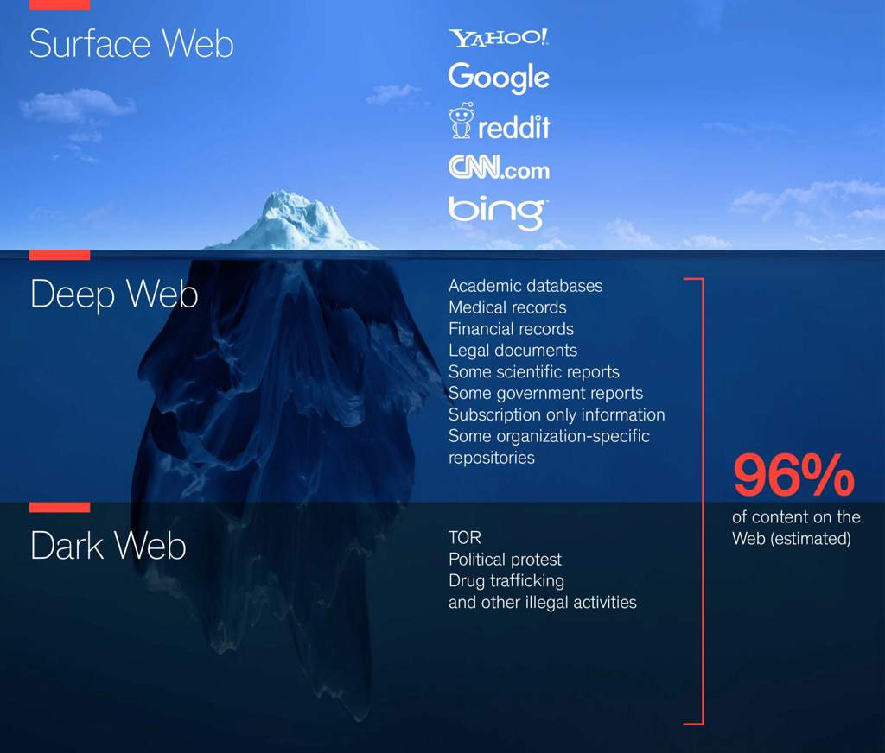
Surface Web vs Deep Web vs Dark Web
4%
Surface Web is only 4% of WWW content (legitimate website we all use)

Slide 11
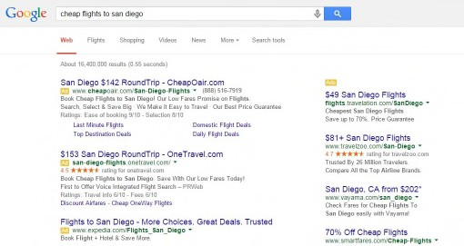
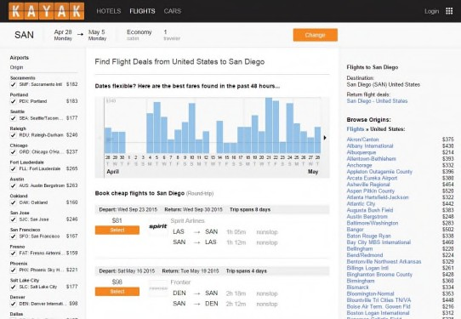
Surface (Open) Web

Slide 12
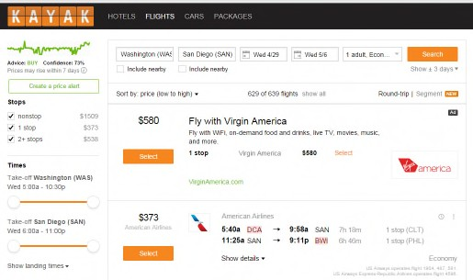
Deep Web
Results from text box-based search on travel site not accessible via search engine (not linked).

Slide 13
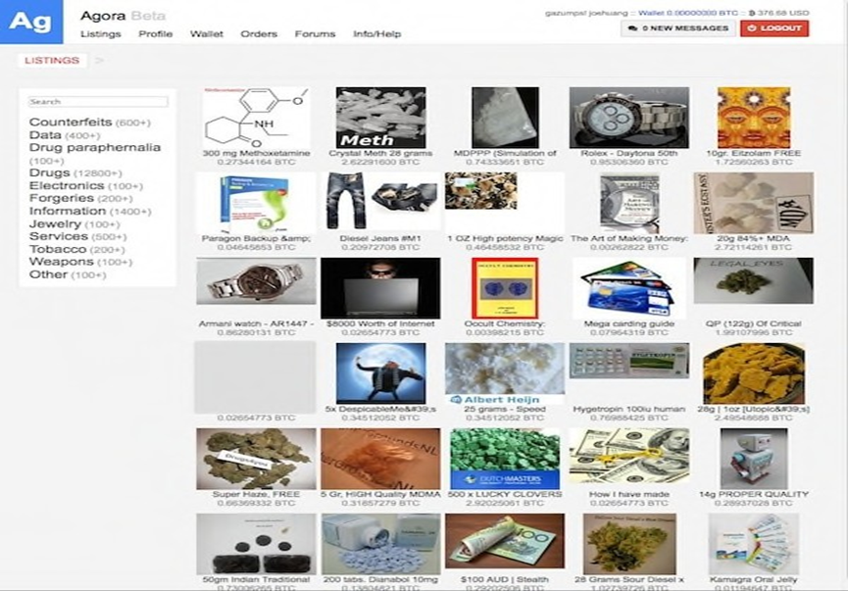
Dark Web / Dark Net
The homepage of Agora, a popular dark market
Source: http://www.coindesk.com/dark-markets-grow-bigger-bolder-year-since-silk-road-bust/

Slide 14
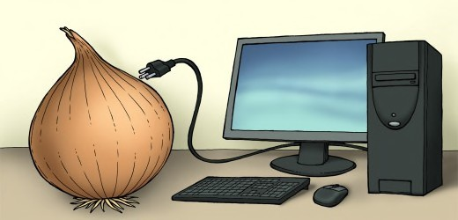
NETWORK (TOR)
Short for “The Onion Router” (TOR);
The most famous anonymous network, which can be accessed using the TOR browser;
TOR browser allows users to surf the dark web anonymously by directing traffic through a network of intermediaries (adding layers)
Source: http://www.coindesk.com/dark-markets-grow-bigger-bolder-year-since-silk-road-bust/

Slide 15
Cont’d….
TOR has an estimated 200,000 to 400,000 websites
  Websites are hosted on hidden servers
    Thanks to encryption and virtual private networks (VPN)
TOR websites are extremely difficult to shut down
  80% of traffic to TOR hidden services are related to child abuse
Source: http://www.coindesk.com/dark-markets-grow-bigger-bolder-year-since-silk-road-bust/

Slide 16
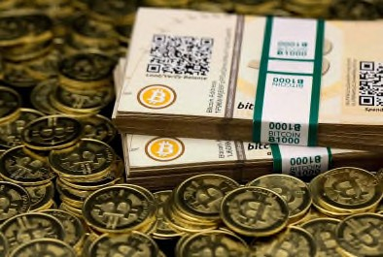
Medium of Exchange
Medium of exchange is based on use of cryptography; a type of digital currency (e.g., Bitcoin)
First came to be known in 2011
Typically decentralized, as opposed to centralized systems like PayPal
Favorite of the dark web markets;
Allows for anonymous transactions
Source: http://silkroaddrugs.org/winning-bidders-in-the-silk- road-bitcoin-auction/

Slide 17
The Dark Web Actors

Slide 18
The Dark Web Sectors

Slide 19
Timeline of the Dark Web
2002 – Tor Network developed by US Naval Research Laboratory
2003 – The I2P peer-to-peer network developed
2006 – Tor becomes a non-profit organization
2009 – “Satoshi Nakamoto” started Bitcoin digital currency
2011 – Silk Road Market launches
2012 – Experts estimate earnings of $22M for SR
2013 – Silk Road shut down (earnings > $1B)
2014 – Other dark web markets proliferate (Agora, Evolution)
2015 – Ross Ulbricht founder of Silk Road) sentenced to life; Evolution exit scam

Slide 20
Users on Dark Web (Global Estimates)
Source: www.statista.com

Slide 21
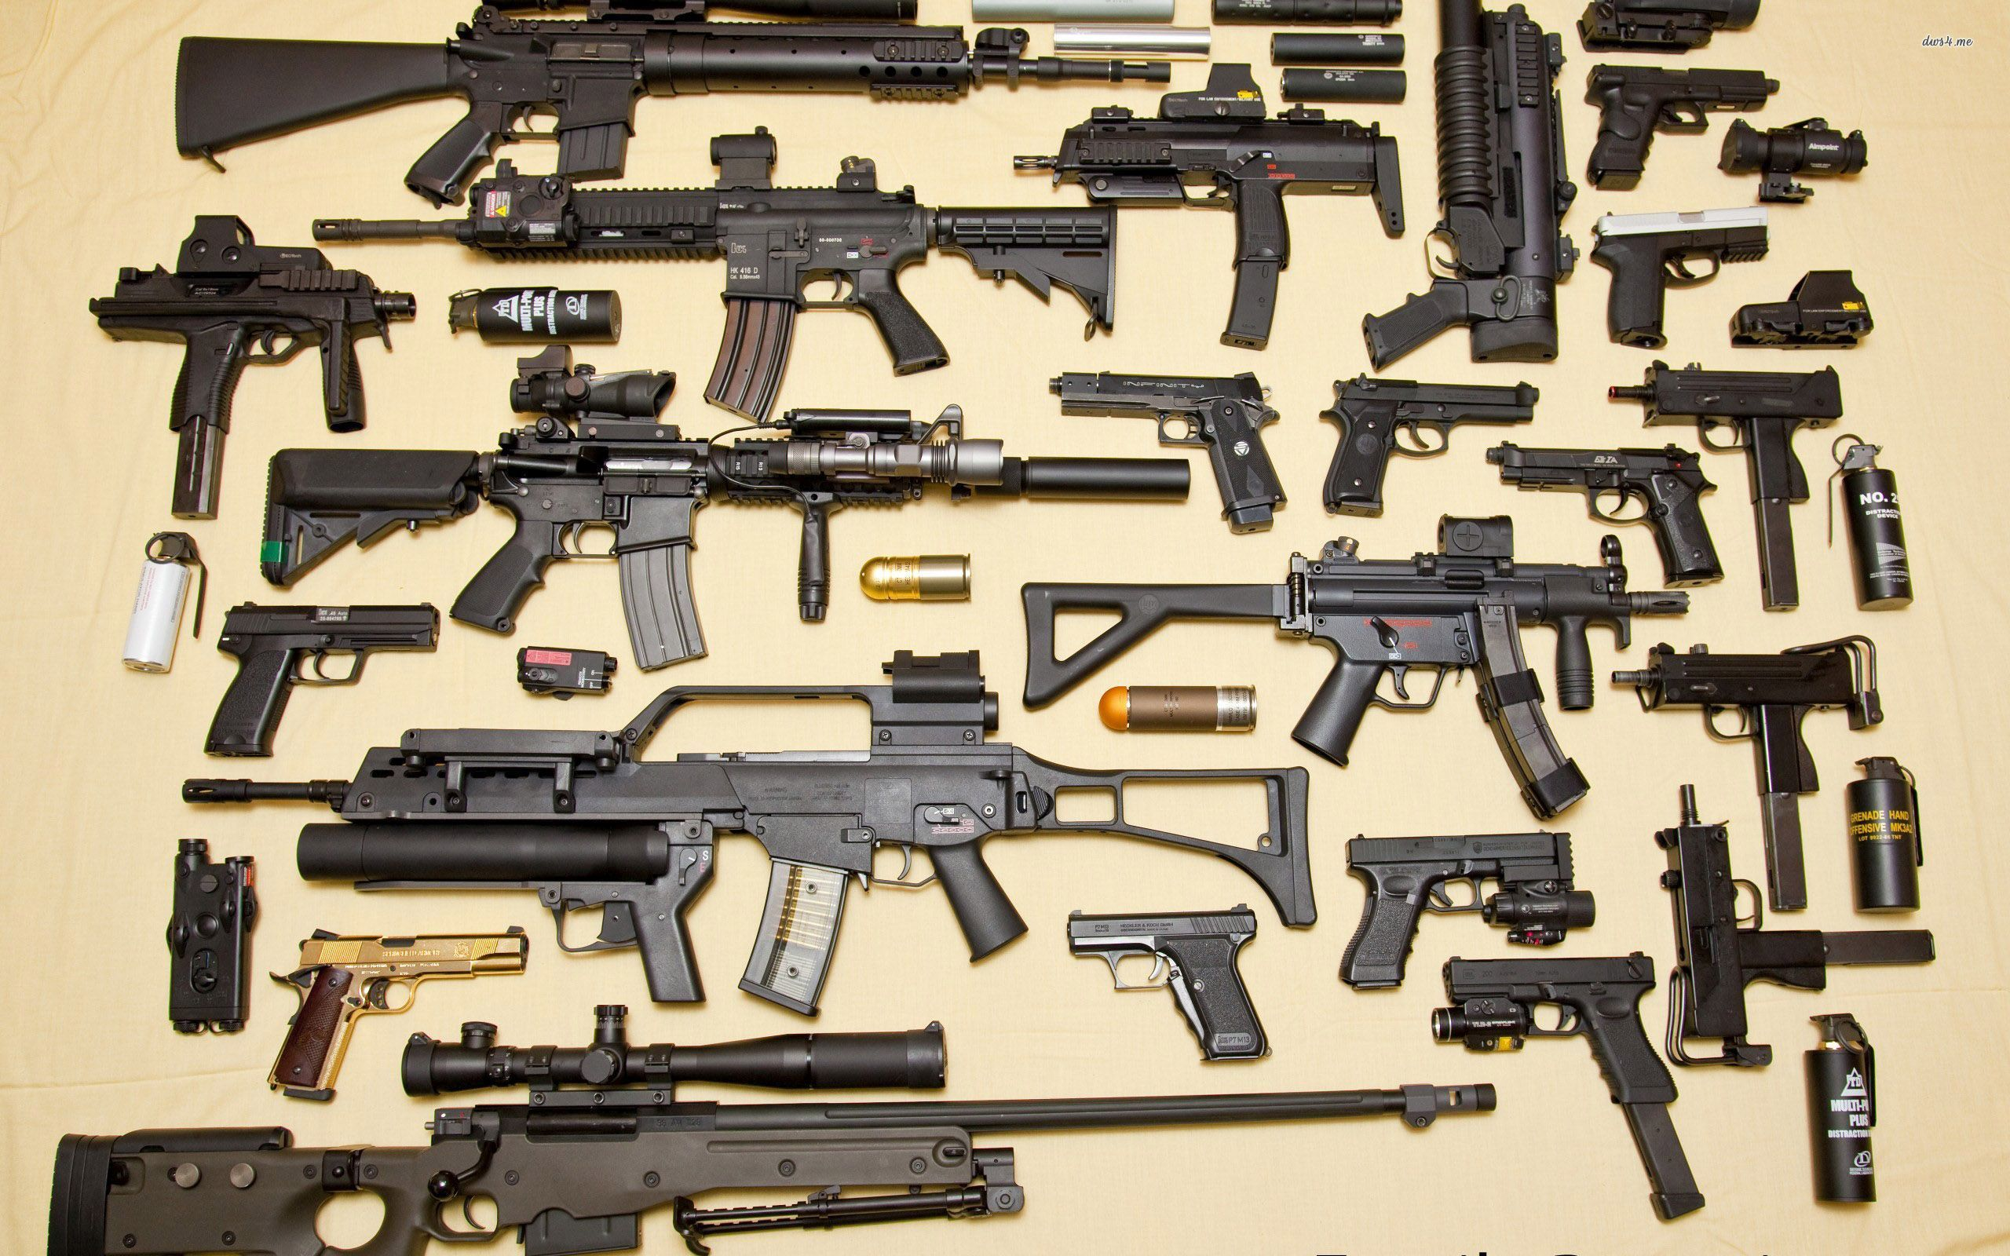
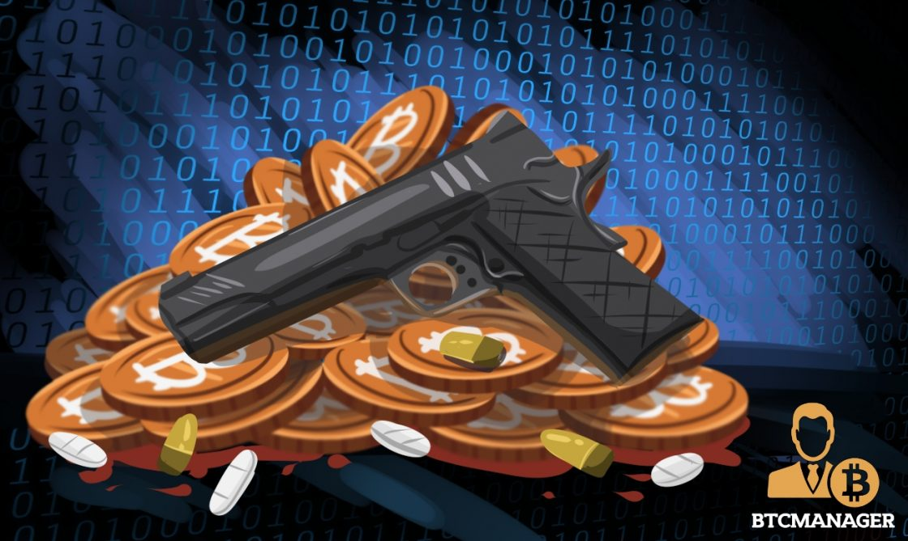
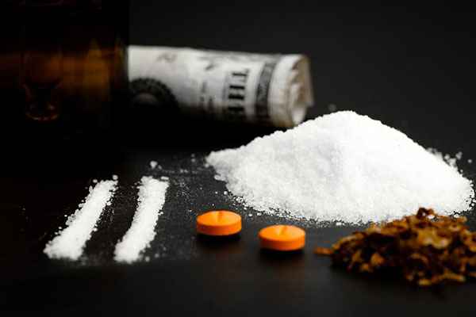


Illegal Activities on Dark Web
Illegal Drug Sales
Illegal Arms Sales
Murder for Hire/Contract Killings
Blackmail/Extortion
Sex Trafficking
Terrorism
Child Pornography
Financing, Fraud Services etc…

Slide 22
Drugs on the Dark Web Market
According to European Monitoring Centre for Drugs and Drug Addiction (EMCDDA)*
Drugs are estimated to account for around TWO THIRD (2/3) of Darknet market activity.
Source:EMCDDA:https://www.europol.europa.eu/publications-documents/drugs-and-darknet-perspectives-for-enforcement-research-and-policy

Slide 23
Pakistan’s Crime Scene
Known market for flourishing Organized Crime
  Drugs
  Arms
  Human Trafficking
All three categories are transnational hence all the more need for the cartels and rackets to go beyond borders in search for lucrative on and off line markets

Slide 24
Pakistan’s Crime Scene
LEAs potential to arrest the misuse of Dark Web
  Still not a priority so the procedures have not followed
  FIA- lead agency but yet to develop guidelines
  Equipment
  Trained human resource
  International Coordination
  Legal shortcomings (PECA)

Slide 25
Users on Dark Web (Pakistan)
Pakistan became the country with the highest number of dark web related queries on the internet in 2018
According to the FIA, more than 1.3 million users searched terms related to the dark web after Zainab, the 7-year old from Kasur, was raped and murdered
It started when a big pedophilic ring was exposed in August 2015 and dozens of child pornographic material was recovered from Hussain Khanwala, a village of Kasur district
The theory that a certain group in Pakistan was involved in shooting and selling child pornography online enraged the public and some even embraced a mission to find such content by themselves and report it to the concerned authorities

Slide 26
Case Study: Misuse of Dark Web
Accused Sohail Ayaz abducted and sexually assaulted a 13 year old boy in Rawat, near Rawalpindi
Co-accused Khurram Tahir also arrested
Death sentence to Sohail Ayaz and 7 years imprisonment to Khurram Tahir (2020)
Confessed that he was a convicted pedophile deported from the UK and Italy
Ayaz had raped over 30 children and uploaded videos of assault on Dark Web

Slide 27
Case Study: Misuse of Dark Web
Saadat Amin convicted under sec 22 of PECA 2016 and imposed Rs.1.2(m) fine (2018)
Arrested by FIA on the complaint of Norwegian embassy
Active member of international racket operating online from Pakistan
Used to sell pornographic videos / pictures of the victims abroad
More than 65000 pictures and videos recovered
Hands in glove with international gangs involved in child pornography on Dark Web

Slide 28
Cyber Security Landscape in Pakistan
Cyber Security regime has evolved in the last two decades
Electronic Transaction Ordinance 2002
Electronic and cyber crime bill 2007
Investigation for Fair Trial Act 2013
Prevention of Electronic Crimes Act 2016
National Cyber Security Policy 2021

Slide 29
National Cyber Security Policy 2021
To mitigate IT security vulnerabilities, a comprehensive Cyber Security policy is a baseline mechanism to address the risks and challenges globally
All actions be driven to protect on line data privacy and security of citizens and enhance national and public prosperity in the digital domain
The objective of Cyber Security Policy 2021:
To establish governance and institutional framework for a secure cyber ecosystem.
To enhance the security of national information systems and infrastructure
A Cyber Governance Policy Committee (CGPC) has been constituted for strategic oversight over national Cyber Security issues

Slide 30
Prevention of Electronic Crimes Act 2016
Means to prevent and detect offences relating to cyber world
Federal government can designate any agency to take cognizance of cyber crime but only FIA has been empowered
“whoever with dishonest intention….” (Essence of PECA, criminalizes the act)
Sections 10, 18, 19, 19A are cognizable, non bailable, and non compoundable (Section 22-Pornography)
What about offences of drugs, arm dealing, and human trafficking on Dark web??
Applied in conjunction with the existing CJ legislations (PPC, CrPC, Qanun e Shahdat, CNSA)

Slide 31
Conclusion

Slide 32
Misuse of Dark Web in Pakistan
Currently not quantified
Reliable data not available
Only after arrests (cases of child pornography)
Cases in the three crime heads need to be explored and arrests be made, gangs be detected
Analyzing international trends do suggest that its misuse is prevalent in Pakistan

Slide 33
Can our Apparatus of LEAs Detect Dark Web Crime?
YES!!
Softwares other than TOR available
Can track data leaks
Search identities through Bitcoin block chain
Can employ Exit data software for photographs
Using TENSOR software to track terrorists activities
(collaborative project with EUROPOL)

Slide 34
Recommendations
I-Law Enforcement Agencies
Investing in the capability enhancement of LEAs to enable them to respond against misusers of Dark Web and Dark nets
Networking and information sharing amongst LEAs (National and International) Law enforcement agencies to develop state of the art forensic laboratories
Use of Knowledge databases and creation of investigation guides
Training on Dark Web / Dark net and cryptocurrencies to ensure that investigators keep up with the evolution of Forensic tools and techniques

Slide 35
Recommendations
II-Legal Framework
Establish a special court to adjudicate the matters related to cyber security and related proceedings
Empowering the legal entities / investigation authorities by rectifying the shortcomings under PECA 2016
III- Societal
Cases of child pornography have exposed the sick elements in our society which has negatively impacted our social and moral fabric
Accessibility be monitored at homes particularly by teen age children, youth etc

Slide 36
Sources
National Cyber Security Policy 2021
Prevention of Electronics Crime Act-2016 (PEACA)
Pakistan Penal Code
Code of Criminal Procedure
Wikipedia
Investigation of Fair Trials Act 2013
Control of Narcotics Substances Act (CNSA)
Taking on the Dark Web; Law and Enforcement expert’s investigative needs (www.nij.ojp.gov)
The Truth about Dark Web by Aditi Kumar and Rric Rosenbach (international Monitory Fund)
Cyber Weapon on the Dark Web by Ayaz Abbasi (The Express Tribune)
Federal Investigation Agency (FIA)
www.statista.com
www.coindesk.com/dark-markets-grow-bigger-bolder-year-since-silk-road-bust
www.silkroaddrugs.org/winning-bidders-in-the-silk- road-bitcoin-auction
EMCDDA:www.europol.europa.eu/publications-documents/drugs-and-darknet-perspectives-for-enforcement-research-and-policy

Slide 37
Thank You

