Slide 1
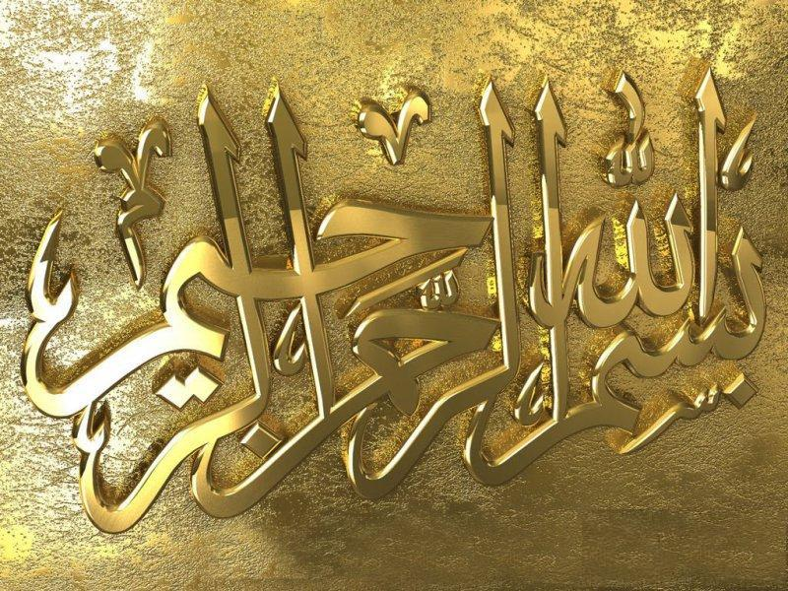

Slide 2
NATIONAL MANAGEMENT COLLEGE 117th National Management Course
Contemporary Issue Series Presentation
Revival of Pakistani music through fusion and other techniques: How promising it is?
By
Rana Muhammad Rafique Khan
(ML&C Gp)
Sponsor DS: Ms. Ambreen Raza
Dated: 22 November 2022

Slide 3
Acronyms
A.I Artificial Intelligence
BBC British Broad Casting
CA Current Affairs
DG Director General
Div Division
DAWs Digital Audio Workstations
FM Frequency Modulation
Govt Government
IP Intellectual Property
IT Information Technology
MoM Month on Month
NA Not Available
NAPA National Academy of Performing Arts
PNCA Pakistan National Council of Arts
PTV Pakistan Television
YoY Year on Year

Slide 4
Sequence
Interviews Conducted
Introduction
Statement of Problem
Key Question
Popular Genres of Music in Pakistan
Transformation of Music
Situation Analysis – Opportunities and Challenges
Conclusion
Recommendations
References

Slide 5
Interviews Conducted
Mr. Shahzad Durrani, Senior Official, National Heritage & Cultural Div
Ms. Saman Rai, Ex – DG, Cultural Department, Govt of Punjab
Mr. Ghulam Abbas, Pride of Performance, Super Star
Mr. Rohail Hayat, Coke Studio
Ms. Shabnum Majeed, Tamgha e Imtiaz
Mr. Arshad Mehmood, Ex Official, NAPA

Slide 6
Introduction
Music – Music expresses that which cannot be put into words and that which cannot remain silent (Victor Hugo)
Art of combining vocal or instrumental sounds (or both) to produce beauty of form, harmony, and expression of emotion (Oxford Dictionary)
Fusion music – A blend of two or more styles of music (BBC)
Purpose – Originates from the desire to
Reach a broader audience
Establish a new or a unique music

Slide 7
Statement of Problem
Culture is an invisible binding force that holds people of a nation together and gets transferred from older to next generation. Music is the manifestation of culture. Pakistani music been fascinatingly rich, diverse and popular amongst old and young alike, however, the everchanging modern techniques corner Pakistani music against evolving challenges which if not responded to may result in extinction of our music.

Slide 8
Research Question
Whether Pakistani music revival through fusion and other techniques is promising or otherwise?

Slide 9
Popular Genres of Music in Pakistan
Classical
Classical note is formed from 7 basic notes called “Sargam” (Sa-Re-Ga-Ma-Pa-Da-Ni) and 5 half notes making it 12 notes
Classical music in Pakistan can be understood from the “Gharanas”-Agra Gharana, Gwalior Gharana, Patiala Gharana, etc.
There are different types of composition- Dhrupad, Khayal, Thumri

Slide 10
Music Genre - Ghazal
A form of music inherited from the Persian
This genre is mainly used for expression of love and separation
Ghazal singers are also trained classically in Khayal and Thumri
Famous Ghazal singers are Abida Perveen, Ghulam Ali, Mehdi Hassan, Tina Sani, Nayyara Noor, Iqbal Bano, etc.

Slide 11
Music Genre - Qawwali
Main substance of Qawwali is love, devotion & longing
Sung by one or two lead vocalists and chorus of hand- clapping Qawwals
Mainly played and heard on Sufi Shrines
Aziz Mian, Nusrat Fateh Ali Khan and Sabri Brothers were Popular Qawwal

Slide 12
Music Genre - Folk
A popular genre in the interiors of the country
Usually performed by “faqeers” on various different shrines of saints
The folk music differ from region to region
Popular fold singers are Allan Fakeer, Saeein Zahoor, Tufail Ahmed etc.

Slide 13
Music Genre - Pop
Ahmed Rushdi’s “Ko-Ko-Korina”,1966 is linked with Pop music birth in Pakistan
True pioneer of pop music was Alamgir in Pakistan and later followed by brother-sister duo of Nazia and Zohaib Hassan
During 1970’s and 1980’s pop singing bands were formed including Vital Signs who inspired the later like Awaz, Junoon, Ali Haider and Atif Aslam

Slide 14
Music Genre - Rock
A heavy western influence is obvious in these bands and from their songs
Started by Junoon, poetry of Sufi’s were used to combine with rock music
Created blend making young generation go crazy
Junoon inspired later rock bands -Entity Paradigm, Mizraab, Aaroh, Roxen, Karavan

Slide 15
Music Genre - Filmi
Music produced by film industry for movies
Songs are performed by playback singers to fit within the storyline
Madam Noor Jehan titled as Malka-e-Tarranum - Queen of Melody and Ahmed Rushdi titled as Prince of melody achieved maximum recognition in playback singing in Pakistani films

Slide 16
7 Decades of Film Music of Pakistan
Decades | Film Songs Produced
 | Urdu | Punjabi | Others | Total
1948-1957 | 893 | 251 | 7 | 1151
1958-1967 | 2653 | 820 | 2 | 3475
1968-1977 | 1984 | 1825 | 21 | 3830
1978-1987 | 574 | 622 | 4 | 1200
1988-1997 | 210 | 310 | NA | 520
1998-2007 | 105 | 49 | NA | 154
2008-2017 | 54 | 74 | NA | 128
Source: Afzal, A. Pakistan journal of society, education and language. Retrieved November 19, 2022, https://www.pjsel.jehanf.com

Slide 17
Film Song Production Trend
Source: Afzal, A. Pakistan journal of society, education and language. Retrieved November 19, 2022, https://www.pjsel.jehanf.com

Slide 18
Downfall of Music : Stakeholders’ Perceptions
Uses and Gratifications Perspective
Now audience is exposed to the music landscape of the whole world
Music with traditional or typical beats and lyrics get little attention as people want something fresh and new
Traditional music productions not gratifying the music needs of the people

Slide 19
Contd…
Time Displacement Perspective
State owned electronic media used to produce & promote entertainment content
Private News Channels made audience switched to News, CA & political talk shows
Displacement effects compelled electronic media to put resources in production of these programs instead of music and entertainment

Slide 20
Contd…
Social Defiance
Music is not socially acceptable to a considerable segment of society and as a result of this social/ religious barrier, music is not considered as decent profession
Less rewarding career for majority of musicians
Declining Music Quality
Non -use of latest technology in music production
Lack of latest technical facilities and music education

Slide 21
Contd…
Lacking Govt Support
Existing institutions PTV/ Radio Pakistan, PNCA, Arts councils, etc. remained
Short of funds
Directionless for development of music platforms in Pakistan
Foreign Music Influence
Indian music has a strong influence over Pakistani music
Indian films have been allowed to screen in Pakistan
Private FM Radios play Indian songs in their broadcast

Slide 22
Contd…
Decline of Film Industry
Music was a core part of our films in the past
With decline of film industry, music was not being produced
Lack of Platforms for Music Promotion
Shift of Pakistani media towards news and current affairs programs
Music gets very less space in the broadcasts

Slide 23
Transformation of Music in Pakistan
Influence of western culture- pop and rock popularity grabbed audience
Trend started by Junoon followed by other bands/solo performers using poetry of famous music genre and packaging into new rock & pop style
Coke Studio Program by Rohail Hayat- band member of Vital Signs, inviting leading musicians from all different genre, created a new type of music
This revolutionized Pakistan music industry

Slide 24
Contd…
A ghazal singer with a rock band performing a song having
tunes of rock music
softness of a ghazal
instruments tabla, dholak, harmonioum, guitar, drums, keyboards, percussions, etc.
New generation started realizing wealth of unexplored traditional music
Singers create new songs but different tone with traditional instruments & vocalists

Slide 25
Fusion and other Techniques
Using old poetic content and composing it in modern style
Using old tune and old genres and arranging music with modern instruments
Treating old compositions with modern techniques & technology
Using classical instruments with modern drums, bass and chord work
Recording old style music/ instruments with modern technology
Use of IT and A.I. driven techno-music

Slide 26
Situation Analysis
A new Paradigm shift in music
Change in traditional music formation
Use of new instruments
Blending two or more music genres
Commingling of language
Cultivating a new form of listenership
Corporate models like Coke Studio are coming on the musical arena

Slide 27
Contd…
Use of technology
DAWs – comprehensive electronic software made music production much easier
Techno music – fast beat features and synthesized sounds
A.I driven
Blend of sound and visuals adds stylistic features

Slide 28
Contd…
People have short span of concentration
Technological innovations do impact people’s sonic sensibilities
Broader exposure to sounds spanning across eras and borders
Revival of classical poetry which was about to die
A new concept emerged link of traditional and popular music

Slide 29
Major Platforms
Coke Studio
Fusion of Traditional and folk music with modern and Western music
Remix of old golden songs also proven instrumental for them
Pepsi Battle of the Bands
Nescafe Basement
Patari Tabeer
Source: Siddiqui, K. H. (2019, October 5). Fusion strategy’ works for “coke studio” to penetrate in Pakistani Urban millennial. www.linkedin.com/

Slide 30
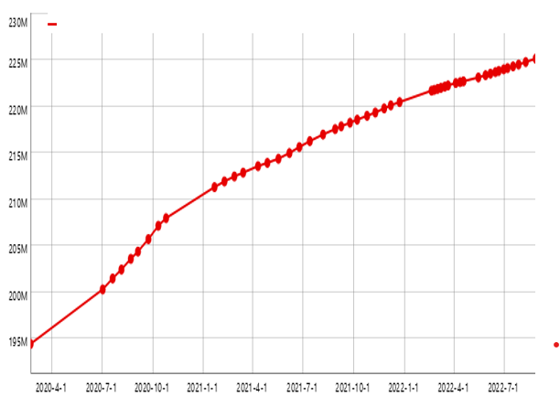
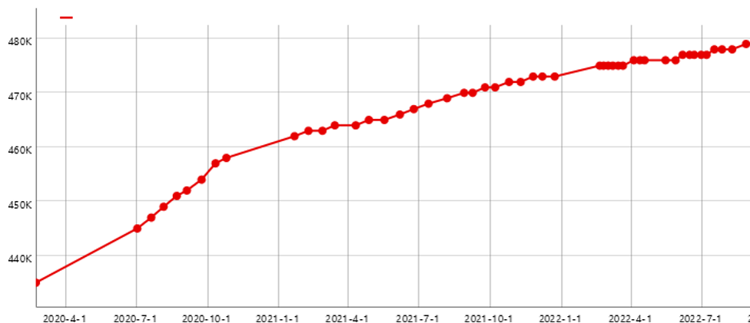
Fusion Strategy – Coke Studio
Total Views on Youtube
Total Subscribers on Youtube
Source: Coke Studio video statistics. YouTubers.Me. Retrieved November 19, 2022, from https://ie.youtubers.me/

Slide 31
Top Music Industry Websites in Pakistan
Website | Visits | MoM | YoY
Spotify | 680.59K | ↓5.23% | ↑52.26%
Soundcloud | 447.64 | ↓23.78% | ↓37.65%
Storyblocks | 294.91 | ↑7.68% | ↑126.32%
Gaana | 228.36 | ↓21.24% | ↓25.77%
Amazon | 181.68 | ↑10.15% | ↑36.97%
Source: Semrush Retrieved November 19, 2022, from http://Semrush.com

Slide 32
Fusion Critique
Fusion music is just
Remix of two or more already sung musical genres
Re-formatting with huge techno music back
Re-arrangement with rap and rock
Re-packaging the old melodious music genres
Untrained and unsupervised singers
Singers’ shortcomings are camouflaged by auto tunes
Short shelf life of music

Slide 33
Contd…
Pakistani music through fusion and other techniques would have
No originality
No innovation
No creativity Just Plagiarism
No musical identity
No IP rights

Slide 34
Future of Music in Pakistan
Modern technology will influence the Pakistani music helping it evolve with the pace of technological advancements
Computer-based and A.I. driven music with human melody
Traditional music will continue serving as a window to the past to be used by musicians and singers while creating new music
Diversification of audience spreading across eras and borders

Slide 35
Issues and Challenges
Music industry working in silos
Non supervised music production
Role of State media houses
Art councils’ Luke worm performance
Content crisis – most music production is old song- driven
IP rights

Slide 36
Conclusion
Distinguishing feature of Pakistani music has been its continuous evolution through decades and has absorbed recent trends to keep it attractive and alive. This evolution is a strength and by no means it is an encroachment on its genesis. This fast pace changes will help it in countering foreign music impact. Its revival through fusion and other IT and A.I- driven techniques is though challenging but is quite promising. This evolving trend has the potential to return the past glory to Pakistani music

Slide 37
Recommendations
Establishment of data bank at Federal and Provincial level
Art Councils need to be more functional and meaningful
Devising IP rights protection mechanism
Proactive role of state media houses

Slide 38
References
Williams, R. D., & Mahmood, R. (2019). A soundtrack for reimagining Pakistan? Coke Studio, memory and the music video. BioScope: South Asian Screen Studies, 10(2), 111-128.
Dr. Irem Sultana **Dr. Malik Adnan ***Dr. Shehla Jabeen. (2018). Musical Communication With Message Of Peace And Religious Harmony In Globe: The Case Study Of Pakistani Sufi Rock Band Junoon. Al Qalam, 23(2), 184-195. Https://Doi.Org/10.51506/Alqalam.26(2)708.
Awais Afzal, Dr. Shahid Hussain, & Javed Iqbal,. (2020). DOWNFALL OF URDU MUSIC IN PAKISTAN: STAKEHOLDERS’ PERCEPTIONS . Pakistan Journal of Society, Education and Language (PJSEL), 6(1), 202-218. Retrieved from https://www.pjsel.jehanf.com/index.php/journal/article/view/425
Qureshi, R., & Qureshi, R. B. (1986). Sufi music of India and Pakistan: sound, context and meaning in Qawwali (Vol. 1). CUP Archive.
Saeed, Y. Amir Khusrau and the Indo-Muslim Identity in the Art Music Practices of Pakistan
Chung, L. W. (2021). Sikh music and its revival in post-partition India. In Routledge Handbook of Asian Music: Cultural Intersections (pp. 241-261). Routledge.
Shah, S. (2021). Sustenance of Classical Music: Study of Ethnomusicology in an Ethnolinguistic Culture. Kashmir Journal of Language Research, 24(1).

Slide 39
References – Contd…
McCain, A. (2022, May 23). 29 music industry statistics [2022]: Facts, trends, and sales. https://www.zippia.com/
Afzal, A. Pakistan journal of society, education and language. Retrieved November 19, 2022, https://www.pjsel.jehanf.com
Coke Studio video statistics. YouTubers.Me. Retrieved November 19, 2022, from https://ie.youtubers.me/
Semrush Retrieved November 19, 2022, from http://Semrush.com
Paradigm shift in music. (n.d.). Psu.edu. Retrieved November 19, 2022, from https://sites.psu.edu/sureshrajanengl137h/music-industry-paradigm-shift/
Ezinearticles.com. Retrieved November 19, 2022, from http://EzineArticles.com/9077123
Ryan. (2019, July 29). What is the future of music? Sageaudio.com. https://www.sageaudio.com/blog/music-news/what-is-the-future-of-music.php

Slide 40
Thank you

