Slide 2
National Management College 117th National Management Course
Contemporary Issue Series Presentation
SMOG : HITHERTO COPING STRATEGIES AND WAY FORWARD
Syed M. Jawad Murtaza NAQVI
(N.A. Secretariat)
Sponsor DS: Ms. Sijal Tauseef Khan
November 22, 2022

Slide 3
Sequence
Acronyms
Introduction
Statement of Problem
Key Questions
Scope
Analysis
Conclusion
Recommendations/Way Forward

Slide 4
Acronyms
ADP | Automatic Data Processing
App | Application
AQI: | Air Quality Index
AQLI: | Air Quality Life Index
AQM: | Air quality management
AQMS: | Ambient Air Quality Monitoring stations
CO: | Carbon Monoxide
EPA: | Environmental Protection Agency
EPD: | Environment Protection Department
FIEDMC | Faisalabad Industrial Estate Development & Management Company
FIRs | First Information Report
I&C | Information and communication technology
ICI&SDD | Industries, Commerce and Investment & Skills Development Department
LUMS | Lahore University of Management Sciences
MVO | Motor Vehicle Operations
NO_{x}: | Oxides of Nitrogen
OGRA | Oil and Gas Regulatory Authority
PDMA | Provincial Disaster Management Authority
PDWP | Provincial Development Working Party

Slide 5
Acronyms
PEPC | Pakistan Environmental Protection Council
PEQS | Punjab Environmental Quality Standards
PGDP | Punjab Green Development Program
PIEDMC | Punjab Industrial Estate Development and Management Company
PM: | Particulate Matter (PM 2.5 &PM 10)
RECP | Resource Efficient and Cleaner Production
RTA | Regional Transportation Authority
SCCFD | Standing Committee of the Cabinet on Finance and Development
SMEs | Small and medium-sized enterprises
SOPs | Standard operating procedures
SO_{x}: | Oxides of Sulphur
TVCs | Television Commercials
UC | Union Council
VICS | Vehicle Inspection and Certification System
VOC | Volatile Organic Compounds
WHO: | World Health Organization

Slide 6
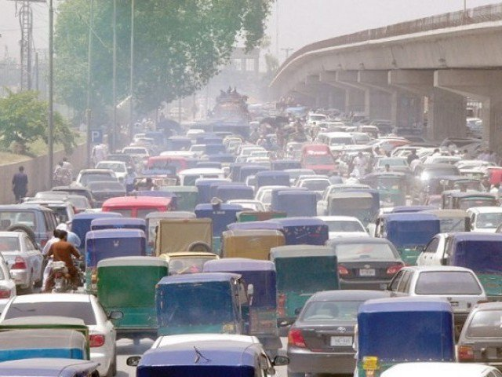
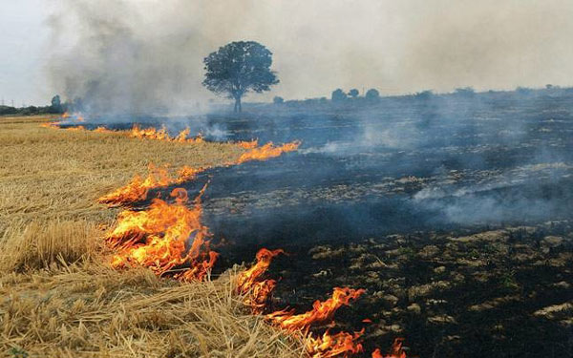
Smog and its Occurrence
Fog is caused by water droplets in the air. But smog is smoke + fog. It is a sign of severe air pollution.
In Punjab, smoke generated from vehicles, industry, and stubble burning etc. converts into smog during the month of November
It normally persists for 3 to 4 weeks when mean temperature remains in the range of 19-21ºC and humidity 30-50% and wind speed lowers
Respiratory infections, asthma, lung cancer, cardiovascular disease, eye problems and possibly damaging children development
Impact on the economy due to reduced ability to work and lower participation rates in the labor force
Children miss school, impacting their learning abilities
Source: Pakistan Meteorological Department, 2020

Slide 7
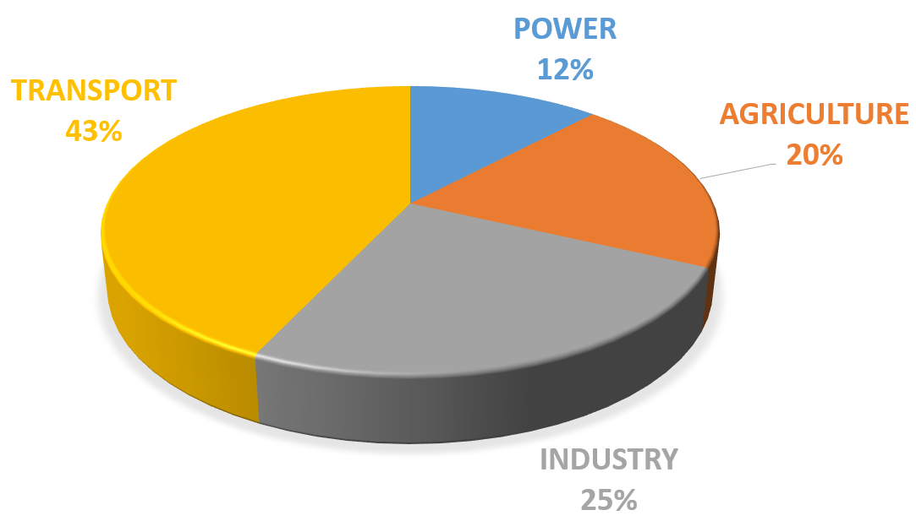
Smog – Introduction
Vehicular pollution
Industrial emissions
Smoke
Smog
Burning of crop residues
Particulate Matter
Fog
Metrologic factors
Source: UN FAO 2018

Slide 8
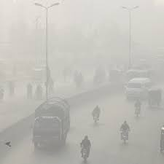
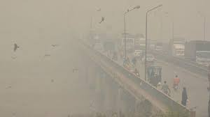
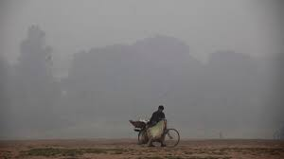
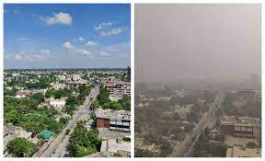
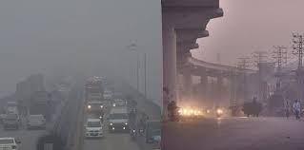
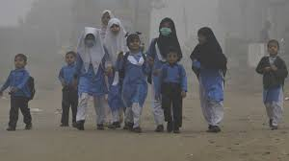

Slide 9
Statement of Problem
In recent years, Smog has become a devastating problem due to the unplanned urbanisation, industrialization, crop residue burning, and vehicle emissions. The hazardous chemicals and pollutants involved in smog formation are highly reactive and are spread in the atmosphere. Smog is equally harmful to humans, animals, plants and the nature itself. Coping strategies hitherto haven’t been useful in thwarting the smog

Slide 10
Key Questions
What are the strategies taken specifically to mitigate smog in Punjab?
Are the coping strategies sufficient enough in controlling smog?

Slide 11
Scope
Research focused on hitherto coping strategies for reducing smog and to redress the degradation of AQI in large urban cities of Punjab
Being the worst hit city the primary focus was on areas in and around Lahore

Slide 12
Smog-Hazards
The smog's most threatening aspect is its high concentration of PM_{2.5} – Small enough to lodge deep into the lungs and enter the bloodstream.
Throughout the winter of 2021, Lahore’s daily average PM_{2.5} concentration stood at 117 𝜇𝑔/𝑚³, while WHO is 10 𝜇𝑔/𝑚³and EPD is 15
Punjab Environmental Quality Standards (PEQS)-based Air Quality Index (AQI) is used to report about air quality as a proxy of smog in winter
PM₁₀ | PM_{2.5} | SO_{x} | NO_{x} | O₃ | CO | AQI | Indicator Color | Overall Description
0-150 | 0-35 | 0-120 | 0-80 | 0-130 | 0-5 | 0-100 | Green | Good – Minimal Impact
151-200 | 36-70 | 121-240 | 80-160 | 131-260 | 5-10 | 101-200 | Light Green | Satisfactory – May cause minor breathing discomfort to sensitive people.
201-250 | 71-105 | 241-360 | 161-320 | 261-450 | 11-25 | 200-300 | Yellow | Moderately Polluted – May cause breathing discomfort to people with lung disease such as asthma, and discomfort to people with heart disease, children and older adults.
251-350 | 106-140 | 361-700 | 321-560 | 451-550 | 26-40 | 301-400 | Orange | Poor – May cause breathing discomfort to people on prolonged exposure, and discomfort to people with heart disease.
351-430 | 141-300 | 701- 1600 | 561-800 | 551- 1900 | 41-50 | 401-500 | Red | Very Poor – May cause respiratory illness to the people on prolonged exposure. Effect may be more pronounced in people with lung and heart diseases.
430 + | 300 + | 1600 + | 800 + | 1900 + | 50 + | 500+ | Maroon | Severe – May cause respiratory impact even on healthy people, and serious health impacts on people with lung/heart disease. The health impacts may be experienced even during light physical activity.
Source: Punjab Smog Policy

Slide 13
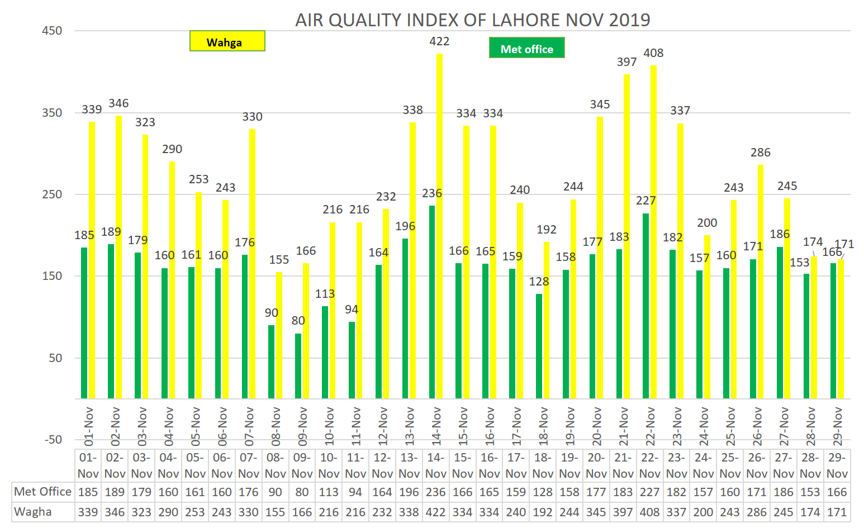
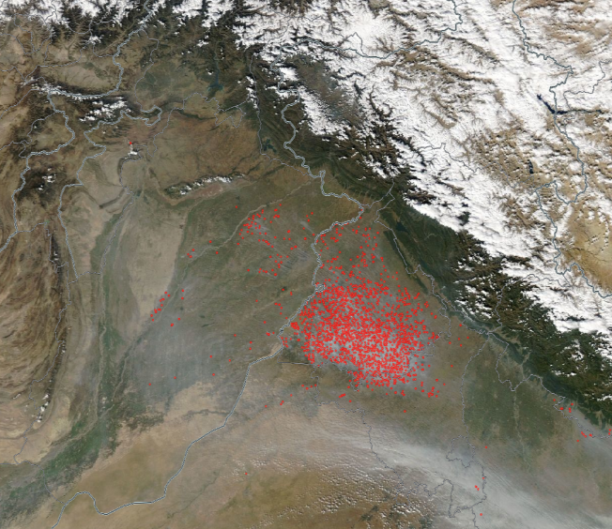
Spatial Statistics of Smog
Trans-boundary dimensions
Punjab (Pakistan)
Punjab
(India)
Source: NASA/MODIS
Source: Punjab Smog Policy

Slide 14
Sources of Smog in Punjab
Farmers burn more than 400 million tons of rice crop residues on both sides of the area bordering Punjab
AQI in Ludhiana is 350 as on Monday and PM2.5 in all cities Indian Punjab were recorded over 220
Over enthusiastic industrialization and urbanization have deteriorated the air quality of major cities
Installation of fossil fuel electricity generation plants have been a main contributor to the smog
Traffic congestion’s and Increased number of vehicles; more than 6.2 million vehicles ply on the roads of Lahore only, of which two stroke vehicles i.e. rickshaws and motorcycles is more than 2 million. These are a major source of Carbon Monoxide.
Burning of tires whether these are used by the wire industry or even during political protests, are a major source of air pollution
Deforestation in and around major cities. Punjab alone from 2001 to 2021, has lost 88ha of tree cover from fires and 347ha from all other drivers of loss
Source: foreignpolicy.com

Slide 15
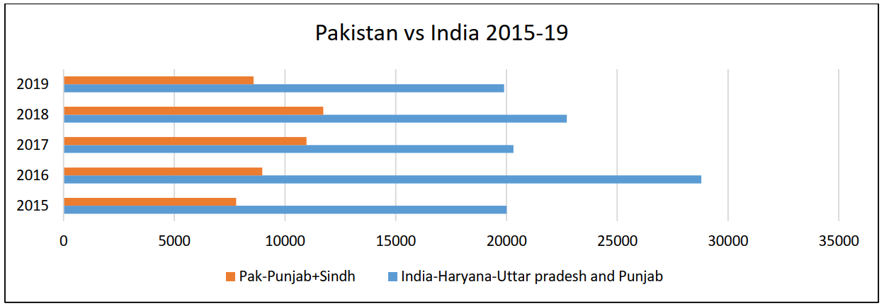
Historic Trends
No. of fire/crop burning points
Source: Punjab Smog Policy

Slide 16
Smog Strategy
There is a phased and focused strategy by the government of Punjab and its lead department which is Environment Protection Department
Traditionally reactive approach through enforcement was followed
Historic trends indicate a limited level of success in controlling the smog issue with the reactive approach
Proactive approach to reduce pollution levels and smog being adopted
Resolve to reduce AQI by at least 50
Early on-set of stakeholder involvement/sensitization
Streamlining data collection

Slide 17
Punjab Disaster Management Authority
(Anti Smog Engagements)
SMOG declared as Calamity under Punjab National Calamities (Prevention and Relief) Act, 1958
Legal empowerment of implementing arms through Relief Commissioner’s order
Ban Imposed on all activities leading to formation of smog
Delegation of powers of Relief Commissioner to all Deputy Commissioners
Engagement of community in Smog control
Development of App/Dashboard by PDMA for real time reporting / monitoring
Robust reporting mechanism established at PDMA

Slide 18
Environment Protection Department (EPD) Measures taken
Smog Policy 2017 has been updated in consultation with LUMS and The Urban Unit
It will be placed before cabinet through PEPC for approval
EPD is preparing industry specific PEQS for strengthening the regulatory regime of EPA monitoring
Tire pyrolysis plants which are a major contributor of air pollution, were shut down in and around major cities
Curbs were placed on steel industry to minimize the effects of smog
Thorough investigation of sources of particulate matter in air is prerequisite for informed decision making
SUPARCO is being engaged under ADP 2022-23
Matter of fuel quality has been taken with up with OGRA to ensure supply of Euro-V compliant fuel in Punjab

Slide 19
EPD Enforcement Drive
From May 2022 till date
Description of Units | No. of Units Inspected | Action Taken
 |  | Fine Imposed Rs. | FIRs Lodged | Persons Arrested | Units Sealed
Non-Compliant Brick Kilns (old BTK or partially converted zig- zag kilns) | 8,083 | 16,662,051 | 569 | 52 | 201
Industrial Units working without or with inefficient Emission Control Systems | 2,973 | - | 79 | 19 | 88
Stone Crushers operating without Wet Scrubbers | 452 | - | 23 | 9 | 40
Total | 11,508 | 16,662,051 | 671 | 80 | 329
Total No. of Vehicles Checked | No. of Smoke Emitting Vehicles | Action Taken in collaboration with City Traffic Police
 |  | Warning Issued | Fine Imposed | Vehicles Impounded | FIRs Lodged
29,796 | 9,266 | 6,092 | Rs. 3,817,009 | 1,372 | 7,502

Slide 20
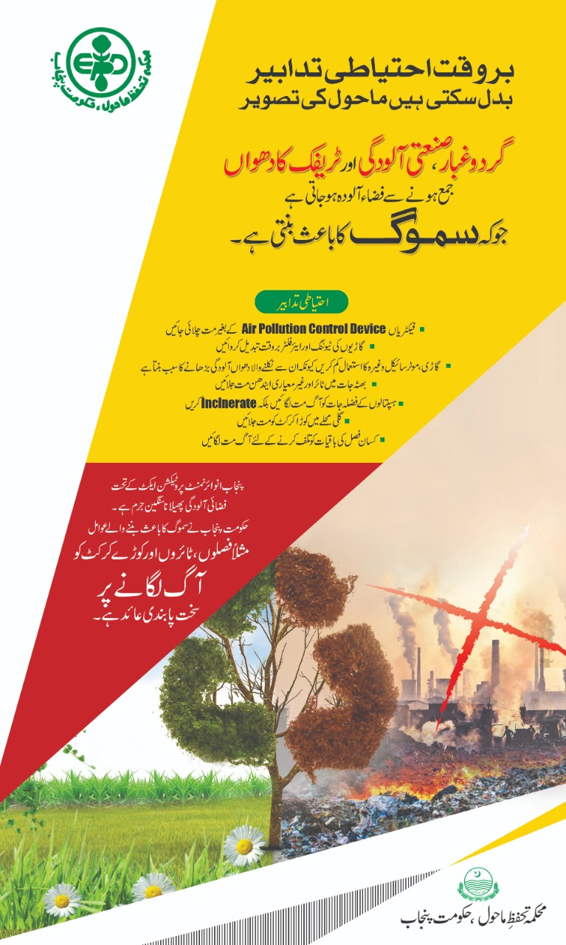
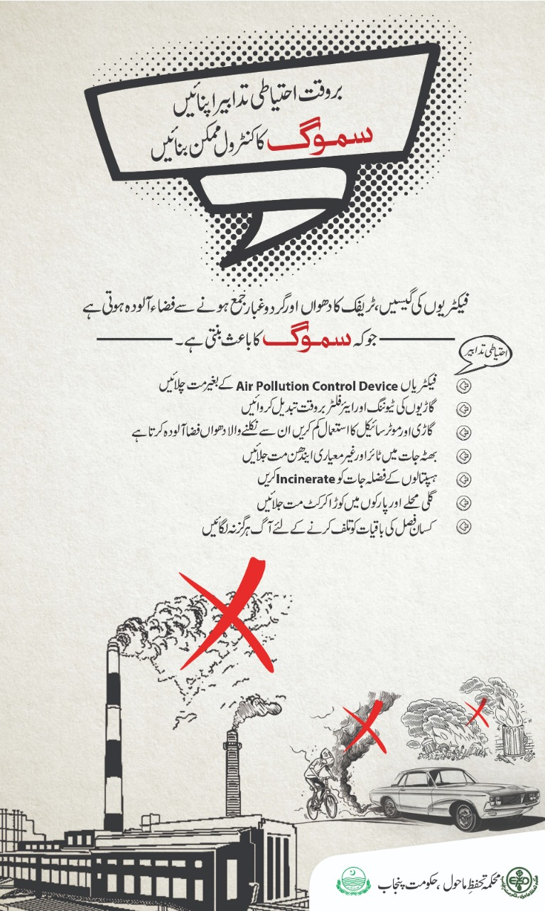
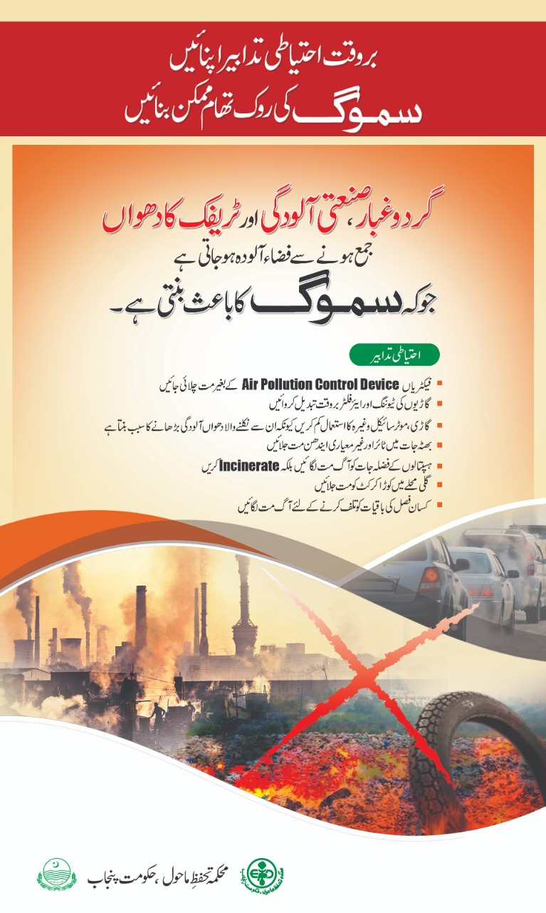
EPD Citizen Engagement

Slide 21
Pakistan Meteorological Department
Watching the weather conditions
Forecast smog intensity
Advice to government about weather patterns
Pre-Smog/Immediate Activities | During Smog Activities
Weather monitoring and alerts issuance. | Smog forecasting.

Slide 22
Transport Department
Established 27 Vehicle Inspection and Certification System (VICS) stations which are functional in 26 districts.
Steps are taken to shift focus on public transport
Plans are envisaged to introduce eco friendly buses in Lahore, Faisalabad and Bahawalpur. Piloting of electric buses will soon be done in Lahore
Enforcement teams of PTC, RTAs and Traffic Police are constituted and deployed at entry and exit points of Lahore and other cities to check violations

Slide 23
Agriculture
Major issue in the agriculture sector is the stubble burning. For this the following steps are taken by the agriculture department:
Awareness
Print Media: Publication of Ads, Feature, News Items
Display Boards: Display of smog related messages through burjis, boards, panaflexes
Electronic Media: Airing of TVC’s, jingles, and ads through TV channels
Social Media: Sharing of smog related material on facebook, twitter
Announcements: Announcements through speaker of the mosque
Awareness walks: Divisional, Districts, Tehsil and UC level
Village Committees: Constitution of committees comprising farmers, students and notables
Seminars: Holding of seminars on divisional, districts and tehsil level
Literature: Preparation and distribution of pamphlet, hand bills and brochures
Mechanisation: Fast paced mechanisms such as introduction of Straw Choppers

Slide 24
Local Government &Community Development / Waste Management Companies
(Initiatives to Combat Smog)
Manual and Mechanical sweeping of main roads
Scrapping and water sprinkling in dusty areas
Special cleanliness drive on entry and exit points of the city
Scrapping and sprinkling in areas where sand trolleys are being loaded
Challans on waste burning
Ensuring covers on sand and other construction material trolleys
Ensuring soil covering at landfill site
Public awareness at schools, commercial, residential and industrial sites
Fines on waste by enforcement wing
FIRs against improper handling of waste leading to Smog
Daily approx. 6000 tons of waste is finally disposed off at landfill site Lakhodair

Slide 25
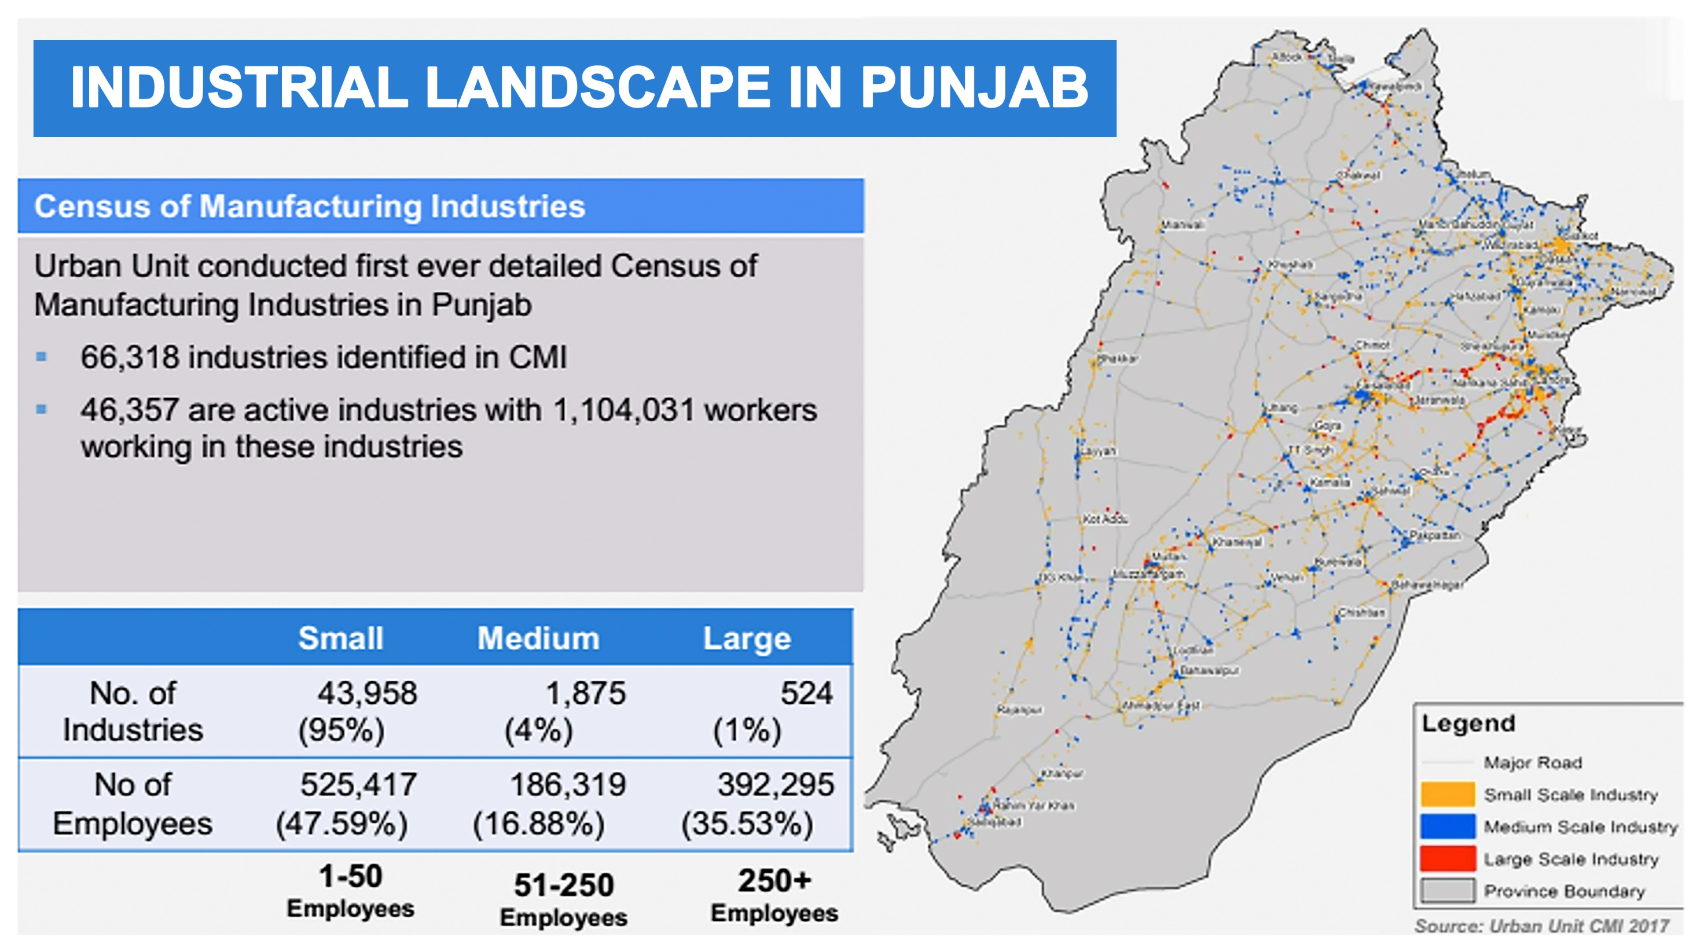
Industrial Landscape in Punjab
Source: Urban Unit CMI 2017

Slide 26
Industries, Commerce and Investment & Skills Development Department
Chambers of Commerce & Industry: Sensitise their members and relevant trade associations towards “Greening of Industrial Processes” by adopting environment friendly technologies / processes
Directorate General, IPWM, Punjab has been advised to pass instructions to field offices to remain in close liaison with local offices of EPD for identification of pollution emitting units
PIEDMC, FIEDMC & PSIC have been advised to ensure that Industrial units located within their respective industrial estates adopt pollution control measures and carry out periodic environmental audits along with EPD teams
PSIC is developing Surgical City, Sialkot to shift surgical industry from the urban area
PSIC has planned to develop Leather City, Kasur outside Kasur
Shifting of hazardous industries from urban area of Lahore to Sundar Industrial Estate

Slide 27
Smog Free Initiatives in Punjab
Energy Department projects completed up till now
Number of sites | Installed Capacity (MW) | Clean Units Produced (GWh) | GHGs Emission Reduced (million metric tons)
13,111 | 448.23 | 2203 | 1.3
Energy Department projects completed up till now
Number of sites | Installed Capacity (MW) | Units Produced (MWh) | GHGs Emissions Produced (million metric tons)
RLNG Bhikki | 1180 | 18,700 | 5.5
Source: EPD, Govt. of Punjab

Slide 28
Smog Free Initiatives in Punjab
Energy Department Renewable projects in Pipeline / Near Completion
Number of sites | Installed Capacity (MW) | Annual Est. Clean Units Production (GWh) | GHGs Emission Reduction ( metric tons)
1,720 | 43.38 | 60.7 | 36,055
95,237 Carbon credits being claimed by QASPL annually.
Source: EPD, Govt. of Punjab

Slide 29
Impact of Strategies
The strategies taken specifically to mitigate smog in Punjab has shown a little bit of improvement in the air quality index which is also evident from the chart. The smog which used to engulf Lahore and other major cities of Punjab by the end of October, hasn’t dawned yet which could also be attributed to the proactive approach of the government.
More relevant measures need to be taken to reach the safer air quality goals such as reduced fossil fuels dependence and moving towards renewable energy, controlled urbanization, stricter emission standards for vehicles, improvement of fuel quality and shifting of the industry away from the cities.
Source: EPD, Govt. of Punjab

Slide 30
Conclusion
The strategies adopted hitherto to cope with the smog problem are working to some extent. However, these efforts are not enough to improve the air quality index (AQI) and eliminate smog hazards. The Government and all sectors be it the media, industry, transport , farming, energy; have to realize that the future of new generation is at stake.

Slide 31
Way forward / Recommendations
The desired result cannot be achieved without political will, public cooperation and realization by all stakeholders, and this has to be done through cohesive and coercive efforts spread over short-medium-long term goals.
Public to be made aware of the importance of the public transport through print and electronic media
Vehicles which are either hybrid or fully electric should be promoted and taxes should be reduced on these vehicles
Strengthening and expanding vehicle inspection regime
Complete ban on burning of plastic waste
Cutting and burning of trees should be completely banned
Filters needs to be used to mitigate the effects of hazardous smoke from the factories

Slide 32
Way forward / Recommendations
A complete shutdown be imposed on the brick kilns in the months of November and December
Although billion tsunami tree plantation project started with a lot of fanfare, but as the time have passed the interest has gone down. Serious efforts are needed to restore the tree cover around the cities.
Agriculture land should not be urbanised without approval of all concerned departments
Air quality monitors are not functional. These should be made functional forthwith.
Live data should be made available in the control room of environment protection department for immediate response and the same should be made available to all stakeholders

Slide 33
Bibliography
Sources
Former Secretary, P&SHD, Govt of Punjab, Lahore, Dr. Naeem Rauf (2022, November 14-18). Smog mitigation strategy (Jawad Naqvi, Interviewer)
Former Secretary, P&SHD, Govt. of Punjab, Lahore, Imran Sikandar (2022, November 14-16). Health hazards of smog (Jawad Naqvi, Interviewer)
Director, Mr. Naeem Majeed, Bill Gates Foundation, Lahore (2022, November 14-16). Health hazards of smog (Jawad Naqvi, Interviewer)
sciencedirect.com
foreignpolicy.com
globalforestwatch.org

Slide 34
Thank You

