Slide 2
NATIONAL MANAGEMENT COLLEGE 117th National Management Course
Contemporary Issue Series Presentation
PAKISTAN REMOVED FROM FATF LIST:
WHAT WILL BE THE IMMEDIATE AND LONGER TERM PAY OFFS?
By
Sultan Omar, IB
Sponsor DS: Dr. Muhammad Ajmal
Date: 25-11-22

Slide 3
Acronyms
AML: Anti-Money Laundering
APG: Asia Pacific Group
CFT: Counter Financial Terror
DNFBPs: Designated Non-Financial Business and Professions
FATF: Financial Action Task Force
FBR: Federal Board of Revenue
FMU: Financial Monitoring Unit
JDP: Jamaat-ud-Dawa Pakistan
LeT: Lashkar-e-Taiba
NACTA: National Counter Terrorism Authority
NAP: National Action Plan
SBP: State Bank of Pakistan
SECP: Security Exchange Commission of Pakistan
STR: Suspicious Transaction Reports
UNSCR: United Nation Security Council Resolution

Slide 4
Scheme of Presentation
Financial Action Task Force (FATF)
Statement of Problem
Key Questions
Pakistan and FATF relationship
Immediate and long term pay offs
Analysis
Conclusion
Recommendations

Slide 5
Financial Action Task Force (FATF)
FATF is an intergovernmental organization mandated to promote effective implementation of Legal, regulatory and operational measures for combating money laundering and terror financing.
40 recommendations and their interpretive notes are together referred to as the FATF standards, which is considered the global standard in AML/CFT regulations

Slide 6
Statement of the Problem
Pakistan is facing daunting economic challenges like shrinking economy and balance of payment problem. The exclusion of Pakistan from FATF Grey list is the only Good news on an otherwise dark economic horizon. Removal of Pakistan from grey list has offered an opportune opening to take short and medium term measures for economic revival.

Slide 7
Key Question
How should Pakistan capitalize on this opportunity and revive its economy?

Slide 8
Pakistan FATF Timeline
FATF and APG has been working with Pakistan to improve its legislative and regulatory framework to align it with international standards. Pakistan was given a 27-point action plan which included full implementation of the targeted financial sanctions against all UN designated terrorists (UNSCR-1267and 1373). The timeline of Pakistan on FATF list.

Slide 9
Immediate and Long Term Pay Offs
Proscribed organizations upgraded from low/medium to high risk entities for greater scrutiny by institutions.
Government enacted about 14 laws and amendments to conform to FATF demands.
DNFBPs (Lawyers, Jewelers, Property dealers and brokers) ,DPMS (Dealers of precious stones and metals) conduct Customer Due Diligence (CDD) while dealing with their clients.
Banks, financial institutions keep an eye on their clientele with the help of database of “Pol­i­ti­cally Exposed Persons” (PEPs).

Slide 10
Immediate and Long Term Pay Offs
…Contd.
Pakistan received a reputational boost which augurs well for Pakistan's image which has been badly shaken by downgrading of Credit ratings.
The removal of Pakistan from Grey list has established the soundness and resilience of our financial system. Two large Pakistani banks, HBL and National Bank of Pakistan, paid $225 million in 2017 and $55 million in 2022 respectively in fines imposed by US regulators for compliance failures and anti-money laundering violations.
Removal is likely to strengthen market sentiments thereby increasing investor confidence and attracting foreign investment.

Slide 11
Immediate and Long Term Pay Offs
…Contd.
Grey listing has improved the working of regulatory authorities like SBP, SECP and FBR.
Money laundering prone sectors like real estate, Jewelry (DNFBPs) have been brought under the ambit of regulatory authorities.
Grey listing led to digitalization as implementation of new technologies were needed to meet FATF compliance requirements.

Slide 12
Immediate and Long Term Pay Offs
…Contd.
A number of high profile UN designated terrorists have been handed down tough sentences. These include Maulana Masood Azhar (Jaish-e-Muhammad), Hafiz Saeed (JDP), Zaki-ur-Rehman Lakvi (LeT), Haji Muhammad Ashraf (LeT), Arif Qasmi (LeT), Yahya Mujahid (JDP) and Hafiz Abdul Salam Bhuttavi (LeT).
De-listing will help movement of capital from undocumented to documented sectors of economy thus providing an impetus for economic recovery.

Slide 13
Analysis
ECONOMIC ANALYSIS
Pakistan’s presence on the ‘grey list’ between 2008 to 2019 resulted in cumulative GDP losses worth $38 billion. Exports and foreign direct investment also fell by 4.5 and 3.6 billion dollars respectively.
Source: https://www.tabadlab.com/wp-content/uploads/2021/02/Tabadlab-Working-Paper-07-Bearing-the-Cost-of-Global-Politics.pdf

Slide 14
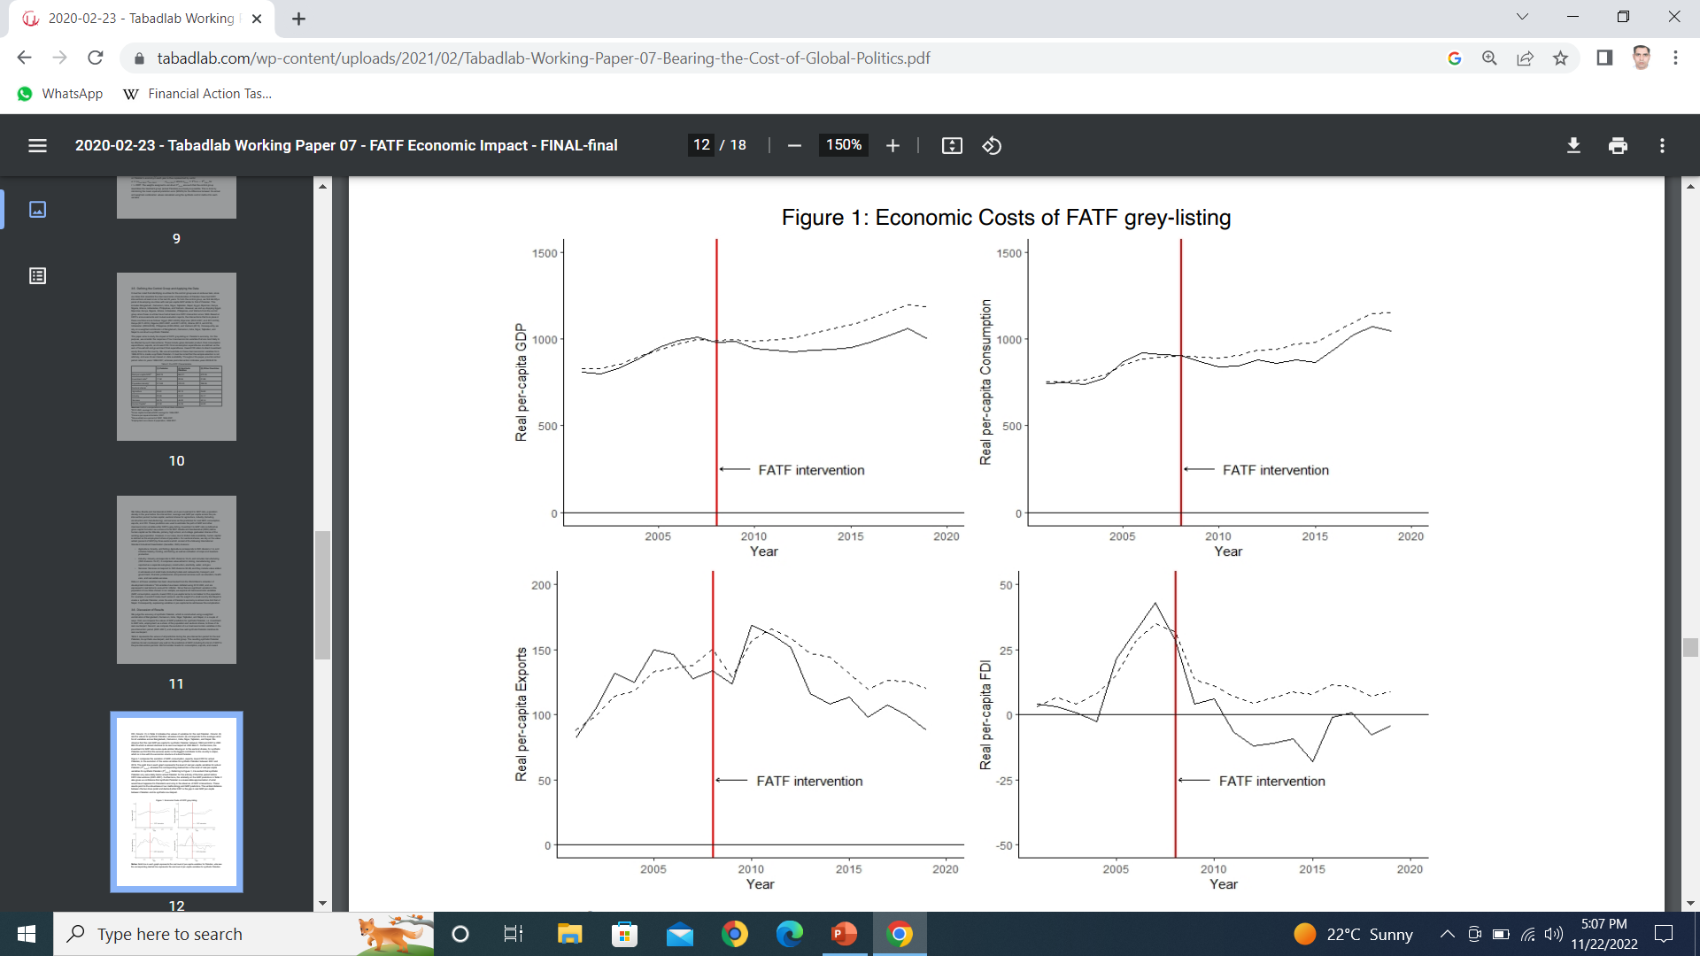
Synthetic Control Method Model for Pakistan and FATF
Economic Costs of FATF grey-listing
Real per-capita GDP
Real per-capita Consumption
Real per-capita FDI
Real per-capita Exports

Slide 15
Analysis
ECONOMIC ANALYSIS
Removal from grey list is not the panacea of our problems but it may provide basis to put economy on the right path. FATF Grey listing was not THE problem but one of the problems afflicting the economy.
Source: https://data.worldbank.org/indicator/NY.GDP.PCAP.CD?locations=PK

Slide 16
Summary of Foreign Investment in Pakistan (2021-2023)

Slide 17
Pakistan Real GDP Growth (2017-2027)

Slide 18
Analysis
…Contd.
GEO-POLITICAL ANALYSIS
US and India spearheaded the move to put Pakistan on grey list. In 2022 even when Pakistan had fully implemented FATF action plan (27+7) it was not removed from grey list until Hafiz Saeed was handed down 33 years prison sentence. This clearly showed that Grey listing of Pakistan was not an economic but rather a geo-political decision.
Pakistan could have exited grey list earlier if it had only convicted Hafiz Saeed and not implemented even a single FATF recommendations.

Slide 19
Conclusion
Removal of Pakistan from FATF list has given an opportunity to realize the full potential of Pakistani economy. However in order to attain this goal Pakistan should also institute corresponding economic and structural reforms .De-listing from grey list alone is not enough but in conjunction with economic reforms it can usher in an era of economic growth and prosperity.

Slide 20
Recommendations
Institutions should enhance coordination to strength financial system. Institutional coordination led to exit from grey list and same is needed to stay out of grey list.
MOUs be signed with countries where Pakistani wealth has been transferred to prosecute individuals involved in money laundering.
Closer links be forged with important countries based upon economic interests Geo-economic instead of geo strategic policy is the need of the hour.

Slide 21
Recommendations
…Contd.
Pakistan should undertake economic and structural reforms to revive the economy.
Pakistan should take steps to control extremism by implementing National Action Plan.
Pakistan should stress upon documentation of economy.

Slide 22
Recommendations
…Contd.
FATF action plan has led to digitalization of economy and the same can help us move towards a cashless economy.
Pakistan should stop punching above its weight. Its strategic aims should be rationalized with its economic resources.

Slide 23
Bibliography
https://dailytimes.com.pk/1016455/removal-from-grey-list-implications-for-pakistan/
https://www.educba.com/grey-list/
https://nacta.gov.pk/wp-content/uploads/2021/09/Pakistan-in-the-FATF-Grey-list.pdf
https://www.dawn.com/news/1694958
https://mettisglobal.news/fatfs-grey-list-pakistan-on-pin-and-needles-since-2008/
https://www.piia.org.pk/pakhz-pdf/008-Pakistan%20FATF%20Conundrum.pdf
http://www.ipripak.org/wp-content/uploads/2018/10/Article-2-2-Oct-2018-ED-SSA.pdf
https://www.fatf-gafi.org/about/
https://www.fatf-gafi.org/about/
https://www.fincen.gov/resources/international/financial-action-task-force
https://www.reuters.com/world/asia-pacific/pakistan-taken-off-global-watchdogs-grey-list-terrorism-financing-2022-10-21/
https://www.thehindu.com/news/international/terror-financing-watchdog-fatf-removes-pakistan-from-grey-list/article66041564.ece
file:///C:/Users/Sultan%20Omar/Desktop/FATF%20Recommendations%202012%20(1).pdf
https://www.usnews.com/news/world/articles/2022-10-20/explainer-pakistan-hopes-to-get-off-global-dirty-money-watchdogs-grey-list
Pakistan: Tackling FATF challenges & solutions by Huzaima Bukhari (Author), Dr. Ikramul Haq (Author), Abdul Rauf Shakoori (Author)
https://data.worldbank.org/indicator/NY.GDP.PCAP.CD?locations=PK
https://economictimes.indiatimes.com/news/international/world-news/pakistan-hit-with-38bn-loss-due-to-fatf-grey-list/articleshow/83867954.cms?from=mdr

Slide 24
Thank You

Slide 25
Legal Amendments & Rules Regs
Sr. | Act | Rules & Regulations
1 | Anti Money Laundering Act Amendments (Phase-1) | ToRs for Pakistan Post Supervisory Board ToRs for CDNS Supervisory Board Regulations of Pakistan Post & CDNS Sanctions Paper High Risk Country Paper - Counter Measures Document MLA Rules Nomination of SECP for DNFBPs Notification of General Committee SBP AML & CFT rules SECP AML & CFT rules SECP rules for oversight body DNFBP regulations Jewelers/ real estate DNFBPs regulations for Accountants Regulations for ICAP & ICMAP TFS reporting SRO issued by SECP Amendments in LLP Regulations Amendments in Companies Incorporation Regulations Foreign Companies Regulations General provision of form Regulations (Beneficial Ownership) Amendments in LLP Regulations Rules for Waqfs, Trusts & Cooperatives AML seized properties mgmt rules 2021
2 | Foreign Exch Reg Act Amendments
3 | Customs/ Income Tax Act Amendments
4 | Mutual Legal Asst Act (New & Amendments 2021)
5 | Anti Terrorism Act Amendments (Phase-1)
6 | UN SC 1948 Act Amendments
7 | Anti Terrorism Act Amendments (Phase-2)
8 | Companies Act Amendments
9 | Ltd Liabilities Partnership Act Amendments
10 | Con of Narco Substance Act Amendments
11 | Criminal Procedure Code (CrPC) Amendments
12 | Anti Money Laundering Act Amendments (Phase-2)
13 | Waqfs, Trusts and Cooperatives Acts Amendments (Provinces)
14 | Waqfs, Trusts and Cooperatives Acts Amendments (ICT)

Slide 26
FEB 28,2008
Pakistan was placed on the FATF grey list after being unable to meet the standard that Anti-Money Laundering and Combating Financing of Terrorism had asked.
JUNE, 2010
Pakistan was taken off the FATF monitoring list after the country showed progress in AML and CFT regime and enacted a permanent law against money laundering

Slide 27
FEB, 16, 2012
Pakistan was placed on the FATF grey list again for not complying with the standards to combat money laundering and terrorist financing
FEB 26, 2015
Pakistan was removed from grey list after it was able to establish a legal and regulatory framework to meet the commitments to the FATF’s action plan
JUNE 28, 2018
Pakistan was placed on the grey list again with the reasoning that the country failed to act against terror financing on its soil
AUG 16, 2018
Deficiencies were found in Pakistan’s FATF action plan after a 12-days inspection

Slide 28
MARCH 8, 2019
High risk banned outfits agreed to comply with FATF terms
JULY 25, 2019
FATF cell was set up at the Federal Board of Revenue (FBR) to deal with terror financing
AUG 25, 2019
PM Imran Khan sets up a body to help meet FATF targets.
OCT 18, 2019
Pakistan is urged to complete an action plan by February 2020 while staying on grey list

Slide 29
OCT 29, 2019
FATF cell is established in the interior ministry to ensure implementation of the action plan
FEB 21, 2020
FATF keeps Pakistan on grey list till June, stressing further actions
JUNE 24, 2020
The FATF’s virtual plenary meeting does not take up Pakistan’s case
OCT 6, 2020
The Securities and Exchange Commission of Pakistan (SECP) met all FATF conditions

Slide 30
OCT 23, 2020
Pakistan is kept on the grey list even after successfully complying with 21 out of 27 points
NOV 19, 2020
Jamaat ud Dawa (JDP) chief Hafiz Saeed is convicted in another terror financing case, and sentenced to 5 and a half years in prison
JAN 8, 2021
The State Bank of Pakistan (SBP) amends AML regulations to comply with FATF demands
JAN 8, 2021
Lahore anti-terrorism court sentences proscribed organization Lashkar-e-Taiba’s (LeT) Zakiur Rehman Lakhvi to 5 years imprisonment for terror financing.

Slide 31
FEB 25,2021
Pakistan remains on the grey list as FATF claims the country failed to complete unmet action plan targets
MAY 19,2021
MAY 19,2021
The Federal Investigation Agency (FIA) sets up special squad to curb money laundering.
JUNE 25,2021
A single unmet action plan keeps Pakistan on the grey list
JULY 4, 2021
JULY4,2021
The National Accountability Bureau (NAB) sets up a cell to counter terror financing, money laundering.

Slide 32
OCT 21, 2021
FATF says Pakistan will continue to be on its increased monitoring list as it was yet to fully implement the action plan
March 4, 2022
FATF retains Pakistan on its terrorism financing grey list and asks to address the remaining deficiencies in its financial system
April 8, 2022
Hafiz Saeed is Sentenced to 33 years in jail
JUNE 14, 2022
Pakistan has been found in compliance with all 34 action-items as required by FATF and is removed from the grey-list.

Slide 33
FATF 27-Points Action Plan for Pakistan
Understanding risks categorized under Counter Financing of Terrorism (CFT) by the Financial Sector;
Outreach sessions of Anti Money Laundering (AML) and CFT for the financial institutions;
Developing on integrated database at airports;
Mechanisms to publicize designated persons and entities;
Terrorists Financing (TF) specific units and analysis done by Financial Monitoring Unit (FMU) and State Bank of Pakistan (SBP);
Audit of financial institutions by the State Bank of Pakistan;
Suspicious Transaction Reports (STRs) disseminations and analysis done by FMU;
Terror financing risk assessment and its implementation;
Inter coordination mechanism of Federal and Provincial departments;
Parallel investigations by Counter Terrorism Departments (CTDs);
Risk assessment of cash smuggling;
Implementation of domestic cooperation to counter cash smuggling;

Slide 34
Understanding TF by the judiciary through conducting awareness and training sessions;
Risk based outreach of Designated Non-Banking Financial Institutions (DNBFIs) and Non-Profit Organizations (NPOs);
Pakistan will have to demonstrate effectiveness of sanctions including remedial actions to curb terrorist financing in the country;
Pakistan will have to ensure improved effectiveness of for terror financing of financial institutions with particularly to banned outfits;
Pakistan will have to take actions against illegal Money or Value Transfer Services (MVTS) such as Hundi Hawala.
Pakistan will have to place sanction regime against cash couriers;
Pakistan will have to ensure logical conclusion from ongoing terror financing investigation of Law Enforcement Agencies (LEAs) against banned outfits and proscribed persons;
Pakistani authorities will have to ensure international cooperation-based investigations and convictions against banned organizations and proscribed persons;

Slide 35
The country will have to place effective domestic cooperation between FMU & LEAs in investigation of terror financing;
Prosecution of banned outfits and proscribed persons;
Demonstrate convictions from court of law of banned outfits and proscribed persons;
Seizure of properties of banned outfits and proscribed persons;
Conversion of madrassas to schools and health units into official formations;
To cut off funding of banned outfits and proscribed persons;
Pakistan will have to place permanent mechanism for management of properties and assets owned by the banned outfits and proscribed persons;

