Slide 1
NATIONAL MANAGEMENT COLLEGE 117th NMC
Contemporary Issue Series Presentation
Dengue Resurgence in Pakistan: Challenges & Solutions
By
Muhammad Kamran Khan, PSP
Sponsor DS: Dr. Naveed Ahmad Chaudhry
Dated: 18-11-2022

Slide 2
Acronyms
CERC | Central Emergency Response Committee
DENV | Dengue Virus
IPH | Institute of Public Health
KP | Khyber Pakhtunkhwa
LG&CD | Local Government and Community Development
PDMA | Provincial Disaster Management Authority
PITB | Punjab Information Technology Board
R&D | Research and Development
SOPs | Standard Operating Procedures
WHO | World Health Organization
WOG | Whole of the Govt.
WOS | Whole of the Society

Slide 3
Sequence of the Presentation
Introduction
Statement of Problem and Key Questions
Situational Analysis
Challenges
Conclusion
Recommendations
Bibliography

Slide 4
Introduction
Dengue is a viral infection, transmitted by mosquito types Aedes Aegypti & Aedes Albopictus, through four serotypes of dengue virus i.e. DENV-1, DENV-2, DENV-3 & DENV-4
Vectors are living organisms that can transmit infectious pathogens between humans, or from animals to humans
Vector Surveillance involves the regular and systematic collection analysis and interpretation of entomological data for health risk assessment and for planning, implementation, monitoring and evaluating vector control
Source:
Ali, J. (30 Sep. 2015). Dengue fever in Pakistan: Challenges, priorities and measures. Journal of Coastal Life Medicine.
World Health Organization. (2022, Oct. 13). Dengue - Pakistan. Retrieved from https://www.who.int/emergencies/disease-outbreak-news/item/2022-DON414#:~:text=Between%201%20January%20and%2027,the%20month%20of%20September%20alone.
Park, D. J. (Jan. 2015). Preventive and Social Medicine.

Slide 5
Statement of the Problem
Pakistan has been witnessing sporadic and endemic outbreak of dengue since 2010. Provinces have been managing these sporadic surges but, since 2021, the outbreak of dengue has simultaneously resurged in provinces despite having experience and prevention & control mechanisms.

Slide 6
Key Questions
What are the driving factors leading to dengue resurgence: A comparative analysis with Lahore Model-2011?
How dengue resurgences can be prevented?

Slide 7
Situational Analysis

Slide 8
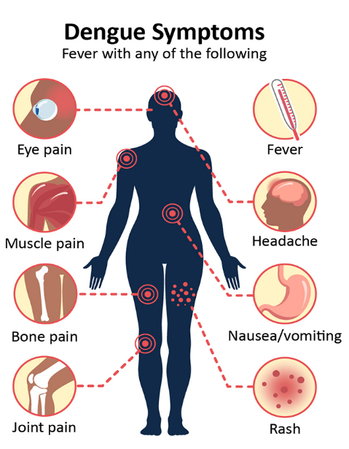
Environmental Factors
Tropical and Sub-Tropical regions
Its life span is influenced by temperature and humidity
Survives best between 16℃ – 30℃
Relative humidity of 60-80%
Eggs can survive up to 6 months to a year
Source:
Centers for Disease Control and Prevention. (2021, September 20). Retrieved from cdc.gov: https://www.cdc.gov/dengue/symptoms/index.html
Park, D. J. (Jan. 2015). Preventive and Social Medicine.

Slide 9
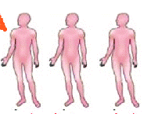
Transmission
Treatment
Mosquito: Aedes Aegypti
No specific medicine
Symptomatic treatment
Pain Management
Don’t take Aspirin
Dengvaxia vaccine
Mosquitoes bite dengue
infected person
Mosquitoes ingest blood with dengue
viruses & become dengue transmission vectors
Dengue vector mosquito bite
another healthy person
Mass transmission of
dengue by mosquitoes
Infected person becomes
Dengue carrier
Source:
Cheng, H. F., Yang, Y. C., Yeh, M. K., & Chen, Y. C. (July 2017). The regulation requirement of dengue vaccines. ResearchGate.
World Health Organization. (2022, Oct. 13). Dengue - Pakistan. Retrieved from https://www.who.int/emergencies/disease outbreaknews/item/2022DON414#:~:text=Between%201%20January%20and%2027,the%20month%20of%20September%20alone.

Slide 10
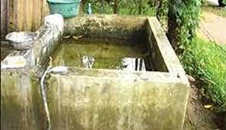
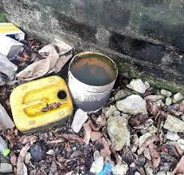
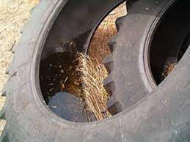
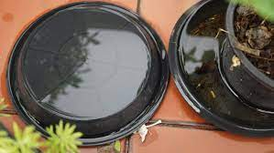
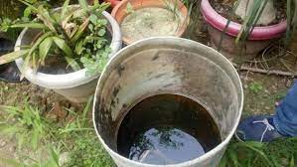
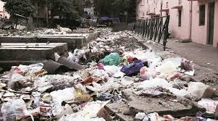
Preferred Breeding Sites
Old tyres
Uncovered laundry tanks / barrels
Discarded buckets
Pet dishes
Construction blocks
Discarded bottles
Tree holes
Flower pots
Desert water coolers
Fridge trays
Sources: Park, D. J. (Jan. 2015). Preventive and Social Medicine.

Slide 11
Dengue stages & requisite strategy for elimination of vector
Vector Stage
Strategy
Eggs
1.
Mechanical cleaning from sides of container with hard brush
Needs dedicated surveillance activities all year round for a more pro-active approach towards Dengue control to deny breeding spaces
Larvae
2.
Physical removal of water from containers
Pupae
3.
Chemical removal of larvae and pupae
Chemical treatment
Fogging
Adult Mosquito
4.
Adult Mosquitoes
Indoor Residual Spray of indoor places
Fogging in respective sites only
Removal of Solid Waste

Slide 12
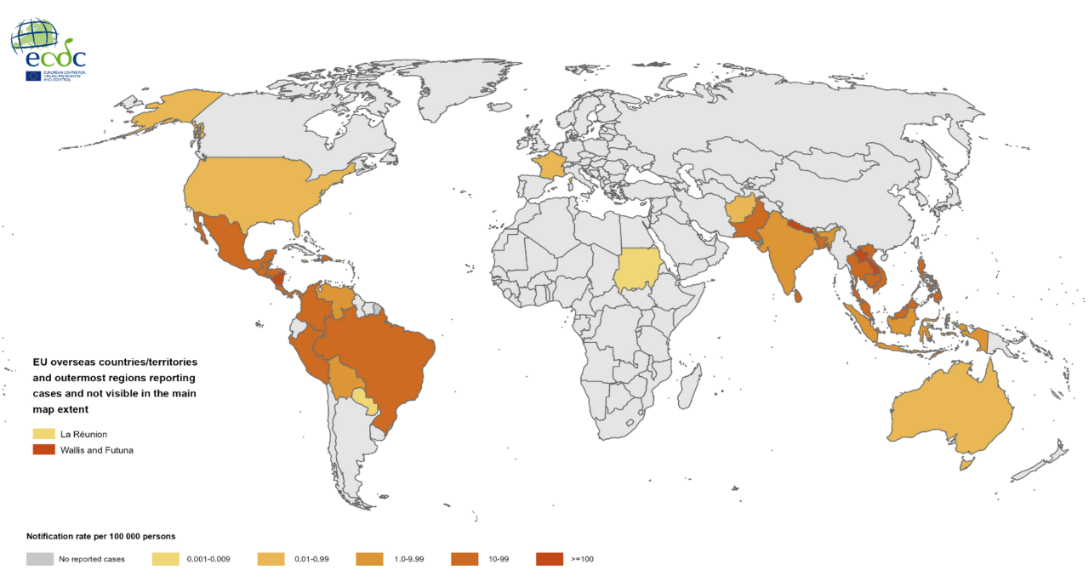
Geographical distribution of dengue cases reported worldwide, August to October 2022
Source: European Centre for Disease Prevention and Control (ECDC) . (2022). Geographical distribution of dengue cases reported worldwide. Retrieved from https://www.ecdc.europa.eu/en/dengue-monthly

Slide 13
Geographical distribution of dengue cases reported in Asia 2022
5th Highest
Source: European Centre for Disease Prevention and Control (ECDC) . (2022). Geographical distribution of dengue cases reported worldwide. Retrieved from https://www.ecdc.europa.eu/en/dengue-monthly

Slide 14
1994: First confirmed dengue case
2005: Karachi (Around 6,000 cases and 52 deaths)
Source:
Sherdil, K., Naru, F., & Rajwana, A. (2011). Dengue prevention & control: The Lahore model of success. Lahore: Provincial Disaster Management Authority.
Khan, U., & Azeem, S. (31 Mar 2022). The rising toll of dengue cases in Pakistan every year: An incipient crisis. National Library of Medicine.
European Centre for Disease Prevention and Control (ECDC) . (2022). Geographical distribution of dengue cases reported worldwide. Retrieved from https://www.ecdc.europa.eu/en/dengue-monthly NCBI. (2022). Dengue cases reported in Pakistan. Retrieved from https://www.ncbi.nlm.nih.gov/core/lw/2.0/html/tileshop_pmc/tileshop_pmc_inline.html?title=Click%20on%20image%20to%20zoom&p=PMC3&id=8783977_gr1_lrg.jpg

Slide 15
Source:
KP, I. V. (2022, Nov.). Dengue Action Plan & Dengue Situation / Activities in KP. Peshawar, Khyber Pakhtunkhwa.
Shah, S. A. (2022, October 05). Balochistan reports 4,000 dengue cases. Retrieved from https://tribune.com.pk/story/2380208/balochistan-reports-4000-dengue-cases
Pakistan Today. (2022, September 28). Balochistan continues to see surge in dengue cases. Retrieved from https://www.pakistantoday.com.pk/2022/09/28/balochistan-continues-to-see-surge-in-dengue-cases/
Mohamed, M. A., Qazi, U., Latif, A., Khan, I. U., & Anwar, S. (Mar. 2020). Dengue Outbreak Response and Control in Khyber Pakhtunkhwa, Pakistan: A Mixed Methods Study. Journal of Epidemiology and Global Health, 74-81.
Federal Disease Surveillance & Response Unit, NIH. (2019). Sindh- Field Epidemiology Report. Islamabad: National Institute of Health (NIH), Islamabad

Slide 16
Resurgence
Dengue 2021
Dengue 2022
Total cases reported: 52,894
Total cases reported: 64,767
Fatalities: 224
Fatalities: 130
Source:
World Health Organization. (2021, December 14). Dengue fever - Pakistan. Retrieved from https://www.who.int/emergencies/disease-outbreak-news/item/dengue-fever-pakistan
World Health Organization. (2022, Oct. 13). Dengue - Pakistan. Retrieved from https://www.who.int/emergencies/disease-outbreak-news/item/2022 DON414#:~:text=Between%201%20January%20and%2027,the%20month%20of%20September%20alone.
Pakistan Red Crescent Societies. (2022). Pakistan: Dengue Response. Islamabad & Rawalpindi: IFRC.
APP. (2022, September 29). Dengue grips coastal belt in Balochistan. Retrieved from https://tribune.com.pk/story/2379153/dengue-grips-coastal-belt-in-balochistan
WHO. (2022). Dengue Situation Report- Balochistan, Integrated Disease Surveillance & Response. Quetta..
KP, I. V. (2022, Nov.). Dengue Action Plan & Dengue Situation / Activities in KP. Peshawar, Khyber Pakhtunkhwa.

Slide 17
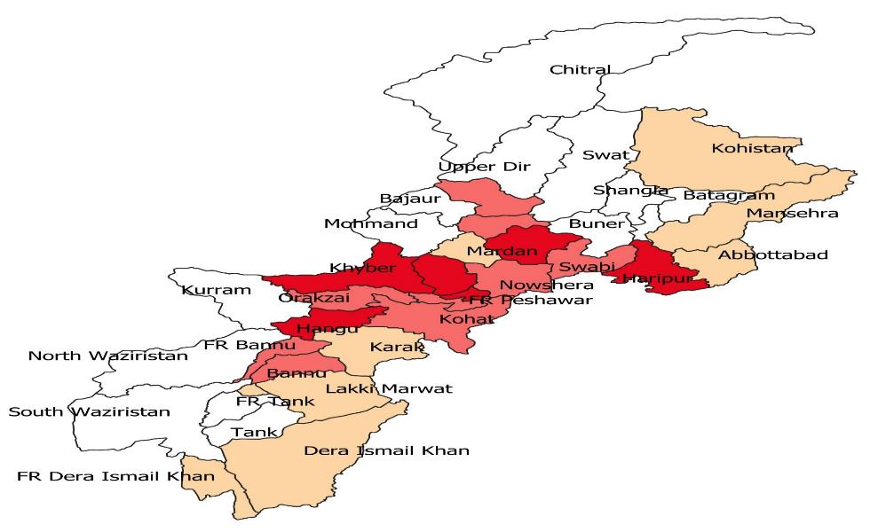
KP Dengue Cases-2022
District-wise Dengue Cases
Source:
KP, I. V. (2022, Nov.). Dengue Action Plan & Dengue Situation / Activities in KP. Peshawar, Khyber Pakhtunkhwa.
IDSRS. (2022). Integrated Disease Surveillance & Response System (IDSRS), Public Health Section, Directorate General Health Service KP. Peshawar.
Yusufzai, A. (2022, October 02). KP records year's highest single day dengue cases. Retrieved from https://www.dawn.com/news/1712975/kp-records-years-highest-single-day-dengue-cases

Slide 18
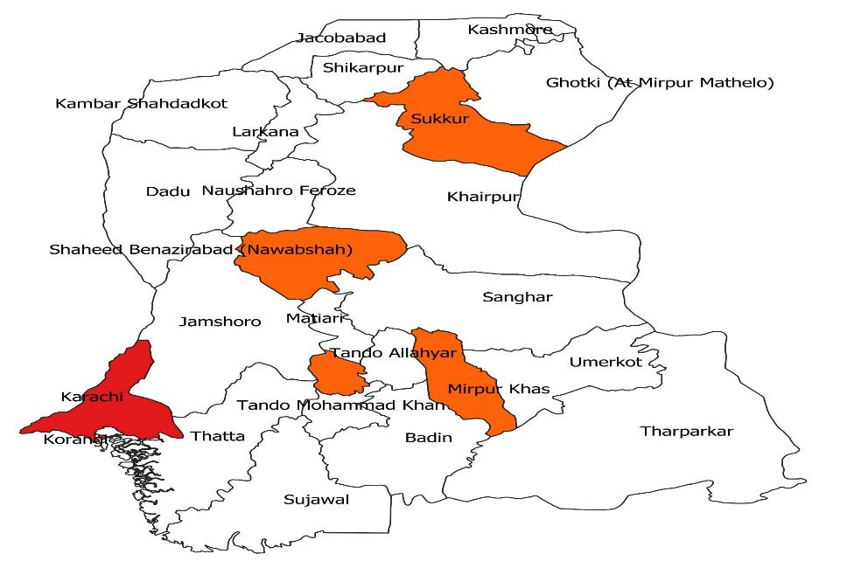
Sindh Dengue Cases-2022
District-wise
Dengue Cases
Source: Federal Disease Surveillance & Response Unit, NIH. (2019). Sindh- Field Epidemiology Report. Islamabad: National Institute of Health (NIH), Islamabad.

Slide 19
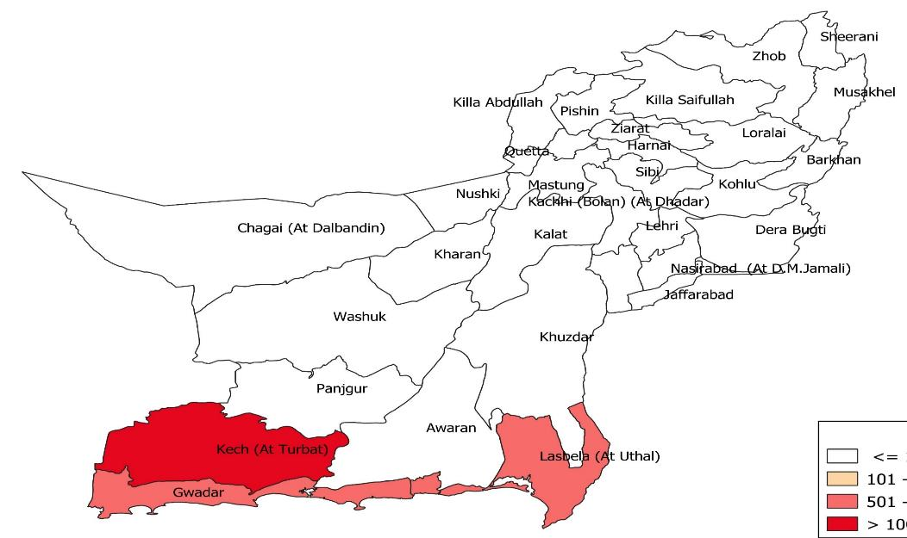
Balochistan Dengue Cases-2022
District-wise Dengue Cases
Source:
WHO. (2022). Dengue Situation Report- Balochistan, Integrated Disease Surveillance & Response. Quetta.
APP. (2022, September 29). Dengue grips coastal belt in Balochistan. Retrieved from https://tribune.com.pk/story/2379153/dengue-grips-coastal-belt-in-balochistan
Pakistan Today. (2022, September 28). Balochistan continues to see surge in dengue cases. Retrieved from https://www.pakistantoday.com.pk/2022/09/28/balochistan-continues-to-see-surge-in-dengue-cases/
Shah, S. A. (2022, October 05). Balochistan reports 4,000 dengue cases. Retrieved from https://tribune.com.pk/story/2380208/balochistan-reports-4000-dengue-cases

Slide 20
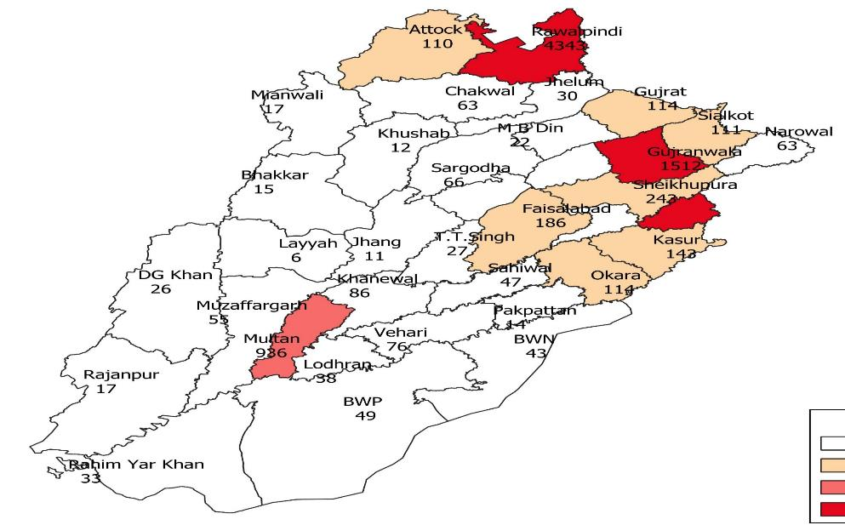
Punjab Dengue Cases-2022
District-wise Dengue Cases
Lahore
Sources:
Pakistan Red Crescent Societies. (2022). Pakistan: Dengue Response. Islamabad & Rawalpindi: IFRC.
District Emergency Response Committee. (2022). Disease Surveillance Dengue. Lahore.

Slide 21
Surveillance Phase
Treatment Phase
Corrective Phase
(Trainings & proactive measures)
Source:
Cabinet Committee Meeting (CCM). (2022). Disease Surveillance Dengue. Lahore.
Lodhi, A. (2022, November 02). Govt struggles to tackle dengue caseload. Retrieved from https://tribune.com.pk/story/2384258/govt-struggles-to-tackle-dengue-caseload

Slide 22
Comparative Analysis with Lahore Model (1/4)
Sr. No. | Driving Factors | Lahore Model (2011) | Resurgence ( 2022)
1 | Dengue Cases | 16,580/18,233 (91%) | 7,639/17,746 (43%)
2 | Deaths | 257/264 (97%) | 22/41 (53%)
3 | Vector Control & Surveillance | Partially Known (First Epidemic) Hit & Trial basis | Known SOPs & Lessons learnt Available
4 | Intl. Best Practices utilized | At a later stage Sri Lanka & Indonesia | Best Practices already available & practiced
5 | Third Party Validation | Special Branch, IB | Agriculture Deptt., LG&CD & IPH

Slide 23
Comparative Analysis with Lahore Model (2/4)
Sr. No. | Driving Factors | Lahore Model (2011) | Resurgence (2022)
6 | Stakeholder Engagement & Involvement | At grass-root level | At mezo-level
7 | Ownership & Approach | Led by Chief Minister CERC = 94 meetings All Line Departments WOG & WOS Approach | Primarily led by CS (few meetings by CM) (CM & Secretary tenure) All Line Departments Laid back approach
8 | Awareness Campaign | Yes (Reactionary but inclusive) | Yes (Proactive but non-inclusive)

Slide 24
Comparative Analysis with Lahore Model (3/4)
Sr. No. | Driving Factors | Lahore Model (2011) | Resurgence (2022)
9 | Media Role | Proactive & Reactive | Reactive
10 | Punitive Action | Epidemic Diseases Act 1958 (Amended in 2011) | Punjab Infectious Diseases (Prevention & Control) Act 2020
11 | Technological Interventions | Mapping of Dengue Cases only (PDMA/ PITB) | Anti-Dengue Tracking System (PITB)
12 | Budget | Available | Available

Slide 25
Comparative Analysis with Lahore Model (4/4)
Sr. No. | Driving Factors | Lahore Model (2011) | Resurgence (2022)
13 | Procurement | Urgent/ Need basis Logistical issues | Planned Procurement No logistical issues
14 | Larva/Vector Variant | No Local Research | Delayed
15 | Co-Epidemic | No | Yes (Covid-19 & Dengue)
16 | Climate Change | Normal Rains | Heavy Rains/ Flood
Source:
Former Secretary, P&SHD, Govt of the Punjab, Lahor, A. (2022, November 14-15-16). Dengue resurgence in Pakistan: Challenges & its solutions. (K. Khan, Interviewer)
Former Secretary, P&SHD,Govt. of the Punjab, Lahor, I. (2022, November 11-14-15-16). Dengue resurgence in Punajb and its challenges. (K. Khan, Interviewer)
Entomologist, S. (2022, November 14). Dengue Resurgence in Punjab, specifically in Lahore region. (K. Khan, Interviewer)
Sherdil, K., Naru, F., & Rajwana, A. (2011). Dengue prevention & control: The Lahore model of success. Lahore: Provincial Disaster Management Authority.
Special Branch. (2012). Anti Dengue Campaign. Lahore: Additional Inspector General of Police, Special Branch, Punjab.

Slide 26
Challenges
Lack of drive and ownership of political leadership
Non-effective implementation of SOPs (lessons learnt)
Focus shift due to Covid-19
Non-effective community engagement

Slide 27
Conclusion
Dengue has made an unusual resurgence in Pakistan due to multiple driving factors including but not limited to weak implementation of established political and administrative interventions, non-effective community engagements, record rains and focus shift due to Covid-19 pandemic.

Slide 28
Recommendations
Top leadership involvement enabling trickle down effect
Monitoring & Evaluation mechanisms with strict compliance of SOPs through integration of databases of all allied departments for bigdata analytics
Proper research and heatmapping of co-epidemic areas with time for better roster management and resource mobilization
Risk communication is important during post outbreak period which is a grace period given by nature to prevent the emergency of the next outbreak
Mass Awareness Campaign to drive behaviour change towards dengue and self-surveillance of household hotspots

Slide 29
Bibliography
Primary Sources:
Former Secretary, P&SHD, Govt. of the Punjab, Lahore, Imran Sikandar. (2022, November 14-15-16). Dengue resurgence in Punjab and its challenges. (Kamran. Khan, Interviewer)
Former Secretary, P&SHD, Govt of the Punjab, Lahore, Ali Jan Khan. (2022, November 11-14-15-16). Dengue resurgence in Pakistan: Challenges & its solutions. (Kamran. Khan, Interviewer)
Entomologist, Saba. (2022, November 14). Dengue Resurgence in Punjab, specifically in Lahore region. (Kamran. Khan, Interviewer)
Daily Dawn Correspondent, Khalid Husnain. (2022, November 12). Resurgent of Dengue in Pakistan. (Kamran. Khan, Interviewer)

Slide 30
Bibliography
Secondary Sources:
Abbasi, A. (2019, October 12). Story of how Shahbaz Sharif defeated dengue. Retrieved from https://www.thenews.com.pk/print/540019-story-of-how-shahbaz-sharif-defeated-dengue
Ali, J. (30 Sep. 2015). Dengue fever in Pakistan: Challenges, priorities and measures. Journal of Coastal Life Medicine.
APP. (2022, September 29). Dengue grips coastal belt in Balochistan. Retrieved from https://tribune.com.pk/story/2379153/dengue-grips-coastal-belt-in-balochistan
ARY News. (2022, October 14). Balochistan Reports 75 new Dengue cases. Retrieved from https://arynews.tv/balochistan-reports-75-new-dengue-cases/
Centers for Disease Control and Prevention. (2021, September 20). Retrieved from cdc.gov: https://www.cdc.gov/dengue/symptoms/index.html
Cheng, H. F., Yang, Y. C., Yeh, M. K., & Chen, Y. C. (July 2017). The regulation requirement of dengue vaccines. Researchgate.
District Emergency Response Committee. (2022). Disease Surveillance Dengue. Lahore.
Ebrahim, Z., & Zahidi, F. (2022, September 27). Dengue surges in waterlogged Pakistan in wake of floods. Retrieved from https://www.eco-business.com/news/dengue-surges-in-waterlogged-pakistan-in-wake-of-floods/#:~:text=The%20deluge%20in%20Pakistan%20left,diseases%20like%20malaria%20and%20dengue.
European Centre for Disease Prevention and Control (ECDC) . (2022). Geographical distribution of dengue cases reported worldwide. Retrieved from https://www.ecdc.europa.eu/en/dengue-monthly
Federal Disease Surveillance & Response Unit, NIH. (2019). Sindh- Field Epidemiology Report. Islamabad: National Institute of Health (NIH), Islamabad.
Government of Pakistan. (2019-2022). Pakistan Cases Details. Retrieved from https://covid.gov.pk/stats/pakistan
Hussain, M., Majeed, A., Imran, I., & Rasool, M. F. (12 December 2019). Dengue control in Pakistan: prior planning is better than controlling too late. The bmj.
IDSRS. (2022). Integrated Disease Surveillance & Response System (IDSRS), Public Health Section, Directorate General Health Service KP. Peshawar.
Islam, Z., Mohanan, P., Bilal, W., Hashmi, T., Rahmat, Z., Abdi, I., . . . Essar, M. Y. (2 Feb. 2022). Dengue Virus Cases Surge Amidst COVID-19 in Pakistan: Challenges, Efforts and Recommendations. Dove Medical Press Ltd., 367-371.
Khan, J., Khan, I., Ghaffar, A., & Khalid, B. (15 Jun. 2018). Epidemiological trends and risk factors associated with dengue disease in Pakistan (1980–2014): a systematic literature search and analysis. NCBI.
Khan, U., & Azeem, S. (31 Mar 2022). The rising toll of dengue cases in Pakistan every year: An incipient crisis. National Library of Medicine.
KP, I. V. (2022, Nov.). Dengue Action Plan & Dengue Situation / Activities in KP. Peshawar, Khyber Pakhtunkhwa.

Slide 31
Lodhi, A. (2022, November 02). Govt struggles to tackle dengue caseload. Retrieved from https://tribune.com.pk/story/2384258/govt-struggles-to-tackle-dengue-caseload
Mohamed, M. A., Qazi, U., Latif, A., Khan, I. U., & Anwar, S. (Mar. 2020). Dengue Outbreak Response and Control in Khyber Pakhtunkhwa, Pakistan: A Mixed Methods Study. Journal of Epidemiology and Global Health, 74-81.
Muhammad T Shakoor, S. A. (2012). Dengue fever: Pakistan’s worst nightmare. South-East Asia Journal of Public Health, 229-231.
NCBI. (2022). Dengue cases reported in Pakistan. Retrieved from https://www.ncbi.nlm.nih.gov/core/lw/2.0/html/tileshop_pmc/tileshop_pmc_inline.html?title=Click%20on%20image%20to%20zoom&p=PMC3&id=8783977_gr1_lrg.jpg
NHS. (2022, Jan 03). Pakistan reports over 52,000 dengue cases in 2021. Retrieved from https://www.geo.tv/latest/391391-pakistan-reports-over-52000-dengue-cases-in-2021
Pakistan Red Crescent Societies. (2022). Pakistan: Dengue Response. Islamabad & Rawalpindi: IFRC.
Pakistan Today. (2022, September 28). Balochistan continues to see surge in dengue cases. Retrieved from https://www.pakistantoday.com.pk/2022/09/28/balochistan-continues-to-see-surge-in-dengue-cases/
Park, D. J. (Jan. 2015). Preventive and Social Medicine.
Rather, I. A., Parray, H. A., Lone, J. B., Paek, W. K., Lim, J., Bajpai, V. K., & Park, Y. H. (2017). Prevention and Control Strategies to Counter Dengue Virus Infection. National Center for Biotechnology Information.
Shabbir, W., Pilz, J., & Naeem, A. (25 June 2020). A spatial-temporal study for the spread of dengue depending on climate factors in Pakistan (2006–2017). BMC Public Health, 995 (2020).
Shah, S. A. (2022, October 05). Balochistan reports 4,000 dengue cases. Retrieved from https://tribune.com.pk/story/2380208/balochistan-reports-4000-dengue-cases
Sherdil, K., Naru, F., & Rajwana, A. (2011). Dengue prevention & control: The Lahore model of success. Lahore: Provincial Disaster Management Authority.
Special Branch. (2012). Anti Dengue Campaign. Lahore: Additional Inspector General of Police, Special Branch, Punjab.
UNHCR. (2021, Jan 18). Pakistan: COVID-19 external update, December 2020. Retrieved from https://reliefweb.int/report/pakistan/pakistan-covid-19-external-update-december-2020
WHO. (10 January 2022). Dengue and severe dengue. https://www.who.int/news-room/fact-sheets/detail/dengue-and-severe-dengue.
WHO. (2022). Dengue Situation Report- Balochistan, Integrated Disease Surveillance & Response. Quetta.
World Health Organization. (2021, December 14). Dengue fever - Pakistan. Retrieved from https://www.who.int/emergencies/disease-outbreak-news/item/dengue-fever-pakistan
World Health Organization. (2022, Oct. 13). Dengue - Pakistan. Retrieved from https://www.who.int/emergencies/disease-outbreak-news/item/2022-DON414#:~:text=Between%201%20January%20and%2027,the%20month%20of%20September%20alone.
Yusufzai, A. (2022, October 02). KP records year's highest single day dengue cases. Retrieved from https://www.dawn.com/news/1712975/kp-records-years-highest-single-day-dengue-cases
Zahir, A., Ullah, A., Shah, M., & Mussawar, A. (2016). Community Participation, Dengue Fever Prevention and Control Practices in Swat, Pakistan. National Center for Biotechnology Information (NCBI), 39-45.

Slide 32
Thank you

Slide 33
Correlation between Dengue & Rain (Pakistan)
Timeline
Source:
Shabbir, W., Pilz, J., & Naeem, A. (25 June 2020). A spatial-temporal study for the spread of dengue depending on climate factors in Pakistan (2006–2017). BMC Public Health, 995 (2020).
Ebrahim, Z., & Zahidi, F. (2022, September 27). Dengue surges in waterlogged Pakistan in wake of floods. Retrieved from https://www.eco-business.com/news/dengue-surges-in-waterlogged-pakistan-in-wake-of-floods/#:~:text=The%20deluge%20in%20Pakistan%20left,diseases%20like%20malaria%20and%20dengue.

Slide 34
Co-epidemic (Dengue & Covid-19)
HR= 19,228
11,027 Contingent Paid Staff | 08 Ad-Hoc Staff
411 Contract Staff | 7,782 Regular Staff
Sources:
Islam, Z., Mohanan, P., Bilal, W., Hashmi, T., Rahmat, Z., Abdi, I., . . . Essar, M. Y. (2 Feb. 2022). Dengue Virus Cases Surge Amidst COVID-19 in Pakistan: Challenges, Efforts and Recommendations. Dove Medical Press Ltd., 367-371.
UNHCR. (2021, Jan 18). Pakistan: COVID-19 external update, December 2020. Retrieved from https://reliefweb.int/report/pakistan/pakistan-covid-19-external-update-december-2020
Government of Pakistan. (2019-2022). Pakistan Cases Details. Retrieved from https://covid.gov.pk/stats/pakistan

Slide 35
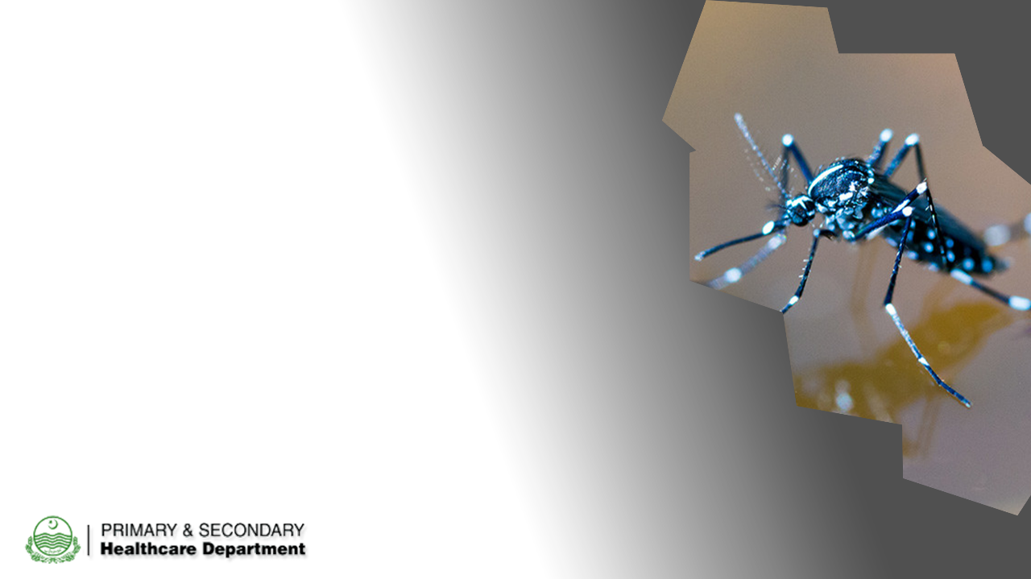
ANTI-DENGUE
TRACKING SYSTEM

Slide 36
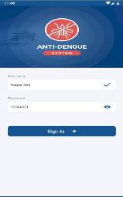
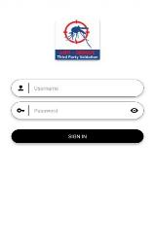
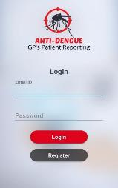
Dengue – Mobile Applications
Four Anti-Dengue Mobile Applications
Covering 36 Districts and 75+ Departments
Developed in-house
Anti-Dengue APP
TPV APP
Dengue GPs Reporting
Special Branch DVR
Anti-dengue mobile application developed for capturing real time information on prevention, larvae detection, case response and awareness activities.
Developed to monitor and evaluate the activities performed on anti-dengue APP regarding larvae, surveillance, and case response
Application has developed for General Practitioners so that they can report dengue patients
Designed and Developed for Special Branch

Slide 37
Dengue – Web Portal
Dengue Tracking System:
Data from all mobile application pushed in dengue tracking system which also serves as a dengue dashboard
Dengue Patient Portal:
Dengue patients through this portal from THQ, DHQ, Specialized Hospitals, Private Hospitals and Labs
Health CMS:
District and Department wise dengue complaints received via helpline or mobile app are processed through this portal
Vector Surveillance System:
Indoor and outdoor surveillance data entry and reports generation
Alert Generation Committee disseminates the daily alerts using vector surveillance system’s data

Slide 38
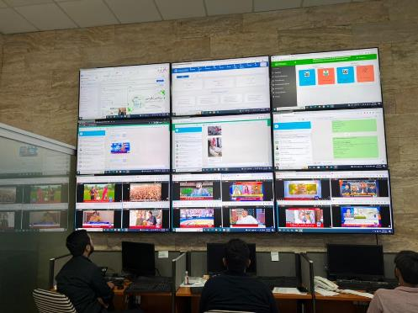
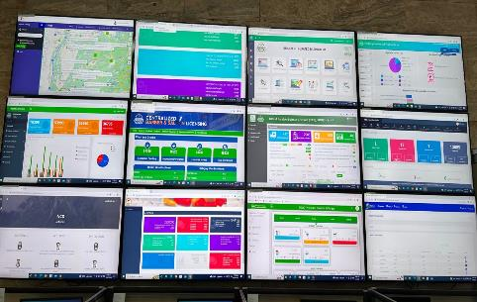
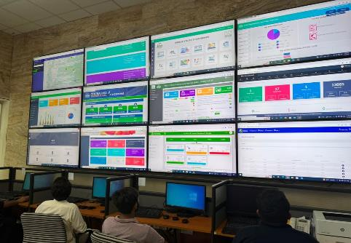
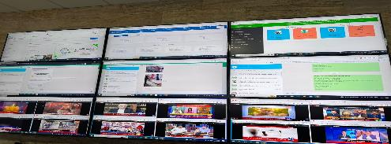
Real-time tracking through a provincial Command and Control Centre
The CCC monitors key dashboards, data, and information sources, and follows an escalation protocol to ensure real time monitoring, timely action

