Slide 1
NATIONAL MANAGEMENT COLLEGE 117th National Management Course
Social Movements as a Medium of Social Change - Case Study of
‘Black Lives Matter’ movement
By
Muhammad Bashir Khetran
(SG)
Sponsor DS: Dr. Naveed A Chaudhary
Dated: 24th November, 2022

Slide 2
Acronyms
BLM-Black Lives Matter
BLMGNF-BLM Global Network Foundation
PTM-Pashtoon Tahfuz Movement
YDA-Young Doctors Association
APCA-All Pakistan Clerk Association

Slide 3
Sequence of Presentation
Introduction
Statement of Problem
Key Questions
Scope
Analysis
Social Change
Social Change in Pakistan
Conclusion
Recommendations
Bibliography

Slide 4
Definitions
Social movement “a loosely organized but sustained campaign in support of a social goal, typically either the implementation or the prevention of a change in society’s structure or values.” Britannica
Social change “the alteration of mechanisms within the social structure, characterized by changes in cultural symbols, rules of behaviour, social organizations, or value systems.” Britannica

Slide 5
Contd..
Racism “belief that humans may be divided into separate and exclusive biological entities called “races”; that there is a causal link between inherited physical traits and traits of personality, intellect, morality, and other cultural and behavioral features; and that some races are innately superior to others”- Britannica

Slide 6
Contd..
Systemic Racism “ Perpetuation of discrimination on the basis of “race” by political, economic, or legal institutions and systems.
According to critical race theory, institutional racism reinforces inequalities between groups—e.g., in wealth and income, education, health care, and civil rights—on the basis of the groups’ perceived racial differences”-Britannica

Slide 7
Introduction
Slavery
Abolitionism
Civil War
Reconstruction
Neo-slavery
Jim Crow (segregation)
Civil rights movement
Mass incarceration
1979 New Social Movements
Barak Obama and 1st Attorney General of US Eric Himpton Holder Jr.

Slide 8
Black Lives Matter Movement
Opal Tometi Alicia Garza and Patrisse Cullors founded the Black Lives Matter movement in July, 2013
Trayvon Martin killed by George Zimmerman birth of #BlackLivesMatter hashtag
Hit the headlines in 2020 after the killing of George Floyd
Killing of Ahmaud Arbery and Breonna Taylor led to widespread protests against police violence and racism.
Black Movement has grown to 40 chapters

Slide 9
Relevance with Pakistan
Large scale movement slow but steady
First decade
Lawyer’s movement, Anti-privatization, regional and city agrarian, public sector employees, ethno-nationalist uprisings
Last decade conscious effort of integration, tech-savvy youth
PTM, YDA, APCA, Student’s Movements
Naqeebullah Mehsood v/s SSP Rao Anwar
Enforced disappearances

Slide 10
Statement of Problem
Black Lives Matter Movement emerged on social media as reaction to killing of African Americans in the United States by the agents of state and others. The lives of Black continue to be blighted by systemic racism, lack of opportunity, sectoral disparities, and prevalence of violence.

Slide 11
Key Questions
Has Black Lives Matter movement succeeded in bringing social change and how it is relevant to Pakistan?

Slide 12
Scope
Scope of this presentation will be limited to systemic racism in US by:
Police
Racism in different sectors
Pakistani context

Slide 13
Analysis
40 chapters now a Global Network
Youth and social media intelligently being used
Loose and decentralized local chapters starfish model and ‘leaderful’
The movement is still dependent on big corporations for funding
Criticism in media about misuse of funds

Slide 14
Continued
The legacy of slavery and Jim Crow laws has left a residue of systemic racism in the United States that has devalued the lives of African Americans.
Once Civil War was over, the confederate soldiers became police officers and judges.
Qualified immunity policies make it difficult to indict police officers.
In Pakistan’s context immunity to armed forces and missing persons

Slide 15
Racism and Police
Black account less than 13% of the U.S. population, but are killed at more than twice the rate of White Americans
1000 people on average killed by police in US
An analysis by the advocacy group Mapping Police Violence
99 percent of police killings from 2014 to 2019 did not result in officers being charged with, let alone convicted of a crime
Source: https://www.washingtonpost.com/graphics/investigations/police-shootings-database/

Slide 16
Other Areas
Criminal justice system
For similar kind of a crime - black as compared to white has to face longer period of sentence
1 in every 3 black American has to spend time in prison
Wages in labor market black v/s white
White Americans hold 84.2% of US assets black 4.8%
During covid-19
Disproportionately higher stay and higher death rate (1/1625,1/3800)
Source: https://www.vox.com/2020/6/17/21284527/systemic-racism-black-americans-9-charts-explained

Slide 17
Results Social Change
“Register to Vote” webpage a resource on voter education and resources.
Historic turnout fueled by Black voters to flip a state like Georgia where 43% of all Democratic votes were cast by Black people
The George Floyd Justice in Policing Act was passed as result of struggle of BLM
Draft Breathe Bill

Slide 18
Results Social Change
In a study, municipalities where protests have been held experienced 20% decrease in killings by police
The study compared police killings in cities that experienced BLM protests with those that did not
Local protests and modern policing i.e. body-worn cameras and community-policing
Source: https://www.scientificamerican.com/article/killings-by-police-declined-after-black-lives-matter-protests1/

Slide 19
Results Social change
Strong footprint on social media
#BlackLivesMatter
47.8 million times on Twitter – an average 3.7 million times per day – from May 26 to June 7, 2020
In second half of 2020
the BLMGNF website was visited by 24 million
June 2, 2020, with 1.9 million visitors
Source: BLM impact report 2020.

Slide 20
Results Social Change
15 to 26 million people demonstrated in 550 U.S. cities after death of George Floyd
Citizen journalism, smartphone and social media
Monuments of confederacy removed
source: https://edition.cnn.com/2022/02/02/us/confederate-monuments-removed-2021-whose-heritage/index.html

Slide 21
Change in Pakistan
PTM after days sit in regarding SSP Rao Anwar
Lawyers movement restoration of Ex-Chief Justice
Authoritarianism and enforced disappearances
Commission on missing persons
Aghaz-e-Huqooq Balochistan 1st and 2nd phase
Sothern Balochistan Development Package
We are sitting on a time bomb
Land holdings
Wealth concentration and Shrinking Middle class
Out of Pocket expenditure

Slide 22
Conclusion
Black Lives Matter has undoubtedly shaped the way American view racial inequality. The Movement has evolved from social media posts to a global civil rights movement. In this respect social movements in Pakistan too have made significant achievements but a lot has to be done.

Slide 23
Recommendations
Societal dialogue
Broad-based dialogue on reforms to address the root causes of the systemic racism
Accountability
Law enforcement agencies
Police Oversight Boards, body-worn cameras etc.
FastTrack disposal of litigation cases
Alternate Dispute Resolutions
Monuments and symbols of confederacy
Political Action Committee, political empowerment/Participation
Local government

Slide 24
Contd…
Example of Germany-Americans need to forget legacy of slavery
Economic empowerment-self reliance of marginalized segments of society
Equitable distribution of resources and opportunities
Social media and black youth engaged-keep on growing

Slide 25
Bibliography
Mapping social movements in Pakistan, HRCP, Feb, 2022
#BlackLivesMatter: This Generation's Civil Rights Movement Tanika Siscoe.
An Analysis of Corporate Responses to the Black Lives Matter Movement Mary Claire Schulz
What Kind of Movement is Black Lives Matter? The View from Twitter Alvin B. Tillery, Jr., Associate Professor of Political Science and African American Studies (by courtesy), Northwestern University, Evanston, IL, USA.
Black Lives Matter Impact Report 2020
The early history of the black lives matter movement and the implications thereof, garrett chase
Civil Society and Peaceful Social Change: Black Lives Matter July 3, 2020, | Volume 13 | Issue 42 Daniel Druckman, Esra Çuhad.

Slide 26
Bibliography
What Kind of Movement is Black Lives Matter? The View from
An Analysis of Corporate Responses to the Black Lives Matter Movement MaryClaire Schulz
Black Lives Matter and the Civil Rights Movement: A Comparative Analysis of Two Social Movements in the United States Dewey Monroe Clayton
https://annenberg.usc.edu/news/research-and-impact/smartphone-witnessing-becomes-synonymous-black-patriotism-after-george
https://www.washingtonpost.com/graphics/investigations/police-shootings-database/
https://www.scientificamerican.com/article/killings-by-police-declined-after-black-lives-matter-protests1/
https://www.pewresearch.org/fact-tank/2020/06/10/blacklivesmatter-surges-on-twitter-after-george-floyds-death/
https://www.bbc.com/news/world-us-canada-56270334
How Change Happens: Why Some Social Movements Succeed While Others Don't | Book reviews | Features | PND (philanthropynewsdigest.org)

Slide 27
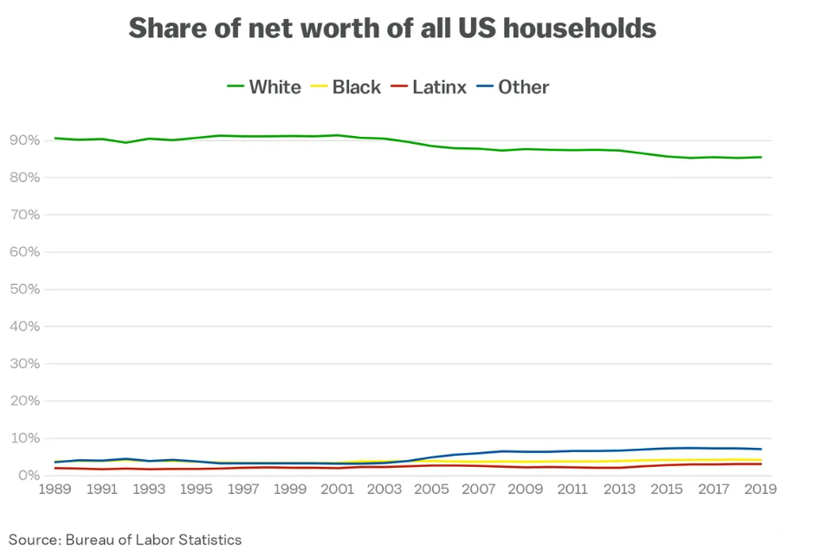

Slide 28
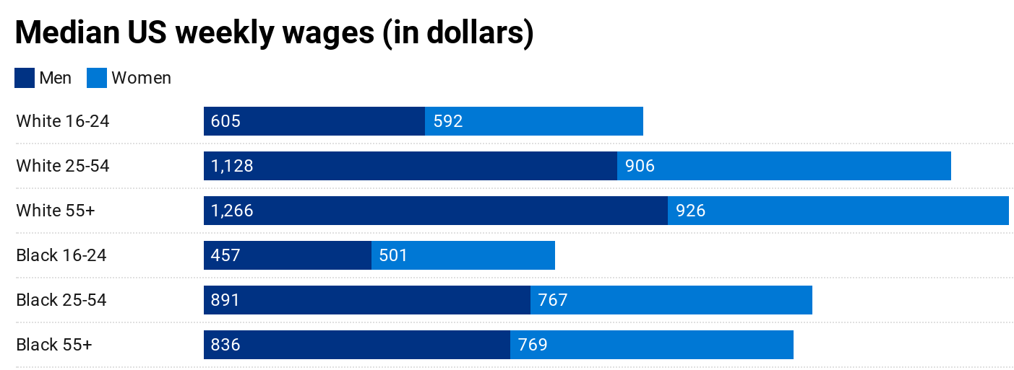
Source: Sean Collins/Vox; US Bureau of Labor Statistics data

Slide 29
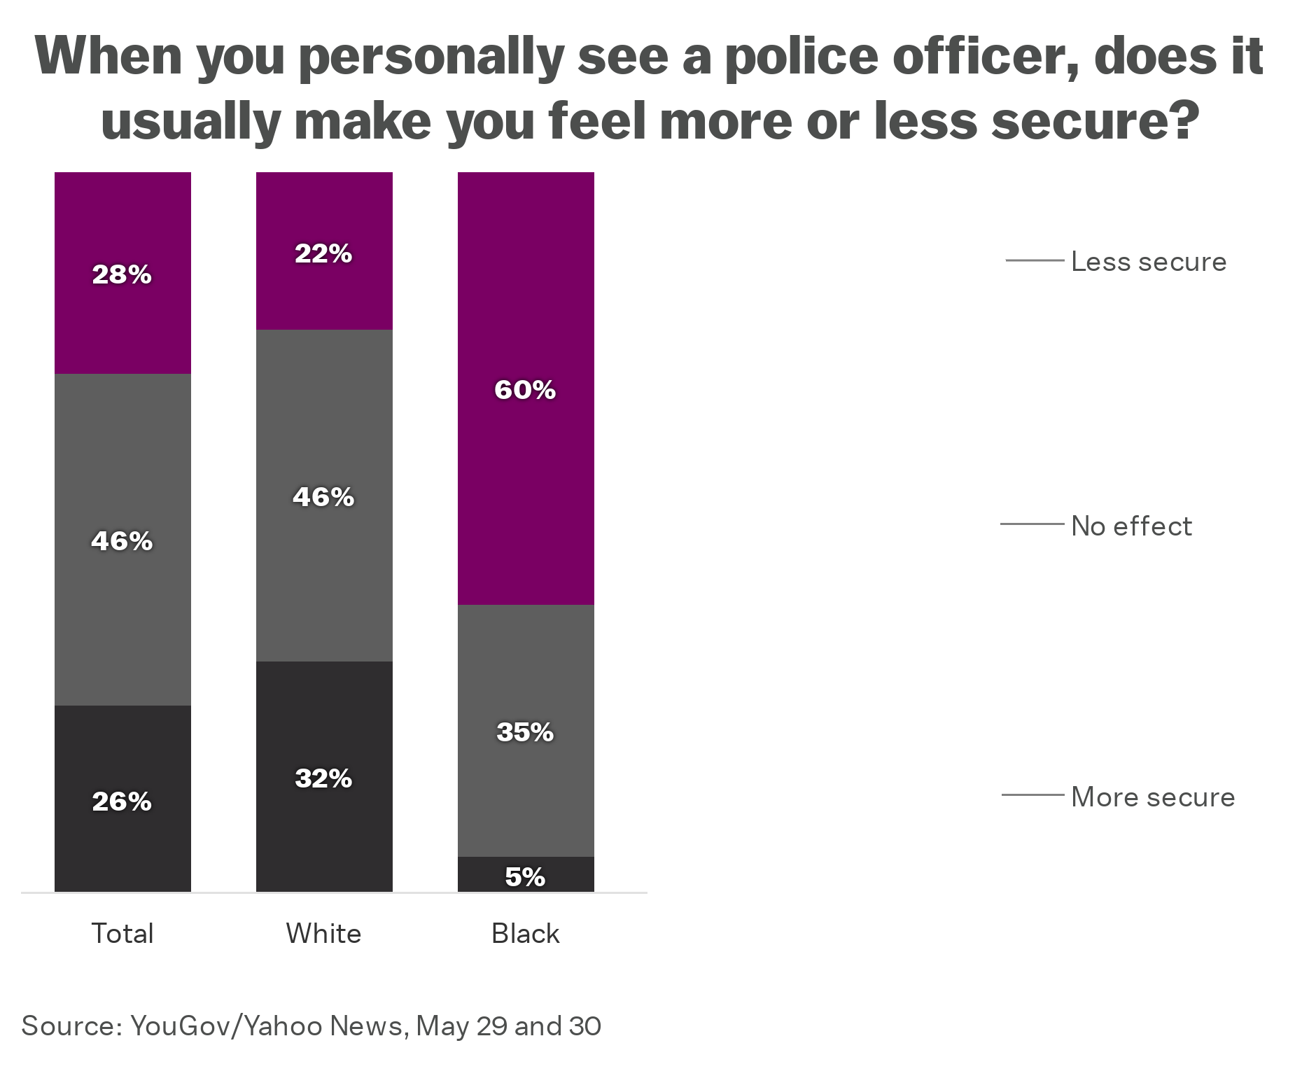

Slide 30
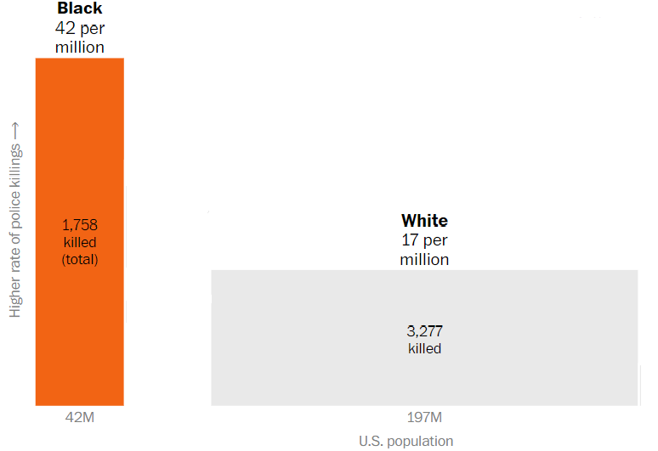
Source: https://www.washingtonpost.com/graphics/investigations/police-shootings-database/

Slide 31
Thank You

