Slide 2
NATIONAL MANAGEMENT COLLEGE 117th National Management Course
Contemporary Issue Series Presentation
Focusing on rural development learning from Chinese experience
By
Iqbal Dara
(PSP)
Sponsor DS: Ms. Sijal Tauseef Khan
Dated: 25 November 2022

Slide 3
SEQUENCE
Perspective setting : Introduction
Statement of Problem
Research Questions
Rural development in Pakistan
SWOT analysis of rural agricultural Pakistan
China: Plans, Programs and Policies for Rural Development
Impact of RD interventions in China
Lessons from China
Pakistan: Enigma of Rural Development
Conclusion
Way forward

Slide 4
Introduction
More than two-thirds of Pakistanis live in rural areas and 68 % of this in rural-agricultural Pakistan
37% of Pakistan’s population lives below poverty line (World Bank, 2021). Majority in rural and remote areas in about 48363 villages.
Sustainable agriculture is the main vehicle for Rural Development
RD has traditionally centered on the exploitation of land-intensive natural resources: agriculture and forestry
Need to value rural people as contributor to the employment, manager of rural landscape and environmental steward in protecting and upgrading the ecosystem

Slide 5
Quality Education, entrepreneurship, physical and social infrastructure all play an important role in developing rural regions.
RD is also characterized by its emphasis on locally produced economic development strategies taking holistic view.
In contrast to urban regions, which have many similarities, rural areas are highly distinguishable in attributes from one another.
RURAL DEVELOPMENT

Slide 6
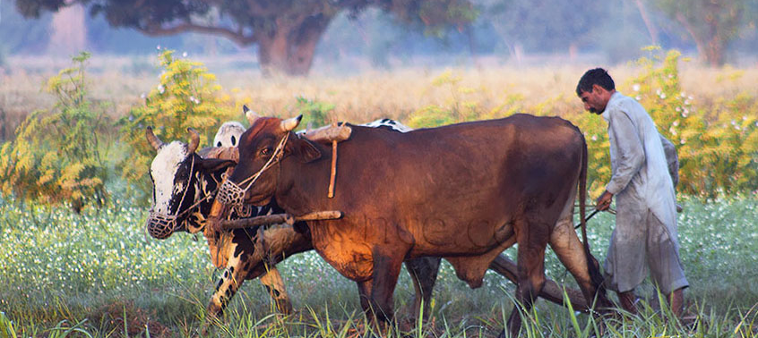
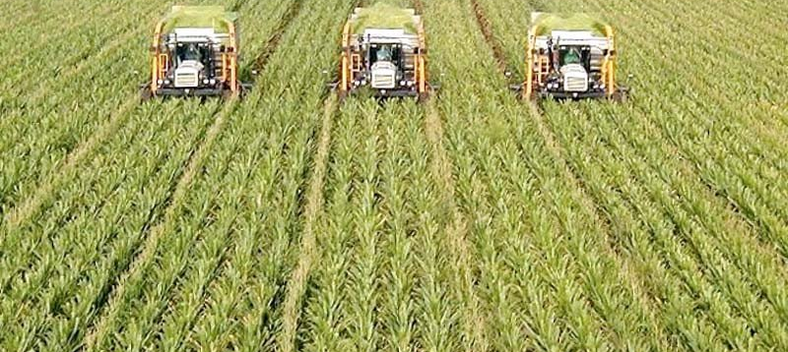
PROBLEM STATEMENT
Rural population in Pakistan is beset with limited access to markets, education, quality infrastructure, employment opportunities, health and financial products. On the contrary, China, has accomplished impressive rural development, sustainable agriculture and poverty alleviation.

Slide 7
RESEARCH QUESTIONS
Why Pakistan is lagging behind in Rural Development?
What policies and strategies did China adopt to achieve stellar progress in the area of Rural Development and can Pakistan learn and benefit from Chinese experience?

Slide 8
Rural Development Programmes in Pakistan
Since its independence, Pakistan launched many rural and agricultural development programs such as;
Village Aid Programme | Peoples Works Programme​
Basic Democracies system​ | Tameer-e-Watan Program​ ,Khushal Pakistan
Rural Works Programme​ | Social Action Program​, Integrated Rural Development
These programs were partially or fully extended to all parts of the country
The overall objectives of these programs were the social welfare, improvement in quality of life and agricultural development.

Slide 9
SWOT ANALYSIS OF RURAL PAKISTAN

Slide 10
STRENGTHS | WEAKNESSES
Availability of enormous Human Capital 59% youth bulge (Economic Survey of Pakistan, 2021-22) | Water resources scarcity
GDP contribution 24% (Bureau of Statistics Pakistan, 2021, n.d) | Limited access to electric power
Subsistence farming of livestock | Lack of adoption and availability of modern farming techniques
Food security | Scarce arable land, low in agriculture potential
Female farm workers | Less access to basic human needs i.e. potable water, sanitation, education, healthcare
 | Limited off-farm employment opportunities

Slide 11
OPPORTUNITIES | THREATS
Skill development of unskilled labour | Law and Order
Enhanced per acre yield of cash crops to balance out CAD | Feudalism, climate change
Availability of cultivable but still un-cultivated land | Low Literacy rate, malnutrition, high infant mortality, low life expectancy
Organic farming can diversify export potential | Rigid Cropping Patterns (Maqbool A. & Khalid M.B, 2009)
Untapped Halal Export Market | Less access to basic human needs i.e. potable water, sanitation, education, healthcare
Extending Forest coverage to mitigate climate change | Low government priority in comparison to Urban Areas and rural urban migration

Slide 12
Historical Background of Rural Development in China
Land Reforms 1949-1952
Since 1978, China launched targeted economic and land reforms
Farmers’ professional cooperatives (FPCs)
Family Planning(One child Policy 1980 to 2016)
Putting limits to migration from rural to urban centers
Township and village enterprises in 1980s
Since 1986 government started investing heavily in rural infrastructure
Rural Vitalization Policy 2018

Slide 13
Agro-Industrial paradigm
Farmers’ professional cooperatives (FPCs) have grown rapidly in rural China over the past 10 years. They have become an important institution in rural China in attempting to achieve the vertical integration of agricultural production, processing, and marketing.
An Advance cooperatives consist of 10 to 20 elementary cooperatives
A cooperative family's income, therefore, depended on the number of work points earned by family members and on the average value of each work point
Rural development to sustainable development: the “agro-industry paradigm,” the “post-productivist paradigm,” and the “sustainable rural development paradigm.”
Ecological agriculture (green, hazard-free food and organic agriculture), which helps to build soil fertility and minimize environmental externalities.

Slide 14
RURAL VITALIZATION POLICY 2018
“MODERATELY PROSPEROUS SOCIETY” (MPS)​
Effective governance
Party leadership
Responsible government
Social collaboration
Public participation,
Guaranteed rule of law, ensuring the rural society of vitality, harmony and order.
Prosperous life.
High quality employment
Diversified income sources,
Reduced urban–rural income gaps
Rural civilization
High degree of civilization
Good spiritual well-being
Civilized rural social interactions
Good family relationships
High morality

Slide 15
China Today
Now China ranks first worldwide in farm output of rice, wheat, potatoes, sorghum, tomatoes, peanuts, tea, cotton, oil seed and soyabeans.
China has 10% cultivated land but produces food for 20% worldwide population
Decrease in poverty (0.6%) by shifting to more integrated and balanced approach to improve economic, social, and environmental welfare in rural areas.
330 million people got rid of poverty in China
Agriculture growth rate remained 3.46% during 13th 5year plan and rural per capita income increase was higher than urban house hold

Slide 16
China vs Pakistan RD context
China | Pakistan
Collectivization based land reforms | Land Reforms based on holding size(failed)
Technology Inputs for modernization | Obsolete farm inputs
Corporatization of collective farms with strict rules and regulations | Elitist capture of resources
Uplifting of rural population by access to Education, Health, Credit lines | Priority is given to Urban centers
Inhibition of migration by compartmentalization | Massive rural to urban migration due to lack of resources
Incentivization to non-farm businesses | Ignoring rural businesses
Research and Development interventions | Least priority for R&D

Slide 17
Can we Learn From the Chinese experience?
Learning from the experience of other countries, for achieving certain development goals, is not an easy task as they vary in their cultural settings, geo-political conditions and mobilization of resources
Despite limitations, the learning process can be useful, in providing necessary inputs, for designing policies and implementing them. The success of China in Rural Development, agriculture promotion and poverty alleviation has attracted the attention and there are some lessons to be learnt

Slide 18
LEARNING FROM THE CHINA
Economists have drawn three lessons, from the Chinese experience for developing countries
It is essential for developing countries to get their economic systems in order
Develop a clear concept of regional development
Specific poverty alleviation measures are necessary that must be highly targeted

Slide 19
Conclusion
Pakistan could not achieve its desired results in Rural Development because of conflicting policies, absence of institutional mechanism to reconcile inter-reform contradictions, inconsistency due to political and policy instability. On the other hand, China’s Rural Development programs were comprehensive, continuous, complementary to over all developmental strategy and there was strong institutional arrangement to back up the initiatives so Pakistan have lessons to learn from it.

Slide 20
Way forward
‘Charter of Rural Development’ by all stakeholders
Population control
Land Reforms of some sorts
Compulsory education
Investment be made on development of rural infrastructure
Improvements in the land administration system

Slide 21
Rural Landholders to adopt progressive practices in farming and allied enterprises
Maximal powers, authority, and finances be made available to rural communities through local governments to enable them to graduate out of poverty
Access to formal and informal credit to farmers and non-farm enterprises
Way forward CONTD:

Slide 22
Research and extension system need to be revised towards more demand driven, participatory approaches
Irrigation water supply and distribution strategy to be formed addressing inter provincial disputes
Way forward CONTD:

Slide 23
Bibliography & references
Rural Development in Pakistan: Issues and Future Strategies (Maqbool A. & Khalid M.B, 2009)
Pakistan Year Book . 2021
G. M. Arif and Shujaat Farooq: Poverty Reduction in Pakistan learning from the Experience of China, (PIDE, Islamabad. 2012)
Ying Lu and Walter de Vries: A Discourse Analysis of 40 years Rural Development in China(MDPI)(doi.org. 2022)
China Agricultural Development Report( ministry of Agriculture, China. 2016)
Yuanzhi Guo and Yansui Liu:Poverty Alleviation Through Land Assetization and its Implications for Rural Development in China (doi.org.2021 )
Jikun Huang, Scott Rozelle, Xinkai Zhu, Shiji Zhao and Yu Sheng: Ariculural and Rural Development in China During the Past four Decades: an introduction( Australian Journal of Agricultural and Resource Economics. 2019 )
Xiaohong Zhuang, Zhuyuan Li, Run Zheng, Sanggyun Na and Yulin Zhou: Research on the Efficiency and Improvement of Rural Development in China: Based on Two Stage Network(MDPI). 2021)
Lu Xu, Hongyang Zhao, Veronika Chernova, Wadim Strielkowski and Guannan Chen: Research on Rural Revitalization and Governance from the Perspective of Sustainable Development(Frontiers in Enviornmental Science, 2022)
Yongi Xue, KuoRay Mao, Nefratiri Weeks and Jingyi Xiao: Rural Reform in Contemporary China: Development, Efficiency, and Fairness( Journal of Contemporary China . 2020) )

Slide 24
THANK YOU

Slide 25
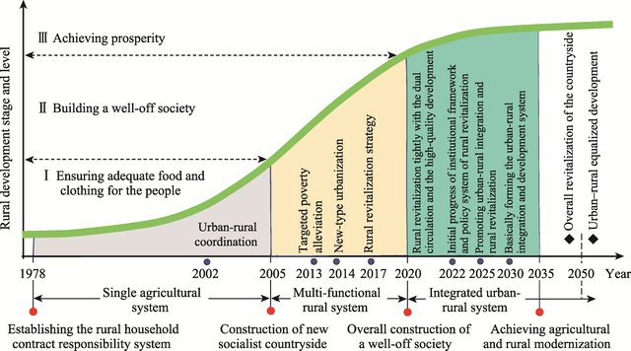

Slide 26
Overall Rural/Urban Poverty Trends Overtime in Pakistan ( 1998-2019)

