Slide 1
NATIONAL MANAGEMENT COLLEGE
117th National Management Course
Contemporary Issues Series Presentation
Slums and Katchi Abadis – Issues and Challenges
By
Imran Sikandar Baloch , PAS
Sponsoring DS : Mr. Nadeem Mahbub
15th Nov 2022

Slide 2
Acronyms
BoP Bank of Punjab
BoR Board of Revenue
DA Development Authorities
DGKA Directorate General of Katchi Abadis
HUD&PHE Housing and Urban Development & Public Health Engineering Department
LG&CD Local Government and Community Development Department
NAPHDA Naya Pakistan Housing and Development Authority
OPP Orangi Pilot Project
PDMA Punjab Disaster Management Authority
PHATA Punjab Housing and Town Planning Agency
PWWB Punjab Workers Welfare Board
UN-Habitat United Nations Human Settlement Programme

Slide 3
Sequence of Presentation
Introduction – What is a Slum ?
Statement of Problem
Research Questions
Analysis
Issues and Challenges of Slums
Case Study of Katchi Abadis Governance in Punjab
Conclusion
Recommendations

Slide 4
Introduction : What is a Slum ?
1792 Rookery - a cluster of mean tenements densely populated by people of the lowest class
1852 Back Slums - a foul back street of a city, especially one filled with a poor, dirty, degraded and often vicious population (Charles Dickens)
1930 Tenement Districts - Legislation authorising elimination of slums
1973 ‘Katchi Abadis’ - Illegal squatters on state land

Slide 5
2002 Slums - UN-Habitat Framework of Deprivations
….as a group of individuals living under the same roof in an urban area who lack one or more of the following:
Durable housing - protects against extreme conditions.
Sufficient living space - not more than three people in a room.
Easy access to safe water in sufficient amounts at an affordable price.
Access to adequate sanitation - toilet shared by a reasonable number of people.
Security of tenure- prevents forced evictions

Slide 6
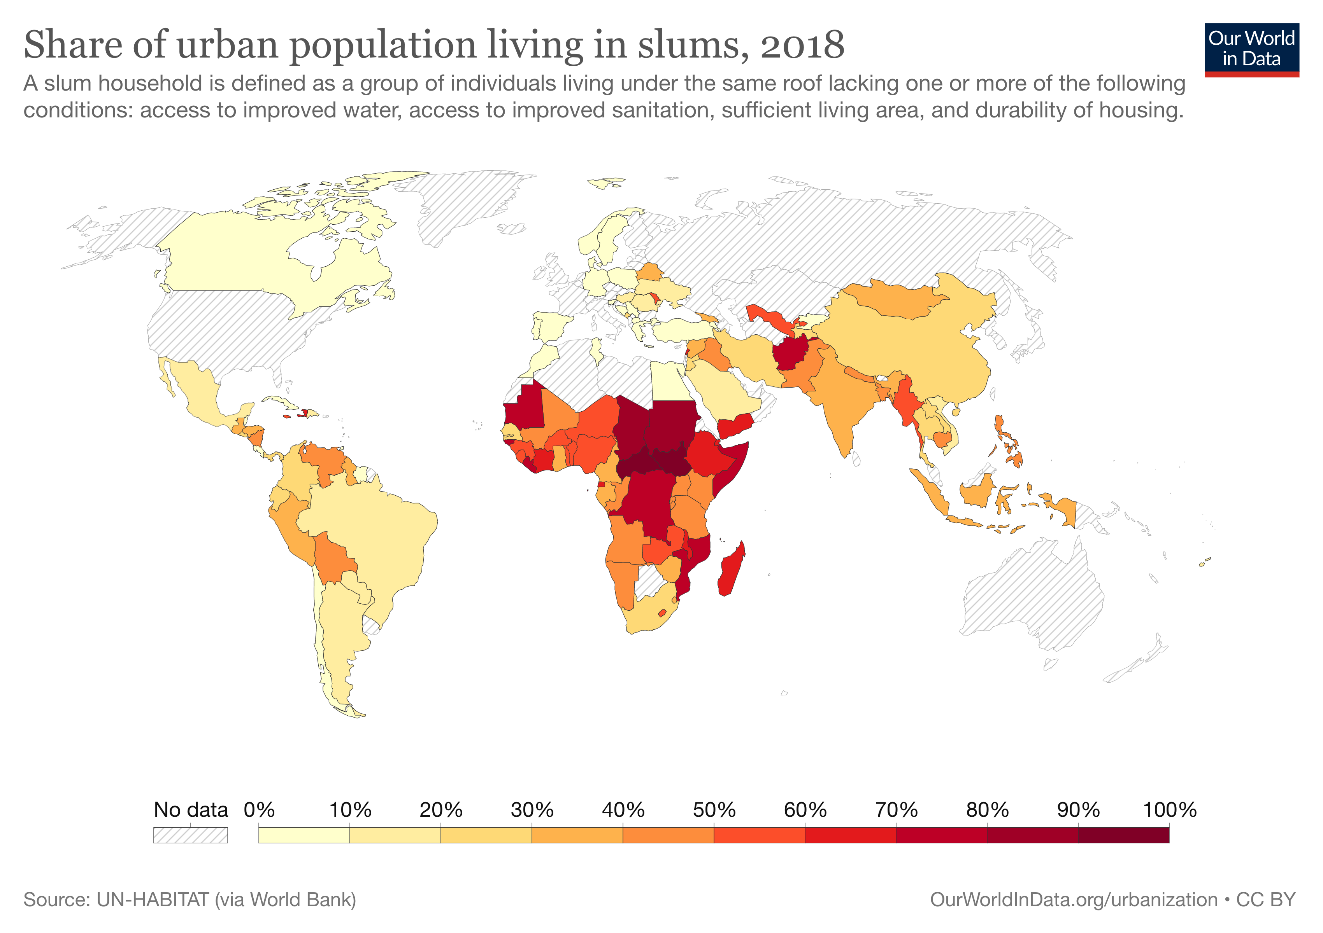
Pakistan : 40 %
Yemen : 66 %
India : 32%
Phillipines : 43 %
Afghanistan : 70 %
Central African Republic : 96 %
WORLD : 29 %

Slide 7
Statement of Problem
Across the globe, more than a billion people live in urban slums or Katchi Abadis. This number is projected to increase to 3 billion by 2050. These slums exist in downgraded and unsafe living conditions that create multi-dimensional governance challenges. The real problem, however, is that the policy makers continue to deal with the issue of slums on the basis of piecemeal approach, whereas, a holistic approach is often lacking.

Slide 8
Research Questions
What are the issues unique to slums and what governance challenges do they pose ?
Does the province of Punjab have a holistic governance framework to respond to the challenge of Katchi Abadis ?

Slide 9
Analysis Issues and Challenges

Slide 10
How Slums are Formed ? Poverty, Inequality and Inadequacy
The Challenge of Slums, UN-Habitat, 2003

Slide 11
1. Security of Land Tenure
Means having legal recognition to the use of property
Between 30 to 50 % slum dwellers lack any kind of legal document – US$ 9.3 Trillion worth assets of Dead Capital
Undocumented Economy of Slums : Settlers purchase guarantees from Slumlords ‘Dalals’
Connections with corrupt politicians and bureaucrats
Baldia Township, Landhi, Orangi
Guarantee against eviction
“Holding On: Security of Tenure - Types, Policies, Practices and Challenges”, 2012

Slide 12
Contd….Security of Land Tenure
Challenge :
No Province in Pakistan has digitised Urban Land Record
Dysfunctional land markets promoting speculation
Black economy hindering collection of taxes for development
Poor public land registry contribute to the proliferation of squatting
If security of tenure is established, residents are willing to invest in upgradation

Slide 13
2. Safe Housing- Risking the Vulnerable
Slums begin with bad geology
Large proportion of households reside on or near a hazardous site
in geologically hazardous zones;
housing on or under garbage mountains;
housing around high-industrial pollution areas;
housing around other unprotected high-risk zones
1984 Union Carbide Gas Leak Tragedy in Bhopal. 3800 people perished in adjoining slums

Slide 14
Contd….Safe Housing- Risking the Vulnerable
In 2001, 74 lives, 3000 slum houses were lost in the flood plains of Nallah Lai
Kachra Kundi , Karachi – on a waste dump
Machar Colony, Karachi – on cut mangroves
Challenge :
Updated Disaster mapping and mitigation plans
Absence of Master plans
Provision roads and electricity connections violating planning codes
A note on Development work, Akhtar Hameed, 1980

Slide 15
3. Affordable and Adequate Housing
Adequate Housing refers to :
Permance of Structures : Adhering to local building codes
Overcrowding : More than three people in a room
In Pakistan
51 % housing units are over crowded more than 3 people per room
Each year 700,000 Households are created while markets supply only 300,000 – Already a gap of 5 million units

Slide 16
Contd….Affordable and Adequate Housing
Challenge :
Poor have issue of equity
Only 2.4 % Pakistanis have access to credit formal financial sources
NAPHDA has affordability issues as the smallest unit costs Rs. 1.5 Million Rs. / Unit
Requires minimum monthly income of Rs. 46,000
Excludes lowest decile of population

Slide 17
4. Inadequate Provision of water and sanitation Services
Refers to adequate supply of water and sanitation solutions at affordable price
A gold mine for private industry
The slumlords have developed an industry - 10 % of monthly basic wage is spent on access to services
In Pakistan :
75 % population is without access to piped water
60 % population is without access to piped sewerage

Slide 18
Contd….Inadequate Provision of water and sanitation Services
Challenge :
Absence of updated Master Plans
Standalone development schemes for political capital
OPP Experiment taught that :
Reluctance to pay tarrifs for services to the government
Very high cost of public works- 250 % of actual cost if by international tender
Lack of community based models to undertake internal works

Slide 19
Analysis Case Study of Katchi Abadi Governance in Punjab

Slide 20
Katchi Abadis in Punjab - Institutional Arrangement
DGKA was created in 1987 under LG Department
Punjab Katchi Abadis Act 1992
Defines ‘Katchi Abadis’ as illeage squatting of 40 dwellings or more
Year 2022 - Number of Slum dwellers is not available however 235,088 Urban Slums in Punjab
Key Mandate :
Regularisation of Katchi Abadis
Development of infrastructure

Slide 21
Contd….Katchi Abadis in Punjab
DGKA is solely dealing with Proprietry Rights and have granted 115,570 PRs till date
Not a single scheme of Area Development has been launched
Punjab Growth Strategy 2023 : Does not mention Slums or Katchi Abadis for once
Punjab Spatial Strategy 2047 : Aims to provide housing in Slums
ADP 2022-23 : No scheme with the title of Slums or Katchi Abadis
Punjab Industrialisation Policy 2018 : No mention of housing for workers around industry

Slide 22
Response in Silos
Definition of Katchi Abadis or Slums as per UN definition | No | Punjab Katchi Abadis Act 1992
Single Institution | Yes | Duplication of functions amongst DGKA, DAs, LGs and HUD
Scope of Intervention | Partial | Covers Land and Development
Security of Land Tenure | Yes | Directorate of Katchi Abadis
Hazard Mapping | Partial | PDMA Punjab
Provision of Adequate Housing | Yes | PHATA, PWWB, NAPHDA
Provision of Municipal Services | Yes | LG&CD, HUD&PHE, DAs
Soft Loans for House Building | Partial | BoP under NAPHDA

Slide 23
Conclusion
Slums are not surplus humanity. Their dynamics, issues and challenges are multi dimensional but, well researched and documented. It is clearly understood that the absence of state intervention exposes the already vulnerable at the mercy of slumlords. By defining slums within the Framework of Deprivations UN has moved the focus from perceived criminality of illegal squatters to deprivations affecting the slum dwellers. These issues, if understood well, can be systematically dealt by building state and sub national level institutions.

Slide 24
Recommendations
Conceptual
Slums have Incendiary potential of political unrest
Understanding of the dimensions by politicians and policy makers
Legal
Define Slums as per UN definitions
Create unitary approach – WB’s proposal of Punjab Urban Development Authority in 1992 – Place in PnDs
Define and Legislate Strategy viz-a-viz Katchi Abadis , Slumlordism

Slide 25
Recommendations
Institutional – Land Tenure and Area Hazard
Policy Choice - Priority of Slum Upgradation over Slum Relocation
Third party Surveys to create Updated Land Registry
Satellite based surveys - Land Use Map
Immediate posession of land – Services and housing to follow later ( Khuda ki Basti Approach )
Updating Hazard mapping – Relocation of slums only in case of hazard conditions
Enforcement of planning and building codes – cancellation of tenency

Slide 26
Recommendations
Institutional – House Building and Municipal Services
Participatory Approach for Municipal Services (Khuda Ki Basti)
Soft loans for Civic Infrastructure – Akhuwat
Internal External Model of OPP
Microcredit for House Financing ( One Time Equity )
NAPHDA to include the lowest decile by adding a Rent model
Sub National Governments to expand Subsidised Housing Models

Slide 27
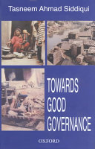
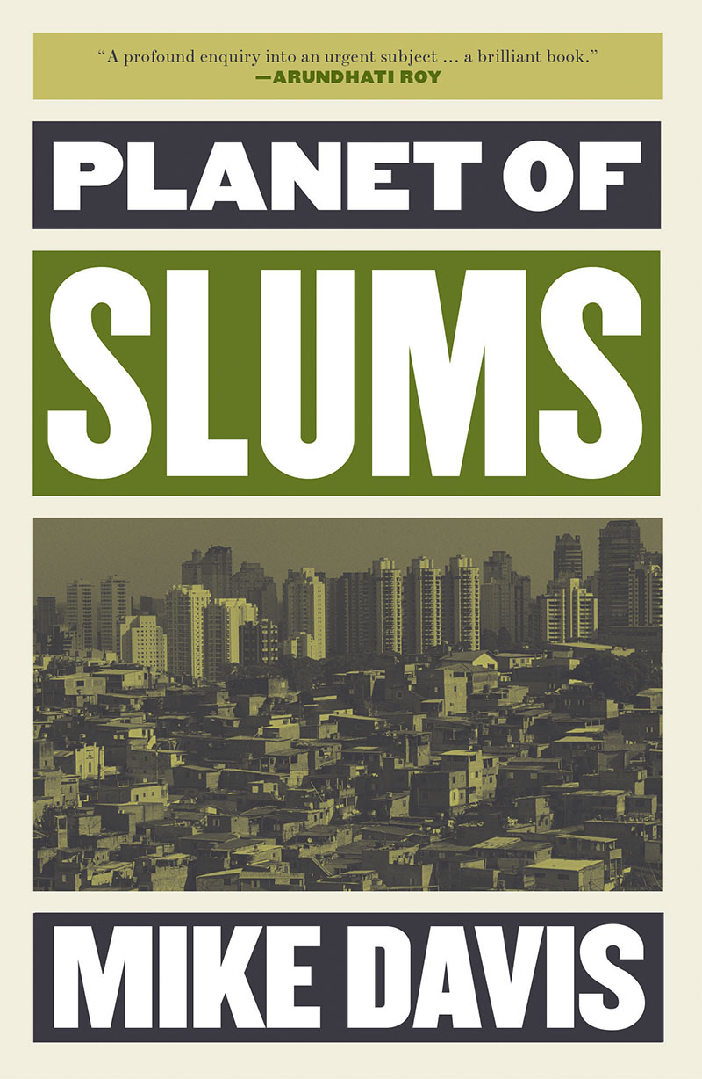
Resources and Bibliography
Holding On: Security of Tenure - Types, Policies, Practices and Challenges, George Payne
Orangi Pilot Project: Reminiscences and Reflections, Akhtar Hameed Khan
Towards Good Governance, Tasneem Ahmad Siddiquie
Planet of Slums, Mike Davis
The Challenge of Slums, UN-Habitat
Working with Government, Arif Hasan
Brief on Census 2017 , PBS
National Financial Literacy Programme , State Bank of Pakistan
Interviews
Mr. Shamim Asif, DG DGKA Punjab
Mr. Yasir Mubeen, Senior Chief PnDB Punjab
Ms. Shahnaz Arshad, Senior Urban Specialist, World Bank Islamabad
Ms. Ume Laila Naqvi, PD PMU , LG

Slide 28
Thanks

