Slide 2
Contemporary Issue Series Presentation Digital Divide, its implications for Developing Countries with particular reference to Pakistan By Dr Gul Mohammad Laghari, M/o PD&SI Dated: 14-11-2022 Sponsor DS: Dr Muhammad Shoaib Akbar
NATIONAL MANAGEMENT COLLEGE
117TH NATIONAL MANAGEMENT COURCE

Slide 3
Acronyms Used
A4AI | Alliance for Affordable Internet
AI | Artificial Intelligence
CAD | Computer Added Design
HEC | Higher Education Commission
ICTs | Information & Communication Technologies
IoT | Internet of Things
ITU | International Telecommunication Union
OECD | Organization of Economic Cooperation & Development
PBS | Pakistan Bureau of Statistics
PDF | Portable Document Format
PERN | Pakistan Education & Research Network
PTA | Pakistan Telecommunication Authority
USF | Universal Service Fund

Slide 4
Sequence of the Presentation
Introduction
Statement of the Problem
Research Questions
Analysis
Conclusion
Recommendations

Slide 5
“Digital transformations have reached the tipping point where digital has become “business as usual” as opposed to an appendage. The tail has become the dog. Digital is not just part of the economy — it is the economy”
Source: Anderson, Lindsay and Wladawsky-Berger, Irving, The 4 Things It Takes to Succeed in the Digital Economy, Harvard Business Review, March 24, 2016

Slide 6
Introduction / Background
Digital Divide
The term “Digital Divide" refers to the gap between individuals, households, businesses and geographic areas at different socio-economic levels with regard to both their opportunities to access information and communication technologies (ICTs) and to their use of the Internet for a wide variety of activities.
Source: Understanding the Digital Divide, OECD, 200, page 5.
( http://www.oecd.org/dataoecd/38/57/1888451.pdf )

Slide 7
Introduction / Background
Information and Communication Technologies (ICT):
ICT is a diverse set of technological tools and resources used to transmit, store, create, share or exchange information. These technological tools and resources include computers, the Internet (websites, blogs and emails), live broadcasting technologies (radio, television and webcasting), recorded broadcasting technologies (podcasting, audio and video players, and storage devices) and telephony (fixed or mobile, satellite, visio/video-conferencing, etc.).
Source: UNESCO E-Learning Portal
https://learningportal.iiep.unesco.org/en/glossary/information-and-communication-technologies-ict
(accessed on 8-11-2022)

Slide 8
Flexible and Expanding Scope of ICTs
E-mail
E-commerce
E-trade
E-government
E-banking
E-learning
E-gazette
…
Developments in Information & Communication Technologies (ICT)
Artificial Intelligence
Database
Virtual Reality
Cloud Computing
Internet
Online
Robotics
Data
Mobile Devices
CAD
Block chain
3G…4G…5G
Automation
PDF
Big Data
Cybersecurity
Internet of Things
Bluetooth
Computers
Social Media
Broadband
Link
Infrastructure
Discussion will be limited to digital divide for Telecom / Computer / IT and allied technologies on developing countries in general and Pakistan in particular

Slide 9
Problem Statement
Many developing countries including Pakistan although have reasonable Digital Infrastructure and ICT Services but it still is not at par with developed countries. The developing countries like Pakistan cannot harness universal fruits / impact of digitization due to existing digital divide.

Slide 10
Research Questions
What is the extent of digital divide in developing countries especially Pakistan?
What has been or being done to bridge the digital divide in Pakistan?

Slide 11
Dimensions of Digital Divide
Access (Unserved / Underserved)
Geography (Rural / Urban or Developed / Developing)
Gender Inequalities / Persons With Disabilities (PWDs)
Affordability (Equipment / Service)
Relevance / Skillsets (individuals or businesses)
Quality of Service (speed, connectivity)
Social / Cultural issues

Slide 12
Global Internet Users
Updated Figure until June 2022 is 5.3 billion users (66% of Total World Population)
Source: Global Connectivity Report 2022 by International Telecommunication Union (ITU)

Slide 13
Global Internet Penetration
Source: Global Connectivity Report 2022 by International Telecommunication Union (ITU)

Slide 14
Global Internet Users – Gender Gap
Source: Global Connectivity Report 2022 by International Telecommunication Union (ITU)

Slide 15
Global Internet Users – Rural Urban Gap (%)
Source: Global Connectivity Report 2022 by International Telecommunication Union (ITU)

Slide 16
Access / Availability in Pakistan
Item | Subscribers (Data Updated until September 2022)
Type of Connections | Cellular | 3G / 4G | Basic Telephony | Broadband
 | 194 Million | 121 Million | 2 Million | 124 Million
Variable | Tele-density* | Penetration | Tele-density | Penetration
 | 87.98% | 54.65% | 1.19% | 56.03%
* Tele-density: users per 100 inhabitants in a particular area
As per PBS, Pakistan had 20.512 million registered TV sets by June 2020
Source: PTA Website www.pta.gov.pk (Accessed on 05-11-2022)

Slide 17
Data Prices – Affordability
(In US$)
Country | Avg. Price of 1 GB Mobile Broadband | Avg. Price of 10 GB Mobile Broadband | Avg. Price of Fixed Broadband
Nigeria | 2.49 | 7.48 | 32.15
Bangladesh | 2.23 | 4.70 | 3.39
India | 1.75 | 2.70 | 5.28
Pakistan | 0.58 | 2.26 | 15.66
Source: Alliance for Affordable Internet (A4AI) https://a4ai.org/about-us/ (Accessed on 06-11-2022)

Slide 18
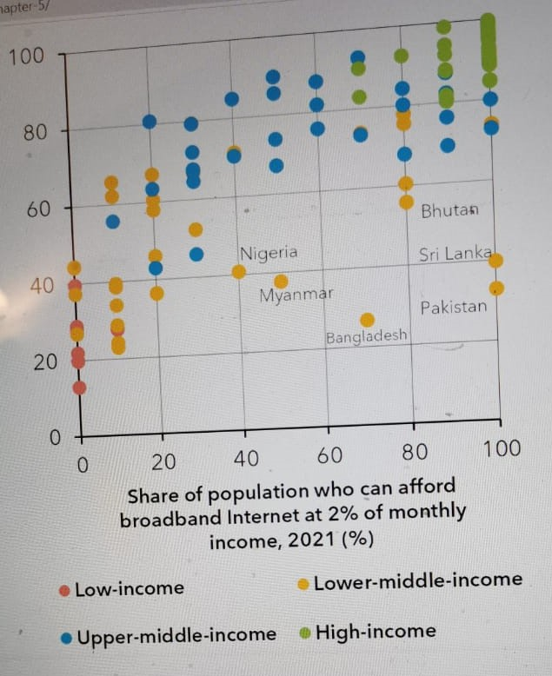
Digital Divide – Affordability
Share of Population who can afford broadband internet @ 2% of monthly income in 2021
Bangladesh = 25%
Pakistan = 35%
Myanmar = 38%
Sri Lanka = 40%
Nigeria = 40%
Bhutan = 55%
Source: Global Connectivity Report 2022 by International Telecommunication Union (ITU)

Slide 19
Digital Divide – Quality
Country | Rank out of 139 | Mobile Broadband |  |  | Rank out of 181 | Fixed Broadband
 |  | Download (mbps) | Upload (mbps) | Latency (ms) |  | Download (mbps) | Upload (mbps) | Latency (ms)
India | 118 | 13.87 | 3.35 | 36 | 79 | 48.59 | 47.83 | 06
Bangladesh | 125 | 11.71 | 8.34 | 28 | 104 | 33.18 | 34.45 | 05
Pakistan | 116 | 14.11 | 8.80 | 30 | 150 | 10.26 | 9.82 | 07
Global Average | - | 33.17 | 9.03 | 28 | - | 71.39 | 30.64 | 10
Source: The Speed Test Global Index, September 2022 https://www.speedtest.net/global-index (Accessed on 11-11-2022)

Slide 20
IT Initiatives – The Response to Access
Federal Government
Universal Service Fund (USF) Board approved an award of 10 contracts worth Rs21 billion for connectivity of under-served areas. This includes high-speed mobile broadband projects, highways and motorways projects and optical fiber cable (OFC) projects.
It will provide 4G LTE connectivity and backhaul connectivity to approx. 3.5 million people by connecting 187 Union Councils (UCs) with 1,554 km of OFC and providing seamless connectivity to 622 km of un-served road segments on the M-8 motorway and N-35 highway.
Directorate General, Special Education, Government of Pakistan has programs (including IT) for PWDs. Similar programs at provincial level too for both access and training.

Slide 21
IT Initiatives – The Response to Training
Federal Government:
USF: 144 Women Empowerment Centers / IT Labs in School of Islamabad
E-Rozgar, Digiskills Program
Ignite / University Incubation
Provincial:
Computer labs in most of boys and girls school in provincial areas
Diploma / Certificate Courses
Private sector IT Institutes
Smart classrooms / Digital Library by HEC
PERN Network of HEC
Private Sector Response to Gender Gap
Jazz
Smart Schools
Entrepreneurship
Telenor
Naya Aghaz
Huawei
Training
Conferences
Zong
SCO
SOS / Orphanages
Flood Victims
Industry
Training in GB / AJ&K

Slide 22
Strengths of Pakistan IT Sector
IT Exports to 120+ countries @ US$ 2.616 billion in 2022 (24% more than previous year)
Robust Telecom sector with 6 international cables and 4 telecom operators
3rd best country of Freelancers (more than 100,000 freelancers)
5th best country of world in term of outsourcing services
300+ international companies (more than 50% ISO Certified)
16 software technology parks
Approximately 25000 IT graduates enter the market every year
Source: Ministry of IT & Telecom

Slide 23
Strengths of Pakistan IT Sector
Google Estimates: Pakistan should focus on 8 new initiatives. These include:
If leveraged, digital transformation can unlock PKR9.7 trillion (USD59.7 billion) to Pakistan by 2030 (19% of Pakistan GDP of 2020)
The Mobile Internet; | Cloud Computing;
Big Data; | Artificial Intelligence (AI);
Financial Technology (Fin-tech); | Internet of things (IoT) and Remote Sensing;
Advanced Robotics; | Additive Manufacturing.
Source: Ministry of IT & Telecom

Slide 24
Weaknesses of Pakistan IT Sector
Quality of IT graduates
Fluctuations of internet speed and allied matters
Forex related problems for imports / exports
Hardware Industry has not developed in the country
Foreign Direct Investment dismal due to political instability
Inconsistency of policies
Cultural / social issues for females

Slide 25
United Nation Sustainable Development Agenda 2030
70% of population 15+ have basic digital skills (Messaging, copy paste, file share)
Gender parity achieved for internet access, mobile phone and digital skills
100% fixed broadbands are 10mbps or faster
20mb/s download speed at every school
50kb/s download speed available for each student
200GB minimum data for each school
Entry level broadband should cost 2% or less of average income of bottom 40% of population
Population of 15+ uses internet
Households have internet access
Businesses are using internet
Schools are connected to the internet
Population is covered by Mobile Network
100% of...
Source: UN Secretary General’s Technology Envoy Office & International Telecommunication Union (ITU)

Slide 26
Federal and Provincial Digital / IT Policies
Digital Pakistan Policy 2018
Punjab IT Policy 2018
Khyber Pakhtunkhwa Digital Policy 2018-23
Balochistan Digital Policy 2021
Sindh Cloud First Policy 2022 (Digital Policy under preparation)

Slide 27
Conclusion
Developing countries including Pakistan have visible digital divide compared to developed countries. This divide is especially more pronounced for females and rural inhabitants. Despite, these disadvantages, the IT Sector in Pakistan is performing reasonably well. However, more investment in IT infrastructure and training is required to harness optimal and universal benefits.

Slide 28
Recommendations
S # | Recommendation | Details
1 | Access / Availability | Government to invest in backbone infrastructure Incentivizing Service Providers to invest in network till last mile connectivity for remote areas PPP projects for un-served / underserved area coverage utilization of PERN / existing Smart infrastructure for education purpose High speed options for software houses / corporate sector
2 | Affordability | Free internet at educational institutions Digi-Vouchers for for students / PWDs Tele-centers in rural areas / community networks

Slide 29
Recommendations
S # | Recommendation | Details
3 | Quality | Public / PPP investment in local satellites, Fiberoptic and collaborating in region for extension of submarine cables
4 | Training / Skill Development | Scaling up Digiskills programs for training in freelancing, AI, Fin-tech, Big Data & Cloud Computing, Robotics & Automation, Machine Learning and Coding Creating Digital Ecosystem by establishing Digital Venture Capital Funds to promote innovation through Entrepreneurship, Incubation, Startups Specialized IT Trainings / short courses for youth especially girls to become freelancers / Entrepreneurs. Empowering women in rural areas by appropriate IT trainings at schools / vocational centers / community networks

