Slide 2
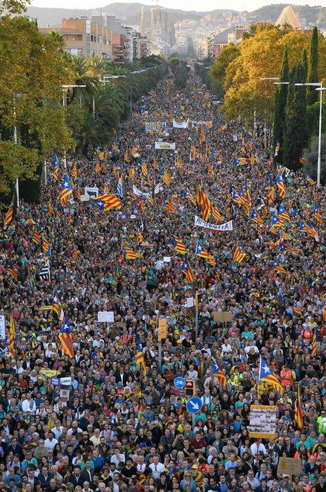

Slide 3
NATIONAL MANAGEMENT COLLEGE 117th National Management Course
Current Issue Presentation
Street protests in Pakistan: An effective way to achieve objectives in a weak governance system?
By
Imran Ali
(Foreign Service)
Dated: 11th November, 2022
Faculty Advisor: Dr. Muhammad Ajmal

Slide 4
Sequence of Presentation
Introduction
Statement of Problem
Key Questions
Scope of the topic
Analysis
Conclusion
Recommendations

Slide 5
Introduction
Pakistan has lately seen street protests as a frequent way to articulate political demands by all political parties. This has specially been prevalent since 2014.
Historically, significant street movements- with political, religious, institutional, federal and self-determination objectives. They relate to democratic and governance issues as well as other issues.
In some cases, state failure to respond to mass sentiments leading to disastrous consequences.
The most negative consequence- image of political instability. Many other negative consequences
However, direct protests are primordial to democracy.

Slide 6
STATEMENT OF PROBLEM
Street protests are perceived to lead to political turmoil, weaken an already weak parliament, and negatively affect the lives of people generally, and economic and socially marginalized sections even more adversely. Political instability can lead to economic problems, and even impact our foreign relations. However, they are an essential ingredient of a democratic polity, and help to articulate public demands effectively and such demands can be vital to the future direction of the state and achieve objectives of large segments of the population. How should a state and society perceive such protests and form a policy thereof ?

Slide 7
KEY QUESTIONS
Are street protests in Pakistan solely a consequence of weak governance and underdeveloped democratic institutions alone ?
Have such protests in Pakistan achieved their objectives historically?

Slide 8
SCOPE AND METHODOLOGY
Focus on Pakistan mainly.
Dissection of 14 protests in Pakistan, and answering the two research questions in each case-were they due to weak governance and were they successful?
Focus on country wide protests of national significance mainly but touching on localized human protests also, as they relate to weak governance.

Slide 9
Analysis

Slide 10
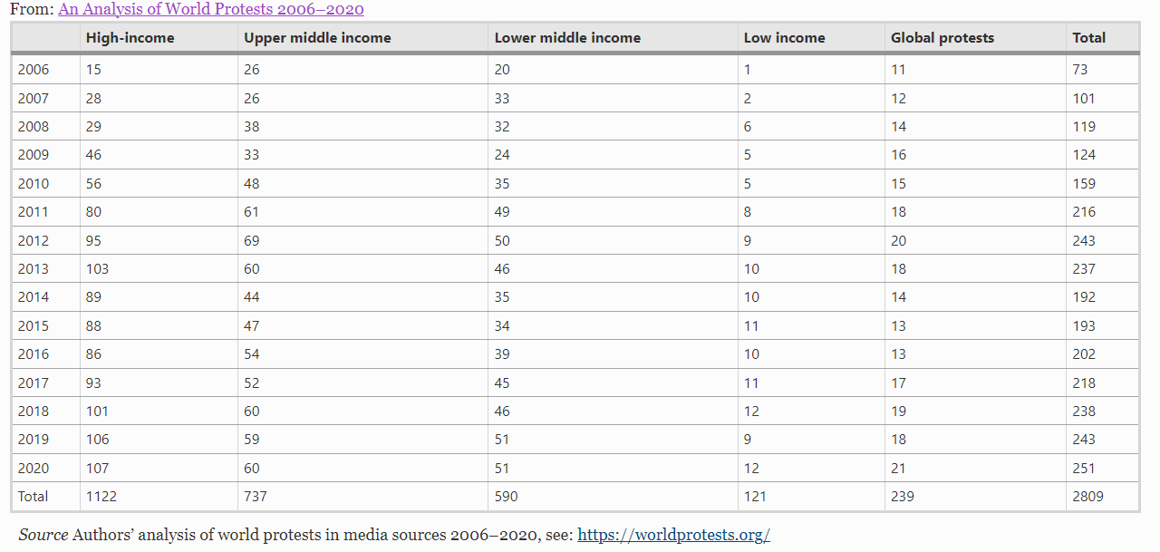
Number of protests by country income groups, 2006–2020
Source Authors’ analysis of world protests in media sources 2006–2020, see: https://worldprotests.org/

Slide 11
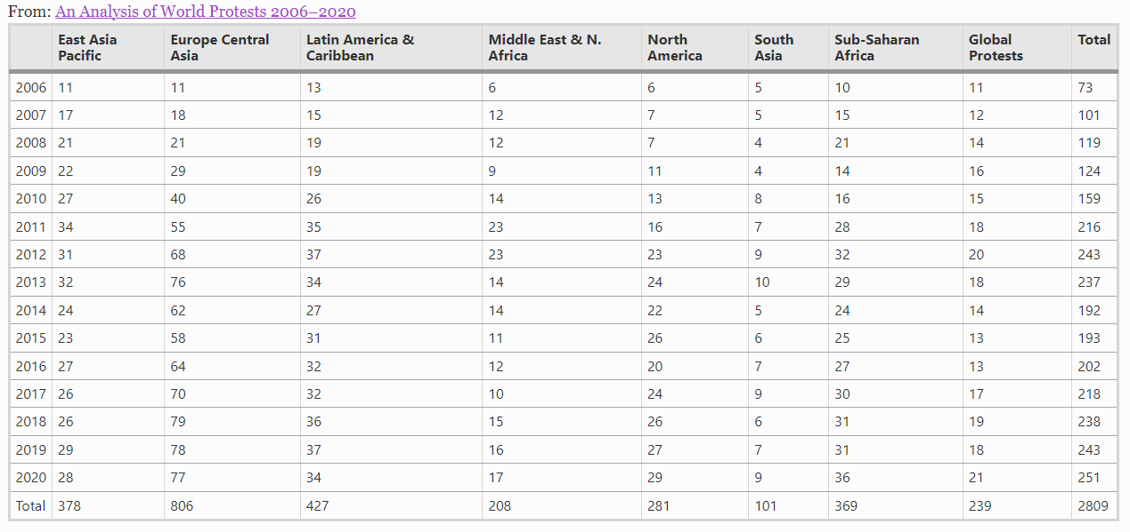
Number of protests by region, 2006–2020
Source Authors’ analysis of world protests in media sources 2006–2020, see: https://worldprotests.org/

Slide 12
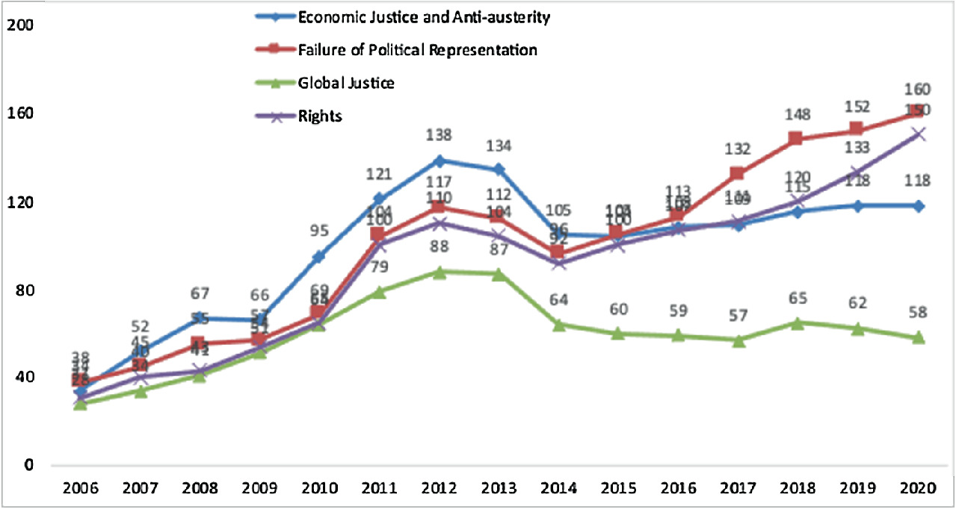
Source: https://link.springer.com/chapter/10.1007/978-3-030-88513-7_2/figures/2

Slide 13
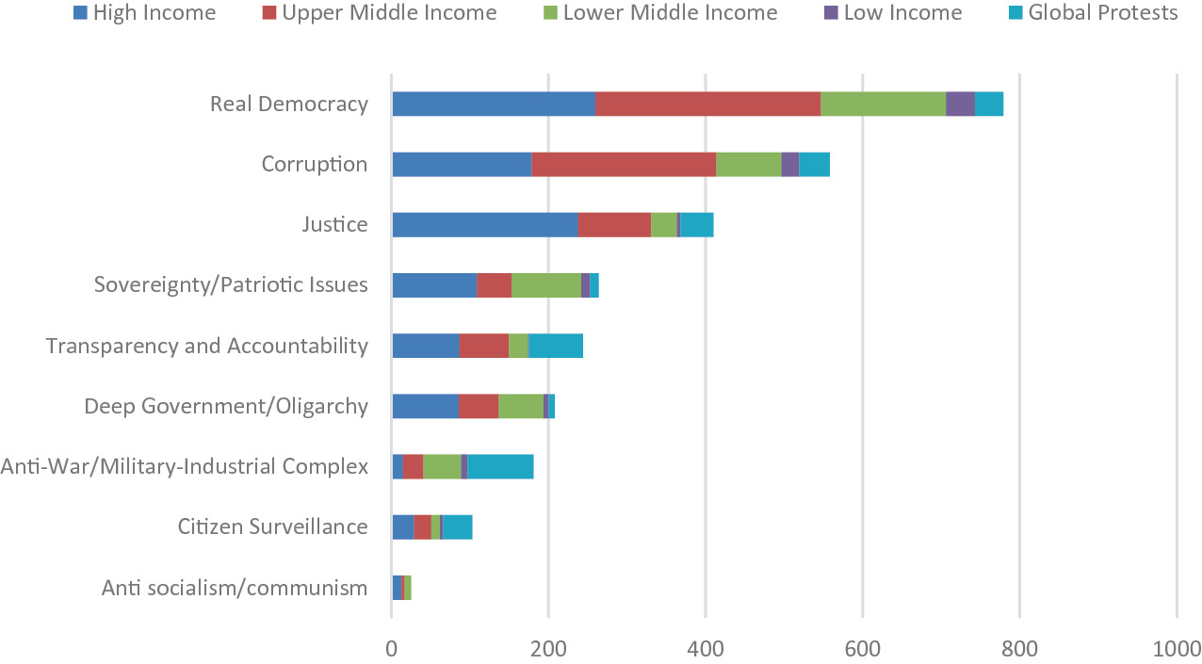
Source: https://link.springer.com/chapter/10.1007/978-3-030-88513-7_2/figures/3

Slide 14
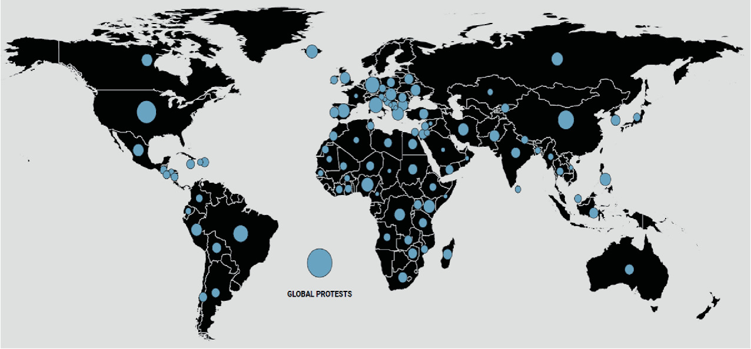
Source: https://link.springer.com/chapter/10.1007/978-3-030-88513-7_2/figures/4

Slide 15
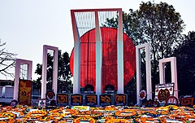
Analysis

Slide 16
1. Language riots 1952:
Objectives and critical analysis:
Protests against the exclusion of Bengali language
Question 1: No, they addressed a fundamental blind spot of Pakistani federalism
Question 2: Successful-1956 constitution
Reasons for success:
Majority demand
Genuine and historic demand
Held up the making of Pakistan’s constitution

Slide 17
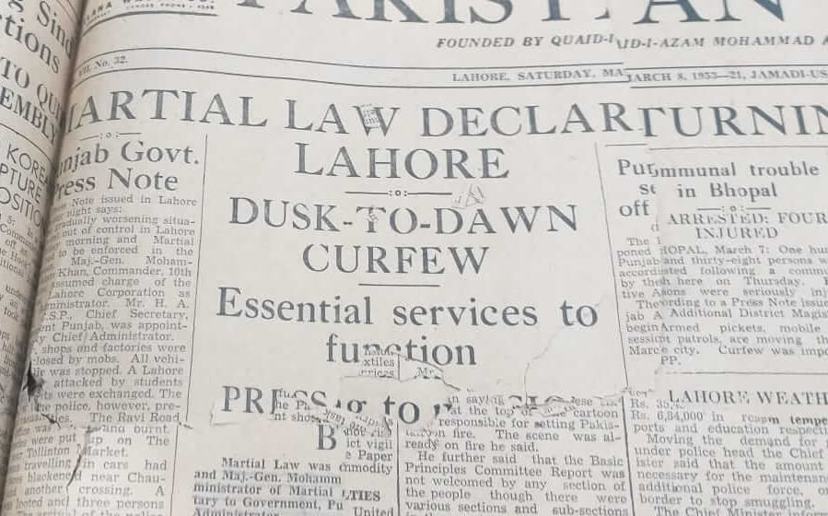

Slide 18
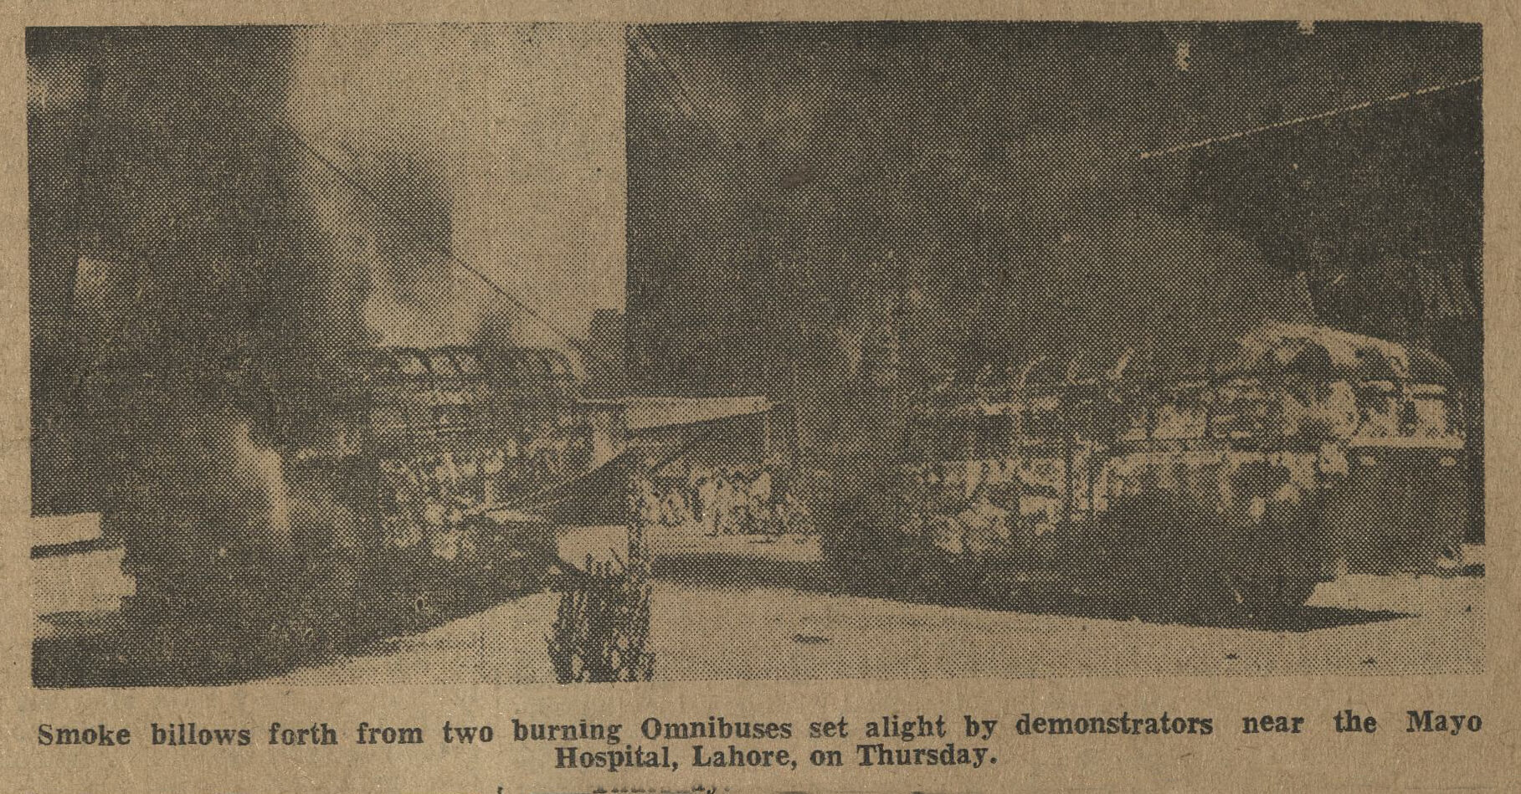

Slide 19
2. Anti Ahmadiyya riots 1953 :
Objectives and critical analysis:
Lahore based-Religious in nature-majoritarian in nature.
Military was called in
Question 1: No, they addressed a deeply divisive religious issue
However, they called into question the performance of civilians
Question 2: Failed in the short term –marginalized a sect
Reasons for failure:
Did not have countrywide resonance then.

Slide 20
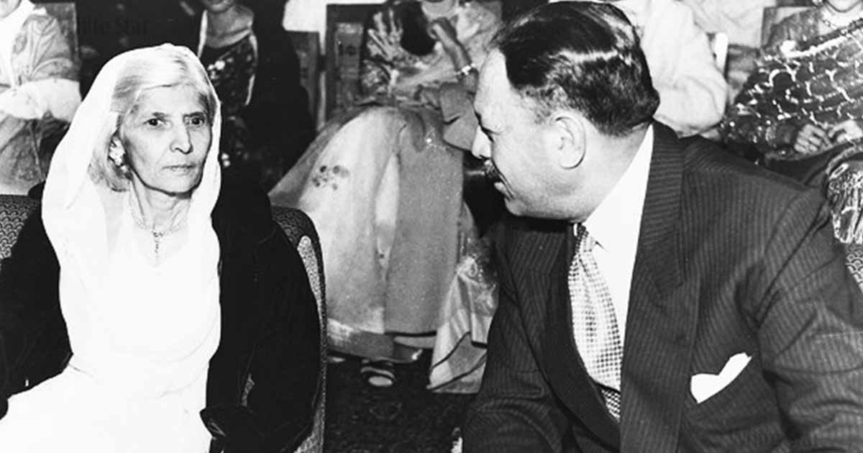

Slide 21
3. Election riots Dec 1964-Jan 65:
Objectives and critical analysis:
Combined opposition COP- against rigging
Attacks on COP rallies
Question 1:
Yes, it was structurally unfair-basic democrats-faithless and malleable-democratic vacuum
Question 2:
Failed in the short term but traction in the long term

Slide 22
3. Election riots Dec 1964-Jan 65:
election results accepted by Ms Fatima Jinnah
One man one vote gained momentum
Reasons for short term failure:
The Ayub regime had strong control in rural areas
Ms Fatima Jinnah won urban centers but COP campaign suppressed

Slide 23
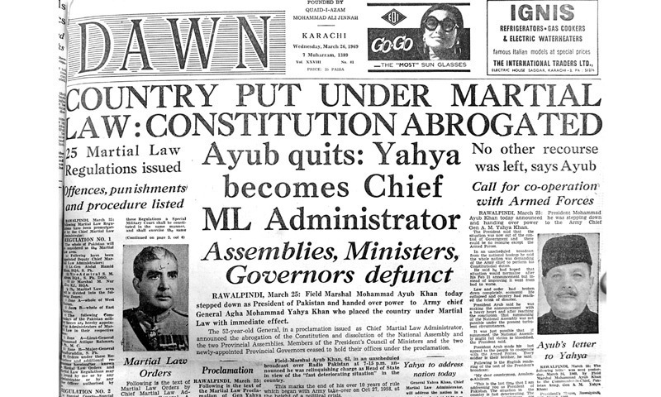

Slide 24
4. 1968 urban riots against Ayub:
Objectives and critical analysis:
One man one vote
End to vertical and horizontal inequality (top bottom and East West)
Question 1:
No, it was a systemic outrage against the whole political system.
Question 2:
Successful- led to eventual overthrow of Ayub and one vote one vote

Slide 25
4. 1968 urban riots against Ayub:
Reasons for success
Widespread vertical and horizontal support
Post 1965 economic miracle slowed down
Ayub’s health
Marginalisation of East Pakistan

Slide 26
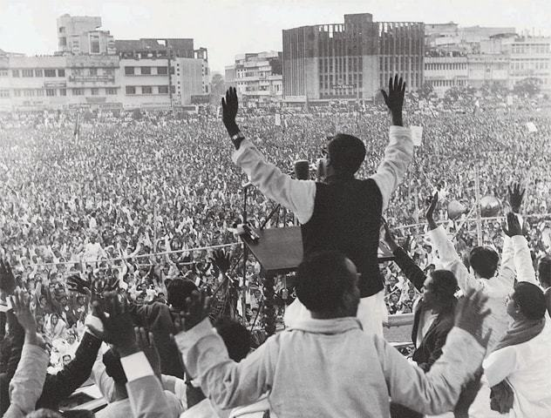

Slide 27
5. March 1971 protests in East Pakistan:
Objectives and critical analysis:
Against delay in convening National Assembly session in Decca
Asked for autonomy not self determination then
Misread, mishandled, and suppressed by “Operation Searchlight”
Permanent ignominy and tragedy for Pakistan
Question 1:
No, they addressed a fundamental blind spot of Pakistani federalism as well as self-determination

Slide 28
5. March 1971 protests in East Pakistan:
Question 2:
Not successful in March-brutally suppressed but led to self determination
Reasons for short term failure:
Military suppression
Failure of tripartite negotiations in mid March 1971

Slide 29
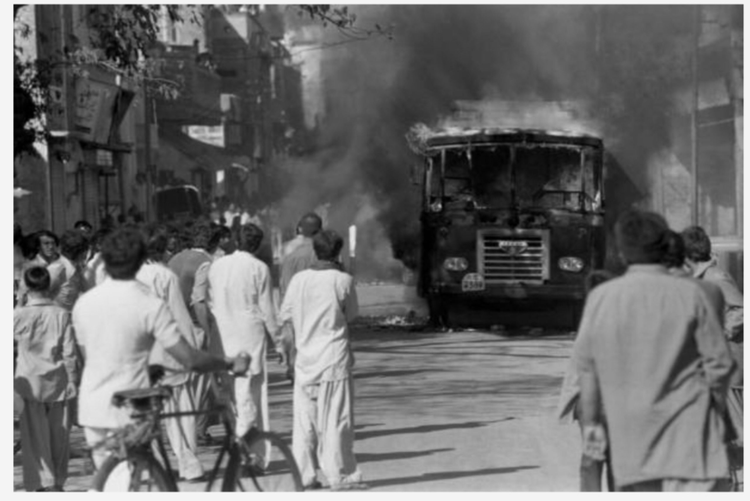

Slide 30
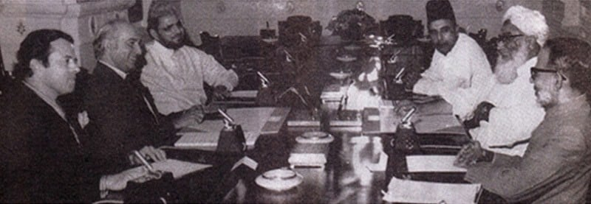

Slide 31
6. PNA riots 1977:
Objectives and critical analysis:
Protests against alleged rigging of 1977 elections
Free and fair elections
Question 1:
Yes, they addressed a democratic institutional deficit
Question 2:
Failure-as described by PNA leaders later on
Democracy derailed

Slide 32
6. PNA riots 1977:
Reasons for failure :
A genuine democratic demand became personality driven (anti-Bhutto)
Military intervention (not the stated motive of PNA leadership)
A case of unintended consequences

Slide 33
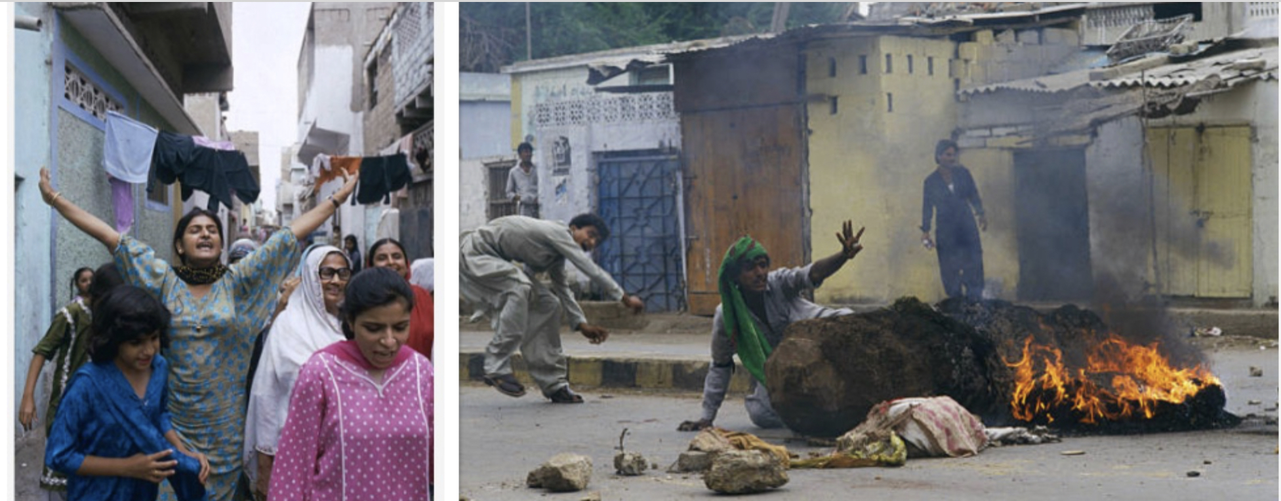

Slide 34
7. MRD PROTESTS 1983:
Objectives and critical analysis:
Nationalist, pro democracy
Sind wide, suppressed with force.
Question 1:
No, they were more fundamental-against dictatorship
Federal deficit
Question 2:
Partial success – brought Sind back to political mainstream

Slide 35
7. MRD PROTESTS 1983:
Reasons for partial success:
Were suppressed in the short term
However, paved the way for the return of Ms Benazir Bhutto.

Slide 36
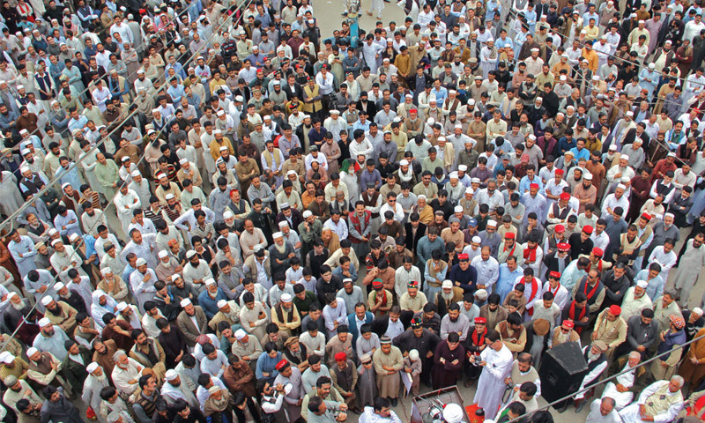
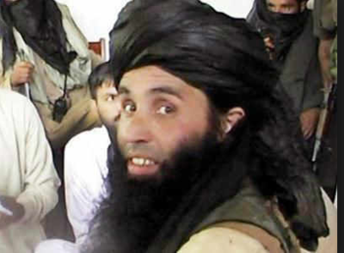

Slide 37
8. Malakand protests 1990s, 2005-2009
Objectives and critical analysis:
Islamic system of government
Military action eventually
Question 1:
Partially, they were based on religion, though portrayed as a democratic alternative
Question 2:
Failed, but created long term political instability in Pakistan.

Slide 38
8. Malakand protests 1990s, 2005-2009
Reasons for failure
State suppression
Extremist version of Islam failed to catch country wide imagination

Slide 39
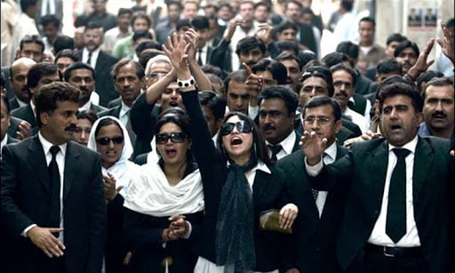

Slide 40
9. Lawyers movement 2007-2009
Objectives and critical analysis:
Restoration of deposed superior judiciary
Question 1:
No, a fundamental paradigm changing movement, unique in world history
Question 2:
Succeeded, start of judicial activism, legal activism, restoration of democray
Reasons for success:
Outrage-removal of Chief Justice, movement against Musharraf

Slide 41
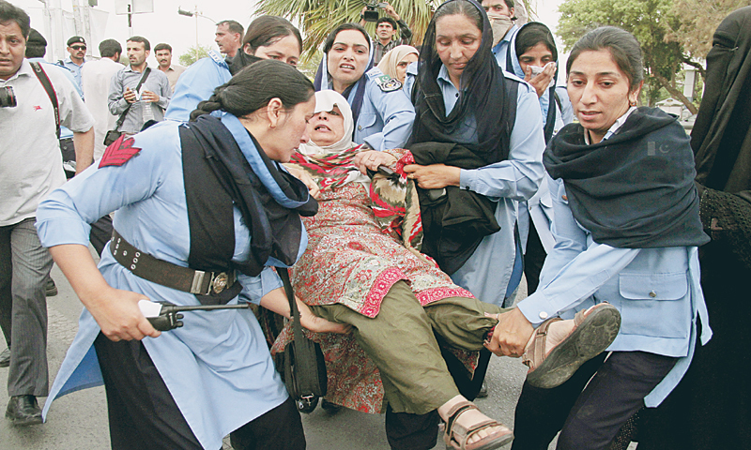
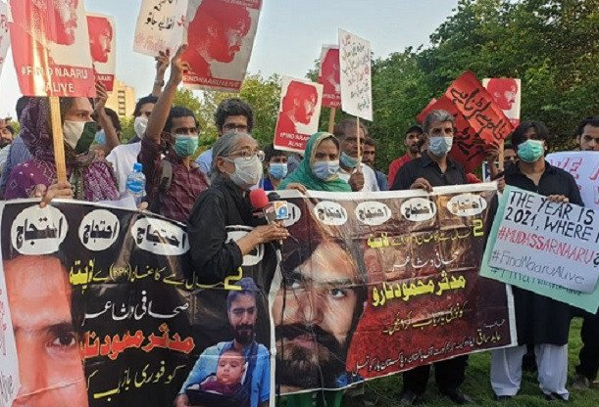

Slide 42
10. Movement against forced disappearances
Objectives and critical analysis:
To trace hundreds of missing Pakistanis, primarily in Balochistan
Question 1:
Yes, the travails of a security state.
Question 2:
Partially successful- state impunity lessened, return of hundreds
Reasons for success:
Judicial activism, media coverage.

Slide 43
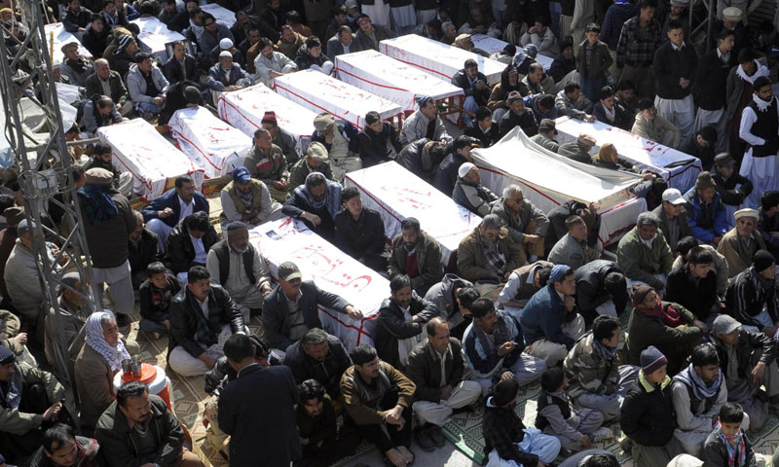

Slide 44
11. Protests against ethnic killings
Objectives and critical analysis:
Outrage against ethnic killings mainly in Balochistan
Delayed burials and political response
Question 1:
Partially yes, federal deficit, minority deficit, related to militancy
Question 2:
Partially successful only- frequency has decreased
Reasons for partial success:
Societal outrage, media coverage, Human rights groups

Slide 45
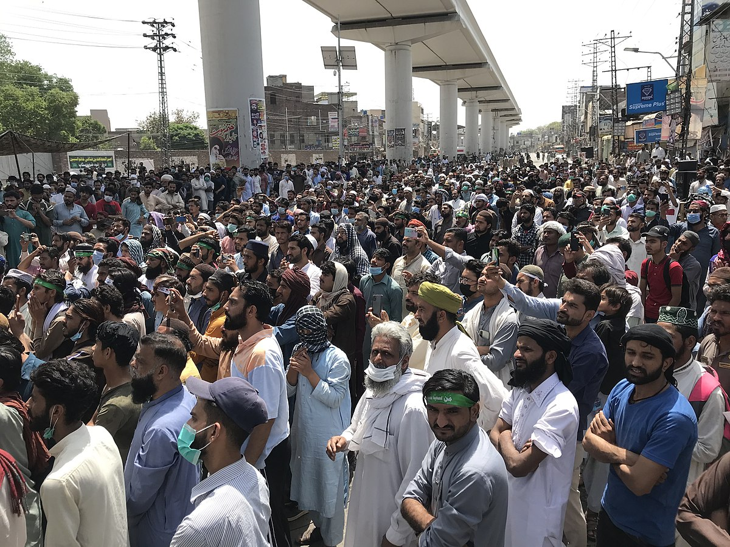

Slide 46
12. Localised protests
Objectives and critical analysis:
Murders, job issues, organizational insensitivity
Question 1:
Yes, weak governance
Question 2:
Failure-short duration attention
Reasons for failure:
Basic structural inadequacies of the state remain

Slide 48
13. Long marches 2014, 2022
Objectives and critical analysis:
Articulation of a narrative against corruption and mal-governance by a political party.
Question 1:
Yes, a democratic deficit and a perception that democracies have been generally corrupt and inefficient
Question 2:
Successful- it has caught the imagination of a substantial vote bank

Slide 49
13. Long marches 2014, 2022
Reasons for success:
Charisma of a political leader
A new worldwide social media successful campaign
A desire for an alternative democratic paradigm

Slide 51
14 . Local issues gone wrong
Objectives and critical analysis:
Passion and rhetoric leads to violent crime
Question 1:
Yes, a democratic deficit and bad governance
Question 2:
Disaster in society
Reason for failure:
Misplaced passion based on malgovernance

Slide 52
Role of social media
They have liberated public groups from the need to use mainstream media
Social media groups can be located outside of the state and free from coercion
This has led to propagation of counterfactual narratives
Mobilise public opinion
Passion and rhetoric leads to violent crime

Slide 53
Directions of the Judiciary
Refusal to pass any anticipatory order to stop the PTI’s planned second long march on the federal capital.
The top court, however, gave a “free hand” to the government to tackle the law and order situation.
Designated routes and venues, guarantees.

Slide 54
Analysis of the protests
Protests | Democracy/governance | Different reasons | Success
1. Language Riots 1952 |  | Yes | Yes
2. Anti Ahmadiyya Riots 1953 |  | Yes | No
3. Election riots 1964-65 | Yes |  | No
4. 1968 riots |  | Yes | Yes
5. March 1971 protests |  | Yes | No
6. PNA riots 1971 | Yes |  | No
7. MRD protests 1983 |  |  | Yes
8. Malakand protests 1990s, 2005-2009 | Yes | Yes | No
9. Lawyers Movement 2007-2009 |  | Yes | Yes
10. Movement missing persons | Yes | Yes | Yes
11. Protests against Ethnic killings | Yes | Yes | Yes
12. Localised protests | Yes |  | No

Slide 55
Analysis of the protests
Protests | Democracy/governance | Different reasons | Success
13. Long Marches 2014, 2022 | Yes |  | Yes
14. Local protests gone wrong | Yes |  | No

Slide 58
Conclusion
Street protests in Pakistan (and the world) are only partially driven by democratic deficit and bad governance, but a historical analysis shows that an equal number or more have been driven by fundamental state and society issues which confront Pakistan, like federal rights, religious fault-lines, and the peoples quest for a more just and egalitarian state.
Protests that have wider following, which have caught country wide traction, and are well articulated have been more successful than those that have challenged the national security paradigm of the state. However, street protests have to be managed to mitigate hardships to public.

Slide 59
Recommendations
Street protests have to be recognized as an integral part of a democratic polity in a state with simultaneity of positive as well as negative consequences.
Suppression of these protests will lead to catastrophic consequences for the state. Therefore Pakistan must learn to integrate them in national polity as a necessary component of state.
Even if parliament is strengthened by institutions such as mandatory presence, question hour, strengthening parliamentary committees, such protests are widespread in Europe and have been accepted as a legitimate means of articulating demands
In recent times, even during protests, unlike the past, the government has continued with its foreign policy functions like important state visits to Saudi Arabia and China. State and society must function along with these protests.

Slide 60
Recommendations
Officers have to be responsive and interactive with public. Random response calls and WhatsApp feedback loops should be encouraged instead of fancy applications to avoid public anger.
Unbridled street protests disrupting life in urban centers must be discouraged. The judiciary has stepped in to fill the void and has instituted guidelines for long marches and protests. Such guidelines must be implemented across the board by the state in a non partisan manner.
Recent judgements of the Supreme Court and the Islamabad High court have not preemptively stopped street protests but have given a carte blanche to the state to take steps to force avoidance of disruption of normal life.

Slide 61
Thank you

