Slide 2
Is another Global Financial Crisis Simmering? How it can be Pre-empted? Ali Jan Khan 117th NMC Sponsor DS: Dr Naveed Ahmad Chaudhry 9th November, 2022
National Management College
Contemporary Issue Series (CIS)

Slide 3
Acronyms
COVID-19 | Coronavirus Disease
CPI | Consumer Price Index
EMDEs | Emerging Markets & Developing Economies
FBR | Federal Board of Revenue
FDI | Foreign Direct Investment
GDP | Gross Domestic Product
GNI | Gross National Income
ILO | International Labor Organization
IMF | International Monetary Fund
PKR | Pakistani Rupee
SOEs | State Owned Enterprises
S&P 500 | Standard & Poor’s 500 Index
USD | United States Dollar

Slide 4
Sequence of Presentation
Setting the context – Problem Statement
Understanding Drivers of Financial Crisis
Current Global Outlook
Framework for pre-empting Global Financial Crisis
Policy Implications for Pakistan
Conclusions and Recommendations

Slide 5
Setting the context – Problem Statement
Understanding Drivers of Financial Crisis
What is a financial crisis, and why does it matter?
Current Global Outlook
Framework for pre-empting Global Financial Crisis
Policy Implications for Pakistan
Conclusions and Recommendations

Slide 6
Defining Financial and Economic crisis – their Interdependence
Financial Crisis
Economic Crisis
Financial assets’ values fall rapidly in an economy
consumers are unable to pay their debts
Financial institutions face liquidity shortages, causing economic instability
Financial crisis can spread in economy, region, country or even worldwide
An economic crisis is when a country’s economy deteriorates significantly.
In most cases, a financial crisis is the cause of an economic crisis
Drying up of liquidity
High unemployment
Low production levels
Falling GDP
Economic fluctuations due to deflation or inflation
Source: https://www.investopedia.com/articles/investing/011116/3-financial-crises-21st-century.asp#:~:text=The%202007–2009%20global%20financial,the%20collapse%20of%20Russia%27s%20economy
Notes:
https://www.investopedia.com/articles/investing/011116/3-financial-crises-21st-century.asp#:~:text=The%202007–2009%20global%20financial,the%20collapse%20of%20Russia%27s%20economy.

Slide 7
Statement of Problem
Finance is life blood of an economy; post pandemic global financial crisis has affected all major economies leading to expected recession. The identification of key drivers causing this global financial crisis will help in comprehending its gravity and taking pre-emptive measures. Developing countries like Pakistan have little role to prevent this yet some measures shall be taken to reduce impact on economy, markets and general public (vulnerable segment in particular).

Slide 8
Key Questions
Likelihood of Financial Crisis
Whether current global financial state is likely to turn into global financial/ economic crisis ? What are likely key drivers of this imminent potential recession?
Pre-empting financial crisis
What are key indicators that will serve as early alarms to indicate and hence in pre-empting the financial crisis?
Implications for Pakistan
What are potential implications of global financial crisis for Pakistan? What policy options shall the Government implement to reduce its impact on economy, markets & common man (marginalized segment)?

Slide 9
Since pandemic, Economists are predicting a financial crisis
Dec, 2020
Oct, 2022

Slide 10
Financial crisis leading to a global recession
April, 2022
Sept, 2022
Sept, 2022
Oct, 2022
In 2006, Economist Nouriel Roubini wrote that the U.S. was headed into a long and "protracted" recession due to the "collapse" of house prices, which he noted were already in freefall. This came true in 2008

Slide 11
Interdependence of Financial and economic crisis
Jun, 2022
Oct, 2022

Slide 12
Understanding factors leading to previous global financial crises shall help in predicting this one more accurately
Setting the context – Problem Statement
Understanding Drivers of Financial Crisis
Current Global Outlook
Framework for pre-empting Global Financial Crisis
Policy Implications for Pakistan
Conclusions and Recommendations

Slide 13
Examples of Drivers from Financial Crises in the past (1/2)
1637
Dutch Tulip Bulb
Artificial hike in import luxury (tulip bulbs). Capital liquidated (including houses) to buy. Massive plunge as price bubble burst.
1720
South Seas Bubble
Company by act of Parliament, awarded slave trading monopoly. World’s 1st financial crash, 1st Ponzi scheme. Stock price from £1000 to £124
1772
British Credit Crisis
Two London banks close in June. Closing spread across England and Scotland; then Dutch banks. Termed as first modern banking crisis.
The Great Depression
1929 stock market crash; world trade and money supply collapses, industrial production declines, mass unemployment, increase in poverty
1929-39
1974
Stock Market Crash
Bretton Woods collapses, all major stock markets in world collapse, Nixon Shock, USD devaluation under Smithsonian Agreement, 1973 oil prices shock
1980s
LATAM Sovereign Debt
Debt to US banks; earning power exceeded after high growth is interrupted (US Fed Res. ▲ interest rate to control inflation in US
1987
Black Monday
Sudden, severe, unexpected stock market crash on Monday, Oct 19, 1987. Strong bull market correction, nascent automated trading and mass panic.
Sources: https://rtistic.info/history-of-the-global-financial-crisis/, https://www.caproasia.com/2016/04/12/economic-crisis-since-1900-2015/ , https://www.economist.com/news/essays/21600451-finance-not-merely-prone-crises-it-shaped-them-five-historical-crises-show-how-aspects-today-s-fina
Notes:
Sources:
https://rtistic.info/history-of-the-global-financial-crisis/

Slide 14
Examples of Drivers from Financial Crises in the past (2/2)
The Asian Crisis
Speculative capital flows from developed countries to Thailand, Indonesia, Malaysia, Singapore, HK, South Korea. Excessive debt accumulation leading to bankruptcies
1997
1998
Russian Ruble Crisis
Asian crisis spillover. Ruble lost over 2/3rds value. Govt defaulted on sovereign debt. Banking crisis and negative impact on neighboring economies
2000s
Dot.com bubble
Rapid rise in U.S tech stock equity valuations Nasdaq index fluctuated (under ~1,000 in 1997 → 5,048 in Mar 2000 →1,139 in Oct 2002)
Subprime Mortgage
Cheap credit, lax lending standards; too many subprime borrowers defaulting. Worthless investments leading to layoffs & unemployment
2008-10
European Debt Crisis
Eurozone member states (Greece, Portugal, Ireland, Spain, and Cyprus) unable to repay debt or bail out over-indebted banks after period of slow economic growth
2010
Russian Financial Crisis
Russian Oil falls, economic sanctions due to Russian invasion of Crimea, investors selling their Russian assets, and a sharp devaluation of Ruble
2014
Sources: https://rtistic.info/history-of-the-global-financial-crisis/, https://www.caproasia.com/2016/04/12/economic-crisis-since-1900-2015/ , https://www.economist.com/news/essays/21600451-finance-not-merely-prone-crises-it-shaped-them-five-historical-crises-show-how-aspects-today-s-fina
Notes:
Sources:
https://rtistic.info/history-of-the-global-financial-crisis/

Slide 15
Drivers of financial crises
1
Excessive risk taking
Negligible or absent regulation, reduced checks, hyper-valuation of assets
Excessive Speculation
2
Increased interest and inflation rates
Reduced spending, increased saving
Saving often in assets, which can increase leverage, but if speculative, can amplify losses
3
Commodity & Energy Market instability
Commodity market shocks, due to natural or manmade events
Energy Markets are volatile and prices increasing
4
Warfare, natural calamities, etc. can trigger financial crises
High synchronization of global financial markets increases vulnerability to shocks
Geopolitical instability

Slide 16
All major recessions preceded by Financial Crisis
Financial Crisis preceding a global recession
Second Oil Shock (1982)
Financial Crisis of 2008-9
Global Supply Shocks (1975)
1930
1975
1982
1991
2008
2020
The Great Depression (1930’s)
Geopolitical uncertainty, Multiple Shocks (1991)
COVID-19 driven recession

Slide 17
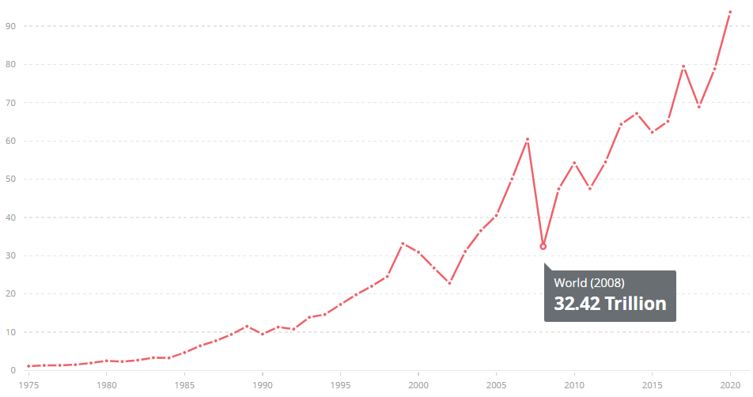
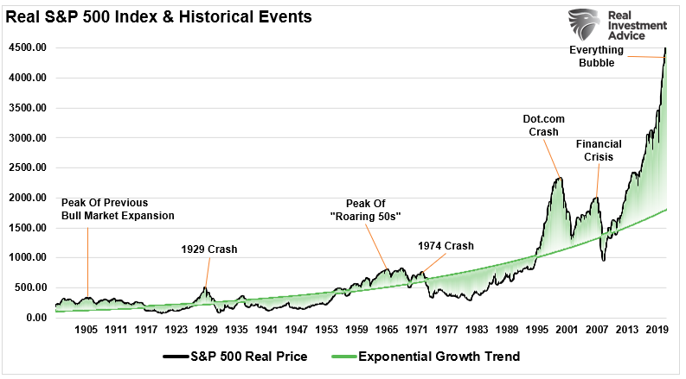
Stock market or asset bubbles can be observed in crises
Causes:
Initially Excessive risk-taking followed by
Panic selling in unfavorable macroeconomic environment
Market capitalization of listed domestic companies, ($)
S&P 500 index performance reflecting bubbles before major crisis
1975 | 1980 | 1985 | 1990 | 1995 | 2000 | 2005 | 2008 | 2015 | 2020
Source: Market Capitalization data, available at https://data.worldbank.org/indicator/CM.MKT.LCAP.GD.ZS
Source: S&P 500 deviations from mean trend, available at https://realinvestmentadvice.com/the-biggest-crash-in-history-is-coming-kiyosaki-says-so/

Slide 18
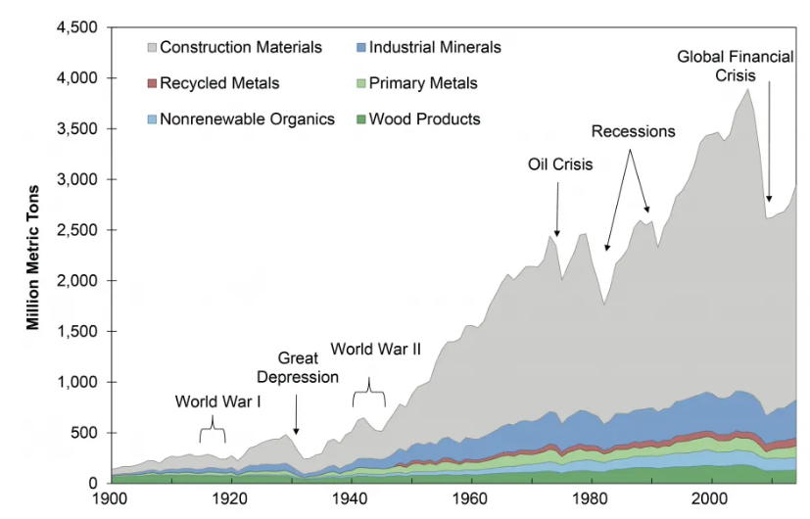
Key industries show sudden drop in activity
Non-fuel material consumption, 1900-2014
Source: https://css.umich.edu/publications/factsheets/material-resources/us-material-use-factsheet
Notes:
https://css.umich.edu/publications/factsheets/material-resources/us-material-use-factsheet

Slide 19
Absolute GDP shows sluggish increase around recessions
Global GDP
Note: Development indicators record begins post 1960
Current USD, billions
1975 Recession
1982 Recession
1991 Recession
Financial Crisis of 2008-09, leading to global recession
COVID-19 recession
Source: GDP (Current USD), World Bank Data Bank, available at https://data.worldbank.org/indicator/NY.GDP.MKTP.CD

Slide 20
GDP growth rates decline around recessions
Global GDP Growth Rate
Note: Development indicators record begins post 1960
Figures in %
1975 Recession
1982 Recession
1991 Recession
Financial Crisis of 2008-09, leading to global recession
COVID-19 recession
Source: GDP Growth Rate (annual %), World Bank Data Bank, available at https://data.worldbank.org/indicator/NY.GDP.MKTP.KD.ZG

Slide 21
Simultaneously, corresponding increase in inflation
Global Inflation in consumer prices
Note: Development indicators record begins post 1960
Annual %
Data not available
1975 Recession
1982 Recession
1991 Recession
Financial Crisis of 2008-09, leading to global recession
COVID-19 recession
Source: Inflation, consumer prices (annual %), World Bank Data Bank, available at https://data.worldbank.org/indicator/FP.CPI.TOTL.ZG

Slide 22
Setting the context – Problem Statement
The World has just passed through once in a century pandemic, it is still witnessing some of disruptions caused by it. There are other factors those have aggravated the crisis
Understanding Drivers of Financial Crisis
Current Global Outlook
Framework for pre-empting Global Financial Crisis
Policy Implications for Pakistan
Conclusions and Recommendations

Slide 23
Post-globalization, financial system failures can spill-over across borders
Volatility due to prolonged and recurring natural disasters
COVID pandemic
Climate crisis - floods in West and Central Africa, Pakistan
Geo-political Conflict (Ukraine-Russia, China-Taiwan)
High Price Volatility (Commodities - Oil price, European Energy Prices)
Intellectual Property Rights Conflict (China-US)
The global environment is fragile right now with fears on multiple fronts
Notes:
https://www.cigionline.org/articles/understanding-intellectual-property-disputes-between-china-and-united-states/

Slide 24
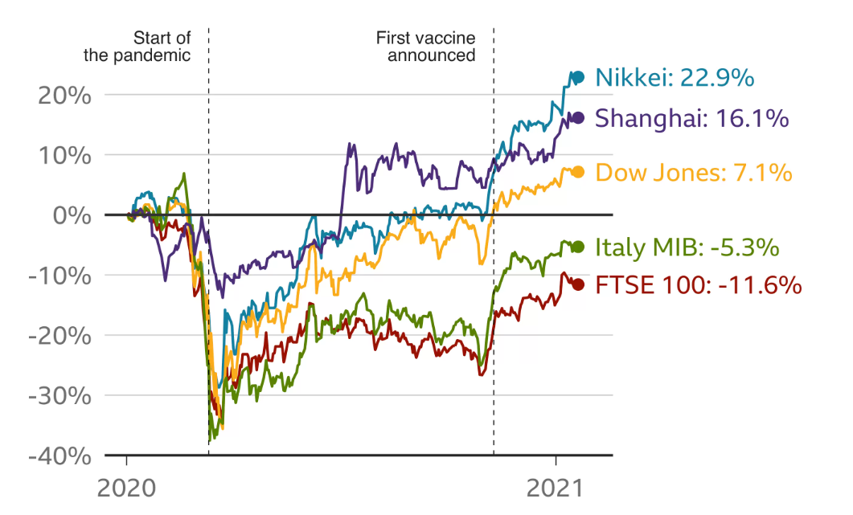
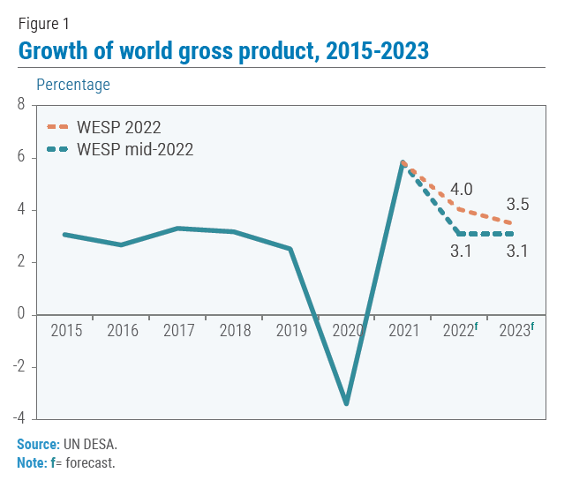
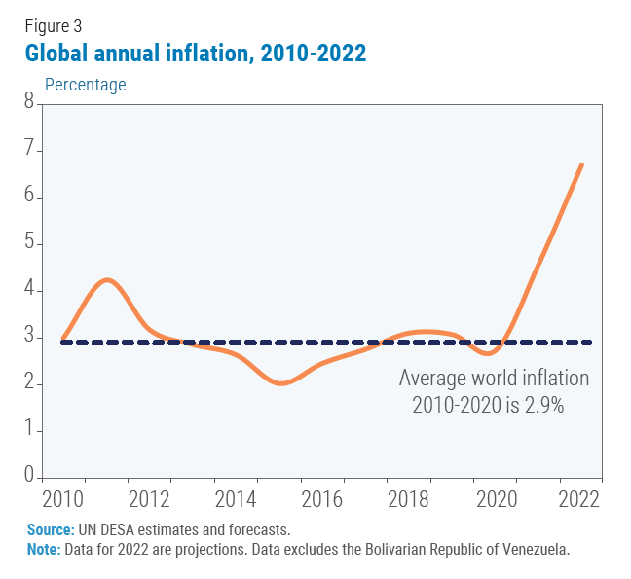
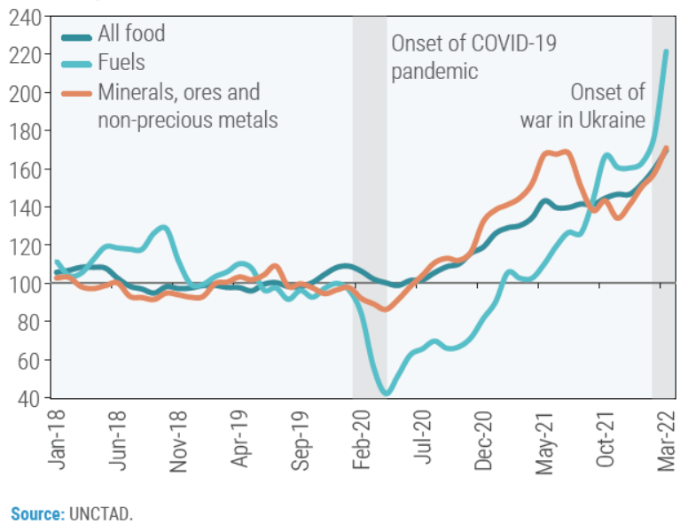
Impact of COVID on global financial markets
1
2
Performance of major stock markets
Global GDP growth (annual %)
Global Annual Inflation (%)
Major commodity price (index, 2019 = 100)
3
4
Source: Nikkei 225 Tokyo, Dow Jones 30 Industrial in US, FTSE 100 London Stock Exchange
Coronavirus: How the pandemic has changed the world economy, available at https://www.bbc.com/news/business-51706225
2. 3., and 4. World Economic Situation and Prospects, available at https://www.un.org/development/desa/dpad/publication/world-economic-situation-and-prospects-june-2022-briefing-no-161/

Slide 25
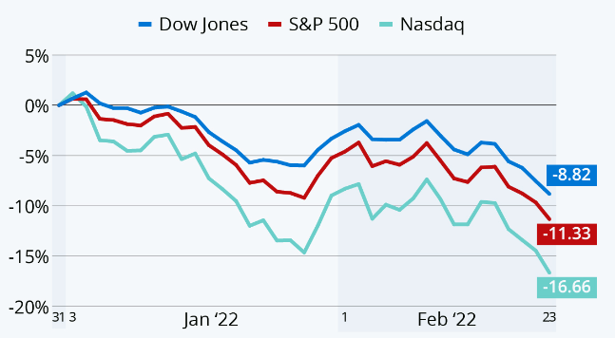
Impact of Ukraine-Russia conflict on global financial market
1
2
Performance of major stock markets
Global GDP growth (annual %)
Global Annual Inflation (%)
3
Major commodity price (index, 2019 = 100)
4
Source:
US Stock Indices, available at https://www.statista.com/chart/26917/year-to-date-development-of-biggest-us-stock-market-indices/
2., 3., and 4. World Economic Situation and Prospects, available at https://www.un.org/development/desa/dpad/publication/world-economic-situation-and-prospects-june-2022-briefing-no-161/

Slide 26
Causality, or correlation; oil price fluctuations and GDP growth rate
1972 - 87
2002 - 17
Crude Oil Real Price (2010 USD, per bbl)
Global GDP Growth Rate
1991 Recession
Financial Crisis of 2008-09
1975 Recession
1982 Recession
COVID-19 driven recession
Source: Pink Sheet Data, World Bank, available at https://www.worldbank.org/en/research/commodity-markets
Notes:
Economic growth is often purported to be linked to oil, creating a certain price inelasticity.

Slide 27
Setting the context – Problem Statement
It is important for countries to develop early warning systems to preempt global financial crisis
Understanding Drivers of Financial Crisis
Current Global Outlook
Framework for pre-empting Global Financial Crisis
Policy Implications for Pakistan
Conclusions and Recommendations

Slide 28
Are current events leading the world to next Global Financial Crisis?
1. Can we categorize current events as Global Risk?
Global risks include the risks which affect the world market in a broad sense. In other words, it refers to the risks that have a negative and crucial influence on many different countries at the same time.
Two pronged framework to assess current situation
Are there any early warning / leading indicators to assess financial crisis risk?

Slide 29
1. Can we categorize current events as Global Risk?
The risk should affect many different regions in the world to be a global risk, this is referred to as having a “global scope.”
The risk has an influence on various industries.
The risk should have a high level of uncertainty to be considered a global risk.
The risk should cause economic damage at an important level (significant scale).
Global risk report by World Economic Forum gives a framework to identify a Global risk:
Source: IMF Global Financial Stability Report October, 2002 available at https://www.imf.org/en/Publications/GFSR/Issues/2022/10/11/global-financial-stability-report-october-2022

Slide 30
1. Can we categorize current events as Global Risk?
Impacts Multiple Industries
Significant Economic Damage
Global scope
High Uncertainty
Natural disaster (pandemic, climate risk)
Geographical Conflict
Commodities Price
Energy Price
Intellectual Property Rights

Slide 31
2. Are there any early warning / leading indicators to assess financial crisis risk
4 Key Indicators
Indicator Detail
Importance of indicator
Sum of gross value added by all resident producers in the economy plus any product taxes
GDP indicates overall health of economy (how much money, moving how fast)
GDP
Inflation
Annual percentage change in the cost to the average consumer of acquiring a basket of goods and services
Ability and willingness to spend is linked to inflation
Budget Balance
Difference between a government’s revenues (taxes and proceeds from asset sales) and its expenditures
If positive, (receive more, spend less), government’s fiscal management is strong
External Debt
Outstanding amount of those actual current, and not contingent, liabilities that require payment in the future, owed to nonresidents by residents
Greater debt = lesser money available for stimulating local economy and GDP = cash strapped countries
Source: https://databank.worldbank.org/

Slide 32
GDP indicators hint towards cycle of recessionary economy
Inflation Rate (% change) Forecast:
EMDE’s forecast is concerning
GDP growth rates (%):
Revised downwards
 |  | Projections
 | 2021 | 2022 | 2023
World Output | 6.1 | 3.2 | 2.9
Advanced Economies | 5.2 | 2.5 | 1.4
Emerging Markets and Developing Economies | 6.8 | 3.6 | 3.9
 |  | Projections
 | 2021 | 2022 | 2023
World Output | 4.7 | 8.8 | 6.5
Advanced Economies | 3.1 | 7.2 | 4.4
Emerging Markets and Developing Economies | 5.9 | 9.9 | 8.1
Source: IMF World Economic Outlook available at https://www.imf.org/en/Publications/WEO/Issues/2022/10/11/world-economic-outlook-october-2022
Notes:
IMF worl

Slide 33
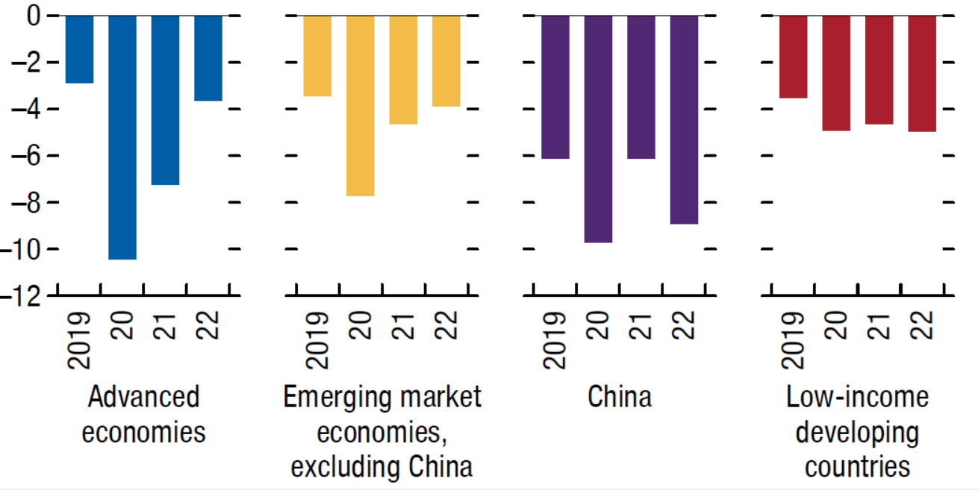
National Budget Balance
Budget Deficit as percentage of GDP
National Budget Balances, by Income Group, 2019–22
Low-income developing countries consistently spending more than revenue
Can be a problem if GDP contracts
Source: IMF Fiscal Monitor, available at https://www.imf.org/en/Publications/FM/Issues/2022/10/09/fiscal-monitor-october-22
Notes:
IMF worl

Slide 34
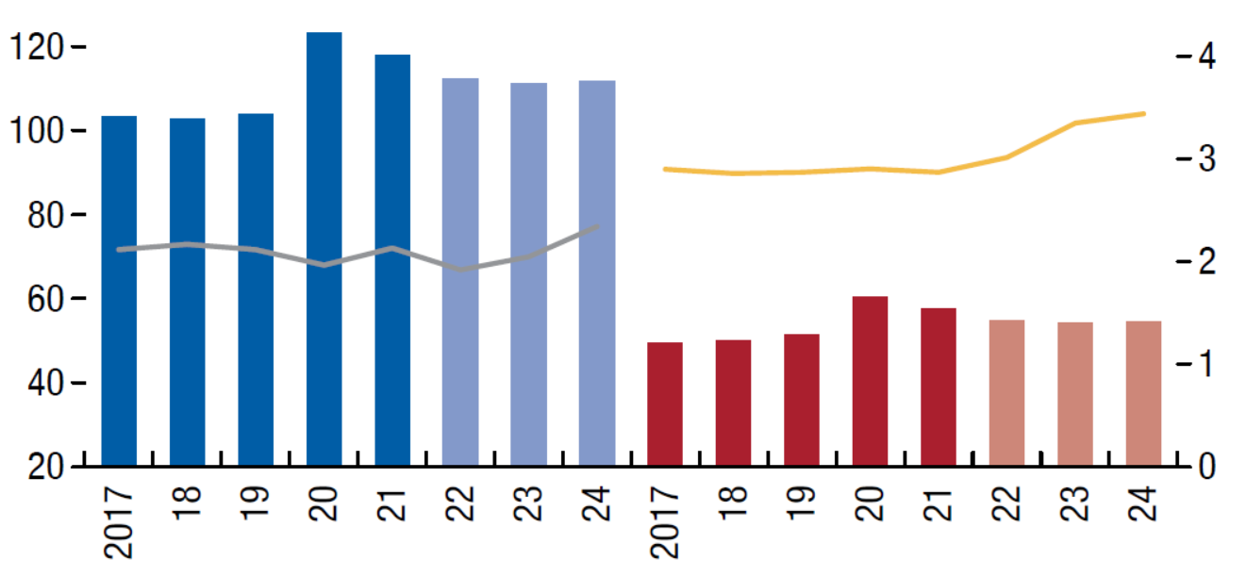
National Gross Debt and Interest Expense
Debt-to-GDP ratio (Percent of GDP) and Interest Payment (weighted Avg, %)
Interest payments on debt expected to rise due to higher interest rates for EMDE’s.
U.S. interest rates have increased 5 times so far in 2022
Source: IMF Fiscal Monitor, available at https://www.imf.org/en/Publications/FM/Issues/2022/10/09/fiscal-monitor-october-22

Slide 35
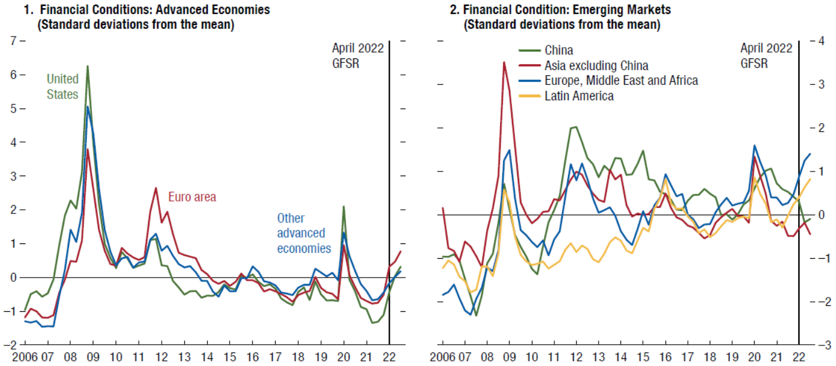
IMF’s Financial Condition Index hint at global macro-financial instability
Financial Conditions Index: Weighted composite scores of riskless interest rates, money markets, debt and equity markets and credit spreads
Higher score, tighter financial conditions
Source: IMF Global Financial Stability Report (GFSR) – Oct 2022, available at https://www.imf.org/en/Publications/GFSR/Issues/2022/10/11/global-financial-stability-report-october-2022

Slide 36
Setting the context – Problem Statement
Countries like Pakistan are vulnerable to any global financial crisis particularly in the US and Europe traditionally and in China post CPEC
Understanding Drivers of Financial Crisis
Current Global Outlook
Framework for pre-empting Global Financial Crisis
Policy Implications for Pakistan
Conclusions and Recommendations

Slide 37
Currently, 5 countries constitute ~54% of the world’s total GDP
Gross Domestic Product
Current USD
~43 Trillion
96.1 Trillion
~46%
4.9 Trillion
4.2 Trillion
3.2 Trillion
17.7 Trillion
~23 Trillion
3%
5%
4%
18%
24%
Source: GDP (Current USD), World Bank Data Bank, available at https://data.worldbank.org/indicator/NY.GDP.MKTP.CD

Slide 38
US and global GDP Growth Rates have mirrored; Recessions causality with decreased GDP growth in US
1975 Recession
1982 Recession
1991 Recession
Financial Crisis of 2008-09, leading to global recession
Source: GDP Growth Rate (annual %), World Bank Data Bank, available at https://data.worldbank.org/indicator/NY.GDP.MKTP.KD.ZG

Slide 39
Pakistan’s economic profile is not very promising to withstand a global crisis (14th IMF Program since 1980)
Exports of goods and services
(% of GDP)
Gross fixed capital formation
(% of GDP)
1
2
Lowest export to GDP ratio in in the Region
Lowest investment rates
3
Personal Remittances received
(% of GDP)
External debt stocks to GNI (%)
4
Excessive Indebtedness
Over-reliance on Remittances
Sources:
https://data.worldbank.org/indicator/NE.EXP.GNFS.ZS
https://data.worldbank.org/indicator/NE.GDI.FTOT.ZS
https://data.worldbank.org/indicator/DT.DOD.DECT.GN.ZS
https://data.worldbank.org/indicator/BX.TRF.PWKR.DT.GD.ZS

Slide 40
Minimal cushion for sustaining any long term financial crisis in Pakistan
 | 2021-22 July - Sept | 2022-23 July - Sept | % Change
Remittances ($ Billion) | 8.2 | 7.7 | 6.3▼
Export ($ Billion) | 7.2 | 7.6 | 5.5▲
Import ($ Billion) | 17.4 | 16.0 | 7.9▼
Current Account Deficit ($ Billion) | 3.5 | 2.2 | ▼
Forex Reserves ($ Billion) | 23.849 | 14.626
FBR Revenue (PKR Billion) | 1,396 | 1,634 | 17▲
Policy Rate (percent) | 7.25 (Sept, 21) | 15.0 (Oct, 22)
CPI (national) (percent) | 8.6 | 25.1
Market Capitalization ($ Billion) | 33.99 | 30.56 | 10.09▼
Source: Ministry of Finance, monthly economic update and outlook – Oct 2022 available at https://www.finance.gov.pk/economic/economic_update_October_2022.pdf

Slide 41
Should Pakistan be worried?
Pakistan is facing stagflation :
Stagnant economic
Inflation rising
This can lead to
Unemployment
Shrinking of economy
High external debt
Repayment will need more money
Increased savings can further slow down economy
Pak inflation (consumer price %)
Pak GDP Constant (Current USD, billions)
Short Answer: Yes
Source: Country wise statistics, World bank. Available at: https://data.worldbank.org/indicator/FP.CPI.TOTL.ZG?locations=PK and https://data.worldbank.org/indicator/NY.GDP.MKTP.CD?locations=PK

Slide 42
Setting the context – Problem Statement
It would be important to pre-empt a financial crisis if economic hardship has already been impacting people, organizations, and countries
Understanding Drivers of Financial Crisis
Current Global Outlook
Framework for pre-empting Global Financial Crisis
Policy Implications for Pakistan
Conclusions and Recommendations

Slide 43
Conclusions
Recessions in past are preceded by Financial crises, World has witnessed once in a century Pandemic followed by regional conflicts, increases in commodities and oil prices. The recession is imminent and EMDEs are likely to suffer more than developed economies. Pakistan shall take measures to reduce its impact on its economy and marginalized segments.

Slide 44
Recommendations (1/2)
Artificial lowering of inflation; increased public spending
Optimize Capital Account and encourage productive FDI to build local capacity
Fiscal and Monetary Management
Regulate big markets, e.g. housing / land markets
Adjust for resilience to shocks
(e.g. ensure food security, work on bilateral agreements to ensure regional stability)
Reduce expenditure by rationalizing subsidies
Privatization of SOEs to counter losses being accrued
Improve Tax to GDP ratio
Market Management

Slide 45
Recommendations (2/2)
Four Pillars of Stability Framework
Incentivize investment in High Impact sectors and provide buffer to local industry against shocks and unemployment.
Import Substitution and Dual exchange rate for preferred exports
Support local industry and incentivize export
Improve Female workforce participation
Invest in ease of entry into workforce through skill development etc.
Gender Dividends
Protecting bottom of the economic pyramid
Provide opportunities to middle and lower income group on the principles of equity
Building Resilience against job or income losses
Strong Social Protection

Slide 46
Bibliography
Finance Ministry, Govt of Pakistan. Monthly economic update and outlook – Oct 2022 available at https://www.finance.gov.pk/economic/economic_update_October_2022.pdf
Financial Times. “Where the next financial crisis could come from.” 2022. Available at https://www.ft.com/content/328bc269-d836-4ca6-991a-029ed25e9e82
Foreign Policy. “Is the World Prepared for the Next Financial Crisis?” 2019. Available at https://foreignpolicy.com/gt-essay/is-the-world-prepared-for-the-next-financial-crisis-christine-lagarde-economy-recession/
Government of the USA. The Financial Crisis Inquiry Report, Financial Crisis Inquiry Commission. 2011. Available at https://www.govinfo.gov/content/pkg/GPO-FCIC/pdf/GPO-FCIC.pdf
Greenwood, R. et al. Predictable Financial Crises. Harvard Business School. 2021. Available at https://www.hbs.edu/ris/Publication%20Files/20-130_77e0879b-606a-4bbe-bd5a-1aa9dd77b6fe.pdf
IMF. Financial Crisis: Explanation, Types, and Implications. 2013. Available at https://www.imf.org/external/pubs/ft/wp/2013/wp1328.pdf
IMF. Fiscal Monitor. 2022. Available at https://www.imf.org/en/Publications/FM/Issues/2022/10/09/fiscal-monitor-october-22
IMF. Global Financial Stability Report. Oct, 2022. Available at https://www.imf.org/en/Publications/GFSR/Issues/2022/10/11/global-financial-stability-report-october-2022
IMF. Is a Global Recession Imminent. 2022. Available at https://openknowledge.worldbank.org/bitstream/handle/10986/38019/Global-Recession.pdf
Morgan Stanley. “How Bad Could the Next Recession Be.” 2022. Available at https://www.morganstanley.com/ideas/recession-2022-potential-how-bad
Real Investment Advice. “The Biggest Crash in History is coming.” 2022. Available at https://realinvestmentadvice.com/the-biggest-crash-in-history-is-coming-kiyosaki-says-so/
World Bank. Risk of Global Recession in 2023 rises amid simultaneous rate hikes. 2022. Available at https://www.worldbank.org/en/news/press-release/2022/09/15/risk-of-global-recession-in-2023-rises-amid-simultaneous-rate-hikes#:~:text=WASHINGTON%2C%20September%2015%2C%202022%E2%80%94,lasting%20harm%2C%20according%20to%20a
World Bank Open data available at: https://data.worldbank.org/

Slide 47
Q&A

