Slide 2
NATIONAL MANAGEMENT COLLEGE 117th NATIONAL MANAGEMENT COURCE
Contemporary Issue Series Presentation
“Downfall of Pakistan Hockey as National Sport”
BY
Muhammad Ahtram Dar
(NAB)
Sponsor DS : Dr. Naveed Ahmad Chaudhry
Dated : 16-11-2022

Slide 3
Glossary of Terms
FIH Federation of International Hockey
LGS Lahore Grammar School
LUMS Lahore University of Management Sciences
PHF Pakistan Hockey Federation
PSHL Pakistan Super Hockey League

Slide 4
Sequence of Presentation
Introduction
Statement of Problem
Key Questions
Methodology of this Research
Climax
Rankings
Causes of Downfall
PHF’s plan to revive Hockey
Conclusion
Suggestions / Way forward
References

Slide 5
Introduction
Pakistan was traditionally the power house of hockey globally, winning three (3) Olympics, four (4) World Cup, eight (8) Asian Games titles, three (3) Asia Cup titles and three (3) Champion Trophy titles.
After 1994, Pakistan has failed to win any international title and Pakistan’s national sport is dying.

Slide 6
Statement of Problem
Apart from a few victories on the Asian level, the Pakistani hockey team has not been able to win any international hockey trophy in the 21st century. Its decline is largely ignored and there is still no serious consideration towards the improvement of the game.

Slide 7
Key Questions
Pakistan’s national sport, Hockey has been declining over the course of
last two decades
Is it due to lack of government patronage or Pakistan hockey structure lacks in terms of skills and competitiveness?
What measures can help to improve the condition of national sport hockey in the country?

Slide 8
Methodology of this Research
Analysis of researches available online
Input from Pakistan Hockey Federation
Views of Legends
Analysis of Data
Interview with Olympians

Slide 9
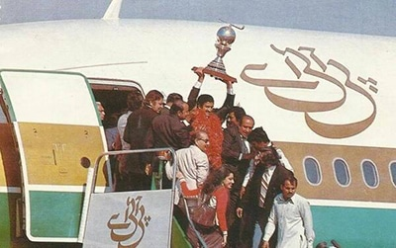
Climax (1960 – 1994)
20 Gold medals
Olympics1960, 1968 and 1984 (3).
World Cup 1971, 1978, 1982 and 1994 (4).
Champions Trophy 1978, 1980 and 1994 (3).
Asian Games 1958, 1962, 1970, 1974, 1978, 1982 and 1990 (7).
Asia Cup 1982, 1985 and 1989 (3).
9 Silver Medals
Olympics1956, 1964 and 1972 (3).
World Cup 1975 and 1990 (2).
Champions Trophy 1983, 1984,1988 and 1991 (4).
https://pakhockey.org/honors-and-recognition-since-1948/

Slide 10
Did not qualify for 2016 and 2020
Did not participate in 1980 (Moscow)
https://en.wikipedia.org/wiki/Field_hockey_at_the_Summer_Olympics

Slide 11
Year Wise Position of National Hokey Team in World Cup
Did not qualify for 2014 and 2023
https://en.wikipedia.org/wiki/Men%27s_FIH_Hockey_World_Cup

Slide 12
Year Wise Position of National Hokey Team in Champions Trophy
Did not participate in 2000, 2008, 2009 and 2016
https://en.wikipedia.org/wiki/Hockey_Champions_Trophy

Slide 13
International Ranking
https://en.wikipedia.org

Slide 14
National indifference towards Hockey
Lack of government patronage and too much popularity and glamour of cricket have contributed to the gradual decline of field hockey.
Hockey is no longer a game of choice for youth. School and college level hockey has diminished from the country. Players are prioritizing global hockey league rather playing for the national team.
A policy analysis by LUMS in 2018 identified allocation of most of the sports budget to cricket as one of the major causes for decline of Pakistan hockey.
https://cbs.lums.edu.pk/student-research-series/decline-hockey-pakistan-policy-analysis

Slide 15
Lack of playing grounds and Astro turf fields
We do not have even simple grounds to play hockey. The big cities in Pakistan do not have space for grounds to play hockey.
Since change of game to Astro Turf, our players could not train or equip themselves for competing against countries that had largely better facilities. As of now, we have only 52 Astro turf grounds for our population of 230 million out of which 20 are unplayable, compared to over 600 grounds in Netherland for 17 million people.

Slide 16
Expensive sport with a lack of funds
Hockey is not a cheap sport. Hockey stick costs around 30 thousand rupees, shoes cost around 20 thousand, and a simple goal keeper kit costs around 3-4 lakh. Players can not afford expensive kits required for practice. The most important thing, Astro turf, would cost 120-150 millions for one field.
For long periods, PHF could not hire any foreign coach or physical trainers and we could not send our team to international events due to lack of funds.

Slide 17
Pakistan Hockey lacks in skills and competitiveness
Pakistan did not have the qualified batch of Managers, Coaches, Physiotherapists and Physical Trainers. Most of the present stuff is not fully conversant with ever changing Rules of the game.
In a study conducted by Sultan Idris Education University, Malaysia, players belonging to 14 national field hockey departments of Pakistan it was found that the coaches are putting less consideration on tactical skills during the training sessions of players.
The result of field performance of players measured by field hockey experts (former Olympians) exposed their weaker fitness capabilities.
https://eujournal.org/index.php/esj/article/view/7450/7175

Slide 18
School and college level hockey has diminished
Out of 32000 Secondary Schools, 6100 Higher Secondary Schools / Inter Colleges, 1600 Degree Colleges, 125 public and private universities, very few are providing opportunities and facilities to play hockey and this game has almost diminished from educational institutions.
Similarly 32 Education Boards in Pakistan are also not giving importance to this game in inter and intra board sports competitions as every school and college wants students to play cricket, football and basketball.
Pakistan – Country Commercial Guide

Slide 19
Demise of hockey clubs
‘Club Hockey’ - which once enjoyed the position of respect and fame for its performance has become extinct. There are a very few clubs who are genuine but do not have any proper ground or a viable system to attract and groom players.

Slide 20
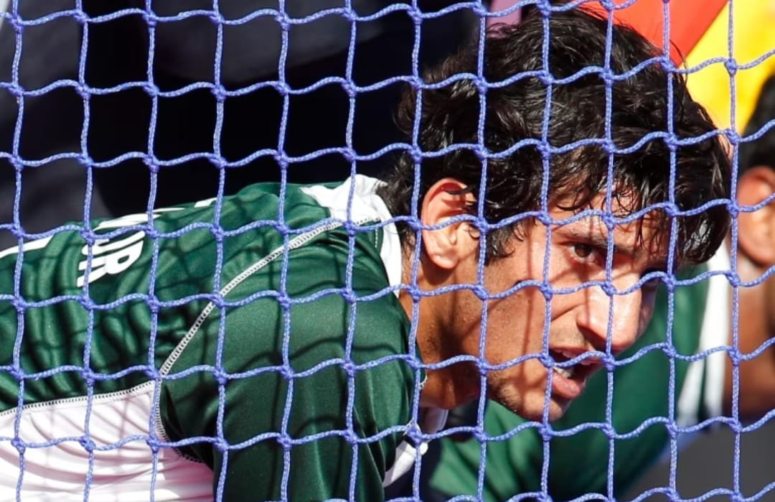
Insecure status of Hockey Players
Hockey players feel that Pakistan hockey is an insecure career. They seek out work in other leagues. 9 senior players opted out of Pakistan’s hockey camp ahead of this years Sultan Azlan Shah Cup. The players have not yet received their dues for Europe Tour in the Asia Cup.
In September 2022 our two national hockey players Ammad Shakeel Butt and Mubashar Ali have resigned from national duty citing financial difficulties.
Hockey players are not accommodated for jobs in Government Departments due to which they feel their status to be insecure.
https://www.dawn.com/news/1712132/nine-senior-players-opt-out-of-pakistan-camp-ahead-of-sultan-azlan-shah-cup

Slide 21
Lack of media attention
Hardly any channel in Pakistan discusses the issues related to hockey due to domination of cricket and football viewership in the country. The lack of media attention towards the national game has resulted in the new generation not being fond of the game.

Slide 22
PHF’s plan to revive Hockey
The PHF’s plan to establish schools of excellence at federal and provincial level could not be materialized.
As per plan, 13 to 21 years old boys were to be trained to participate at international level.

Slide 23
Conclusion
Our national sport hockey is nowhere close to its former glory. This issue has been knocking on the door of attention for more than last two decades and there is still no success towards the improvement of the game.
Amongst many other causes including lack of funding, national indifference towards hockey and diminishing of hockey in educational institutions are the main reasons of downfall of Pakistan’s national sport.

Slide 24
Suggestions / Way forward
Revival of hockey in educational institution:
Education Boards (32 in total) may lay and maintain at least one Astro turf in their areas of jurisdiction on land to be provided by respective provincial governments. These Education Boards may also provide kits to the players.
125 public and private universities to lay and maintain at lease one each Astro turf on the land provided by provincial governments. These universities may also provide kits to the players.
Big systems of private schools e.g. Beaconhouse and LGS may lay and maintain Astroturfs at Provincial Headquarters and big districts.

Slide 25
Suggestions / Way forward
Government to play its role:
Government should financially support PHF and hockey clubs. Hockey teams of departments may be formed and jobs to the players in government departments be provided.
Enhancement of skills of coaches and other managerial staff :
A system has to be evolved wherein we have to train our Coaches, Managers, Physiotherapists, Physical Trainers and Umpires.

Slide 26
References
https://pakhockey.org/
https://www.pakistantoday.com.pk/2021/02/18/the-end-of-an-era-the-fall-of-pakistan-hockey/
https://pakhockey.org/honors-and-recognition-since-1948/
https://en.wikipedia.org/wiki/Field_hockey_at_the_Summer_Olympics
https://en.wikipedia.org/wiki/Men%27s_FIH_Hockey_World_Cup
https://en.wikipedia.org/wiki/Hockey_Champions_Trophy
https://en.wikipedia.org
https://cbs.lums.edu.pk/student-research-series/decline-hockey-pakistan-policy-analysis
J. Hassan, “DECLINE OF HOCKEY IN PAKISTAN: Policy Analysis,” no. 2018, p. 2020, 2018, [Online]. Available: https://cbs.lums.edu.pk/student-research-series/decline-hockey-pakistan-policy-analysis.
https://eujournal.org/index.php/esj/article/view/7450/7175
Pakistan – Country Commercial Guide
https://www.dawn.com/news/1712132/nine-senior-players-opt-out-of-pakistan-camp-ahead-of-sultan-azlan-shah-cup

Slide 27
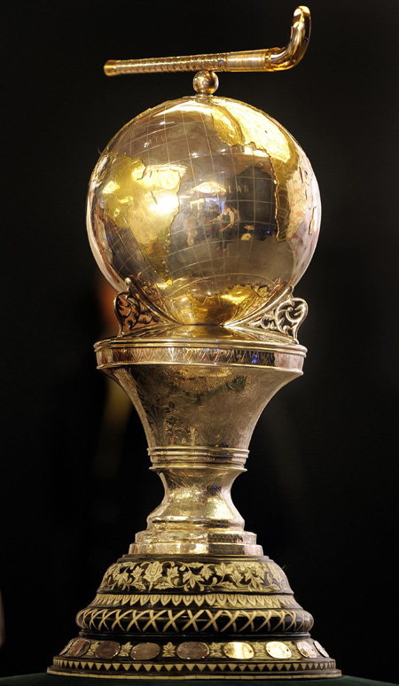
Thank You

Slide 28
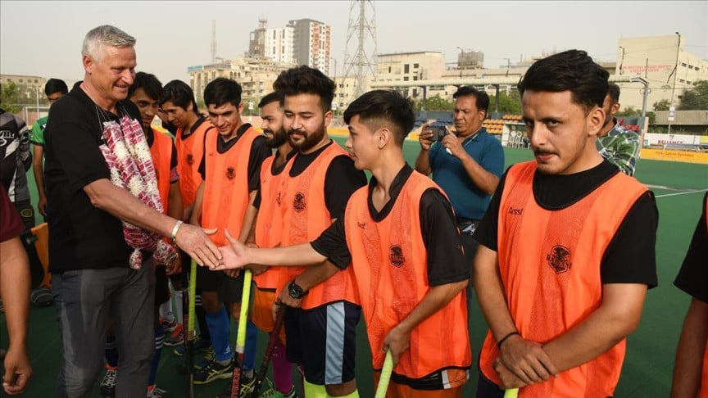
Despite waning popularity, field hockey still has place in Pakistan
German legend Stefan Bloecher
The Express Tribune, 01.04.2022 KARACHI:
Field hockey fans all across the globe still recall Germany's legendary forward Stefan Bloecher, who mesmerized generations with his dribble and feint, moves otherwise considered a forte of Asian players.
Unlike other European players, who relied on long passes, the tall, broad-shouldered Bloecher would pick the ball from the middle of the ground and dribble through the D with ease and perfection, leaving the opposing defence helpless.
Bloecher, who represented the country from 1978 to 1992, first for erstwhile West Germany and then Germany after the fall of the Berlin Wall and reunification of the East in November 1989, spoke exclusively to Anadolu Agency about the factors that contributed to the decline of field hockey in South Asia, particularly in Pakistan.
Field hockey is the national sport of an otherwise cricket-obsessed Pakistan, which has dominated the game for decades, most notably from 1948 to 1994.
Bloecher, who is currently in Pakistan, believes that a lack of government patronage and modern infrastructure, dwindling sponsorships, a decaying domestic structure, and "too much popularity and glamour" of cricket have all contributed to the gradual decline of field hockey in the South Asian country, pushing the former sport giant to 18th place in the world ranking.
Another factor, he added, is Pakistan's "huge size and population," which makes it difficult to find and gather quality hockey players.
"In countries like Germany, (the) Netherlands, or Belgium, which are way smaller (than Pakistan), it's quite easy to gather hundreds of top-class players in one place. But, it's too difficult for Pakistan, which, in addition to its huge size and population, lacks resources and finance," he observed.

Slide 29
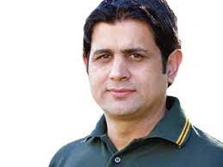
Interview with Olympian Asif Bajwa
Asif Muhammad Bajwa mentioned the main reason of decline of hockey in Pakistan as change of game from natural grass to Astro Turf. He strengthened his view point with the remarks that hockey on Astro turf has different dynamics with respect to both human resources and changes in game. He said that unluckily, Pakistan could not bridge this gap as we have only 40 Astro Turfs out of which 5-6 are functional at the moment.
He also expressed his views that the federation has not financial support and it succeeds to get only 80 to 90 million rupees per Anum, the major portion of which comes from Sindh Government. Mr. Bajwa said that the cricket as a monster in Pakistan has eaten the national game hockey and presently it is being played only in some areas of Pakistan including Gojra, Pir Mehal, Sialkot, Vehari, Sheikhupura and rural areas of Lahore.

Slide 30
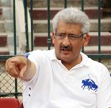
Interview with Olympian Tauqeer Dar
In an interview, the Olympian Tauqeer Dar expressed his views that the hockey is a very expensive sport and unless you are playing hockey on AstroTurf, you are wasting your time. Hockey stick costs around 30 thousand rupees, shoes cost around 20 thousand, and a simple goal keeper kit costs around 3-4 lakh. Players can not afford expensive kits required for practice. The most important thing, one Astro turf costs Rs. 120 to 150 millions. He said that Pakistan has become a one-sport nation, while we are very blessed to have so many talented players and all educational institutions are worried about their academic results and sports are no where in their priorities.
Tauqeer Dar opined that there is a need to lay more Astro Turfs in the country and wished that had the business tycoons sponsored, the present condition of our national game could have not been worst. Mr. Dar suggested that the big chains of private educational institutions like Beaconhouse and LGS may be compelled to play role for improvement of infrastructure of hocky in our country.

